Slide 1
CSE 4905: Introduction to Network Security
Drs. Bing Wang and Ben Fuller
Computer Science & Engineering Department

Slide 2
Course info
Instructors:
Bing Wang
bing@uconn.edu
Office: ITEB 367
Office hours: M Th 11-12pm
Benjamin Fuller
benjamin.fuller@uconn.edu
Office: ITEB 243
Office hours: Tu 11-12pm W 1-2pm

Slide 3
Course goals
Understand concepts and practices of network security
Understand attacks that occur on the internet systems security threats
Learn defensive techniques and how to design good systems
Ethical issues

Slide 4
Textbook
No required or suggested textbook
Ross J. Anderson, Security Engineering. [Covers security in general, with many non-computing examples.]
William Stallings and Lawrie Brown, Computer Security Principles and Practice. [Introduction. not deep]
Bruce Schneier, Applied Cryptography. [Very broad coverage of crypto and its applications. Approachable but not as rigorous as other texts.]
Niels Ferguson and Bruce Schneier, Practical Cryptography. [Focused coverage of applied cryptography, not the most rigorous source.] A more recent version is called Cryptography Engineering
Jonathan Katz and Yehuda Lindell, Introduction to Modern Cryptography [A technical introduction to crypto.]
Douglas R. Stinson, Cryptography Theory and Practice (2nd edition). [Cryptography textbook. Math-intensive.]

Slide 5
Textbook (cont’d)
No required or suggested textbook
Alfred J. Menezes, Paul C. van Oorschot and Scott A. Vanstone, Handbook of Applied Cryptography (Discrete Mathematics and Its Applications). [A good reference book on the details of algorithms, math, and implementation].
Dieter Gollmann, Computer Security. [General security textbook. Good for what it covers, but doesn't cover everything.]
David Kahn, The Codebreakers. [History of cryptography. Not very technical]
Steven Levy, Crypto. [History of cryptography since 1970. Non-technical]
M. Ciampa, Security Awareness: Applying Practical Security in Your World, [Cover background. Useful tips]
John Viega and Gary McGraw, Building Secure Software. [How to write software that has fewer security bugs]
Matt Bishop, Introduction to Computer Security. [Intro level]
Matt Bishop, Computer Security: Art and Science [deeper than the previous one by the same author]

Slide 6
HuskyCT website
All relevant information
Slides
Relevant reading (papers, from the Internet)
Announcement
Written & lab assignments
Exam information
Discussion

Slide 7
Grading
6 projects (70%)
2 written
Basic cryptography with OpenSSL, PKI
DNS and DoS
4 practical
Hacking a web server
Wireless sniffing
Understanding TLS
Intrusion detection systems
You’ll have 2-3 weeks for each project
You have a total of 7 late days for all the projects
Final exam (30%)
Random quizzes (3% extra)

Slide 8
Honor codes
All submitted work should be yours!
NO sharing of project reports
Do not copy answer from Internet
Cite sources properly
Discussion is encouraged!
Be sure of the ethical and legal actions you take, check with instructors if unsure (more later)

Slide 9
Your best strategy
Come to every lecture
Quizzes
Understand more
Class interaction will save your time
Do not wait till last minute to work on projects
Read books/articles related to computer security
Check graded homework and projects
Have fun!

Slide 10
We need help!
Ask questions
Correct us! It’s a large field that moves fast
Make suggestions!
What issues do you want to discuss? Topics from your experience and life are very welcome
Read something interesting and relevant? Post and start a discussion

Slide 11
What is network security?
Every day we interact with many devices that communicate with one another, usually over Internet
There are many malicious actors on the Internet that want to steal, subvert, harm, cheat, and expose (who? why?)
Network security is the interplay between malicious actors and defenders who are trying to safeguard the network
Internet was not built with security in mind, making many defenses ad-hoc and incomplete

Slide 12
Café Sniffing
It is possible to learn what other individuals are sending over the same wireless network
This is also legal (depending on many factors)
Common practice at cafes and hotel hotspots

Slide 13
DNS Poisoning
It is possible to convince others that you own important addresses such as google.com
One behavior of the “Great Firewall of China”

Slide 14
Denial of Service
Possible to Overwhelm Online Services, making them unavailable, costing owners revenue

Slide 15
Network Worms
Possible to spread malicious software through the Internet

Slide 16
Other network security examples?
Stuxnet, Flame, Duqu, Social Engineering, Beast,…

Slide 17
Security
Assets
File, directory, data, service, system capability, system component (hardware, firmware, software)…
Users
Human, systems, …
Adversary
with specific capabilities
No system is absolutely secure

Slide 18
How to achieve security goals?
Understand the adversary.
what are the resources available?
what is the goal of the attack?
Understand the modes of attack.
in what ways can the attack be launched?
what are the vulnerabilities?
Understand the security/usability tradeoff.

Slide 19
Security goals
NIST Computer Security Handbook (1995)
Confidentiality: Access of assets (viewing/printing/copying/listing) is restricted to entities that are authorized to do so.
Integrity: Assets are processed (modified/altered/created/deleted etc.) only in authorized ways by authorized parties.
Availability: Assets are accessible to authorized parties at the appropriate times.

Slide 20
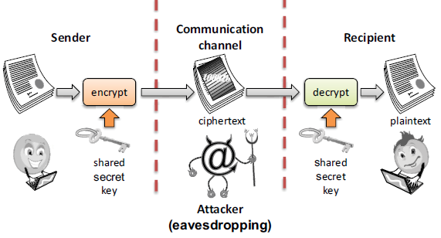
Tools for confidentiality (1/3)
Encryption: encrypt data using an encryption key
Notes:
The key may, in some cases, be the same as the encryption key.

Slide 21
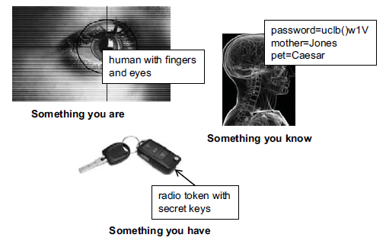
Tools for confidentiality (2/3)
Authentication: determination of the identity or role that someone has.
Fingerprint, password, smart card / radio key,

Slide 22
Tools for confidentiality (3/3)
Access Control: rules and policies that limit access to confidential information to those with a permission or certain level of eligibility.
Authorization: determination if a person or a system is allowed access to resources, based on an access control policy.
Notes:
Physical barriers : secure building
The construction of building incorporating copper mesh (called Faraday cages) so that electromagnetic cannot enter or exit the enclosure.

Slide 23
Tools for integrity
Prevention Mechanisms
Access controls
Authentication
Detection Mechanisms
Message authentication code: cryptographic technique to detect whether bits have been modified
Data correcting codes: the ability to restore the original data if a transient error took place.
Intrusion detection and prevention: try and understand normal behavior and detect anomalous
Notes:
Physical barriers : secure building
The construction of building incorporating copper mesh (called Faraday cages) so that electromagnetic cannot enter or exit the enclosure.

Slide 24
Tools for availability
Redundancies
e.g., backup generators, multiple mail/DNS/DHCP servers, multiple network paths to ISP
Was a major goal of Internet design (to be nuclear blast proof)
Intrusion prevention/firewalls
Notes:
Physical barriers : secure building
The construction of building incorporating copper mesh (called Faraday cages) so that electromagnetic cannot enter or exit the enclosure.

Slide 25
Exercises
Classify each of the following as a violation of confidentiality, of integrity, of availability, or of some combination
Paul logs into John’s Facebook, posts a photo
Steve sees network traffic of Apple’s earning projections and sells Apple stock
Jenny forges an email from Ben and changes her Network Security Grade
Allie causes the power system to fail, taking the submission server offline

Slide 26
Other security goals
Authenticity
Proof of originality (e.g., watermark)
Anonymity
Certain records or transaction not to be attributable to any individual
Accountability
Having a way to hold someone accountable
Assurance
Can you trust this software/system/application?
Notes:
Physical barriers : secure building
The construction of building incorporating copper mesh (called Faraday cages) so that electromagnetic cannot enter or exit the enclosure.

Slide 27
Points to keep in mind - I
Security is not an “add-on” feature
Security is a property of a system not a feature. Similar to usability, reliability
Lessons from Internet design
Many patches to make things work; no systematic solution
New clean-slate design; how to deploy?

Slide 28
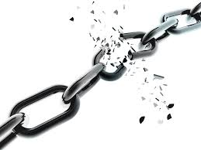
Points to keep in mind - II
A system is as secure as its weakest component
There is nothing that you can add to your system to “secure it”
Partly why security so hard: attacker just needs to find the weakest link

Slide 29
Points to keep in mind - III
Professional paranoia/security mindset: Thinking like an adversary is essential for building secure systems
in fact you have to think like any possible adversary!
Always ask yourself
Who is the adversary?
What are the attack possibilities?
What is at stake?
Separate your professional life from personal life ☺

Slide 30
Threat models
We’ll spend time trying to understand what an attacker can and cannot do, their goals, capabilities, etc.
This will help focus our attention to defending the system
Also provides a target for compromise, attacker does not need to obey the model

Slide 31
Understanding how to defend
Policy
Incentives
Mechanism
Assurance

Slide 32
Points to keep in mind - IV
Be wary of snake-oil security products
“Unbreakable ciphers”
“No key cryptosystems”
“Secret cipher”
“1-million bit length”
“Information-theoretic security”
…

Slide 33
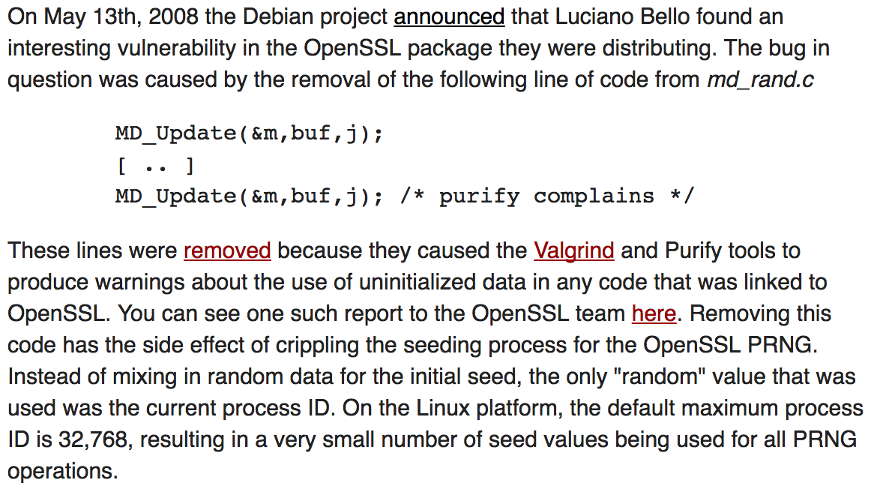
Points to keep in mind - V
Do not implement cryptographic algorithms yourself for serious purposes
Use cryptographic libraries
Consulting seasoned experts pays off

Slide 34
Points to keep in mind - VI
Security holes and vulnerabilities are
discovered constantly
The absolute transparency principle:
publicize all attacks and reveal all details of security components.
A discovered attack that is publicized forces positive changes (patching, upgrading, reevaluations of assets).
A discovered attack that is kept muffled is a time-bomb.
Responsible vs. full disclosure, bug bounties
History littered with breaks of secret designs

Slide 35
Topics to be covered
Intro to practical crypto (used for many defenses)
Authentication, Public Key Infrastructure (PKI )
Wireless network security
IPSec
Border Gateway Protocol (BGP)
Transmission Control Protocol (TCP) and Transport Layer Security (TLS)
Domain Name System
Denial of Service
Network defenses
Blockchains

Slide 36
Student conduct
The class will touch on sensitive issues (including attacks, vulnerabilities, …)
If a student is found to employ acquired knowledge with the purpose of launching an attack (beyond the ones that will be asked as a homework :-) he/she will be immediately given an ‘F’ with possible disciplinary action
Furthermore, legal action may be pursued, be very careful

Slide 37
Exercise: Grade Change
You’ve reached the end of the class and don’t think you’re going to like your grade
Brainstorm what actions you could take to override your grade, these actions can be over the network, in person, anything
Spend ten minutes discussing a plan
Be explicit about:
What are you assuming you can do?
What is the risk of your actions?
What are you assuming about the grade submission process?

Slide 38
Kerckhoff’s Principle
One should assume the only unknown thing about system design is the cryptographic key
“One ought to design systems under the assumption that the enemy will immediately gain full familiarity with them” – Claude Shannon
Put differently, the system designer should know what needs to be private for their system to be “secure”

Slide 39
Exercise: Kerckhoff’s principle
What is gmail counting on being private to verify your identity?
What am I assuming is private to prevent exam cheating?
Prevent bad people from entering your dorm? Your apartment?
An employer when requesting a transcript from UConn

