Slide 1
Border Gateway Protocol Security CSE 4905
Slides heavily adapted from Sharon Goldberg, Boston University

Slide 2
Last Class
Covered the basics of BGP, economic incentives, how IP addresses are allocated on the Internet
Showed that RPKI can prevent direct hijacking of IP prefixes
Cannot prevent an AS announcing they have a path that doesn’t exist

Slide 3
Prevented Attack
INTERNET2-TRANSITRAIL-CPS 11164
Evil AS!!
66666
LEVEL 3
3356
66666, 1, 151.101.193.0/24
…
CT Ed Net 22742
Fastly
54113
Uconn 13796

Slide 4
Feasible Attack
INTERNET2-TRANSITRAIL-CPS 11164
Evil AS!!
66666
LEVEL 3
3356
66666, 54113, 2 151.101.193/24
…
CT Ed Net 22742
Fastly
54113
Uconn 13796

Slide 5
Prefix Filtering
Many ASes are called “stubs” they have no customers
Prefix Filtering: only ROAs should be accepted from stubs, means only non stubs can execute this attack
INTERNET2-TRANSITRAIL-CPS 11164
Evil AS!!
66666
LEVEL 3
3356
66666, 54113, 2 151.101.193/24
…
CT Ed Net 22742
Fastly
54113
Uconn 13796

Slide 6
Feasible Attack
RPKI and ROAs do little to stop an AS from announcing it can:
Route to a location it has no path to
Lying about the quality of its path to attract traffic
The issue is that we created a mechanism to establish IP ownership not path validity
Need a mechanism to validate a path
Lets take a first attempt
Exercise: What should we do?

Slide 7
Potential Defense
Route announcements have grown from linear to quadratic in size
Have multiple cryptographic signatures to send and verify
Sign₃₃₅₆(3356, 54113, 151.101.193/24) Sign₅₄₁₁₃(54113, 151.101.193/24)
INTERNET2-TRANSITRAIL-CPS 11164
Evil AS!!
66666
LEVEL 3
3356
66666, 54113, 2 151.101.193/24
…
CT Ed Net 22742
Sign₅₄₁₁₃(54113, 151.101.193/24)
Fastly
54113
Sign₂₂₇₄₂(22742, 11164, 33356, 54113,…)
Sign₁₁₁₆₄(11164, 3356,54113,…)
Sign₃₃₅₆(3356, 54113, 151.101.193/24) Sign₅₄₁₁₃(54113, 151.101.193/24)
Uconn 13796

Slide 8
What did we accomplish?

Slide 9
Potential Defense
Sign₃₃₅₆(3356, 54113, 151.101.193/24) Sign₅₄₁₁₃(54113, 151.101.193/24)
INTERNET2-TRANSITRAIL-CPS 11164
Evil AS!!
66666
LEVEL 3
3356
66666, 54113, 2 151.101.193/24
Sign₆₆₆₆₆(66666, 54113, 151.101.193/24) Sign₅₄₁₁₃(54113, 151.101.193/24)
…
CT Ed Net 22742
Sign₅₄₁₁₃(54113, 151.101.193/24)
Fastly
54113
Haven’t actually accomplished anything!!!
Uconn 13796

Slide 10
Exercise
We are signing the entire path
Didn’t prevent the attack we cared about
What should we do?

Slide 11
BGPSec
Sign₃₃₅₆(3356->11164, 54113, 151.101.193/24) Sign₅₄₁₁₃(54113->3356, 151.101.193/24)
INTERNET2-TRANSITRAIL-CPS 11164
Evil AS!!
66666
LEVEL 3
3356
66666, 54113, 2 151.101.193/24
…
CT Ed Net 22742
Sign₅₄₁₁₃(54113->3356, 151.101.193/24)
Fastly
54113
ASes no longer announce a route, they specialize to each neighbor, sign a message saying they are connected
Uconn 13796

Slide 12
Cost of BGPSec
Have to implement RPKI and ROAs
Additionally route announcements become quadratic size
AS can no longer send messages arbitrarily to neighbors, specialize for each neighbor
Verifying a route requires verifying each individual signature and that the content is valid
All of this means that BGPSec is more costly to run and will probably be run less frequently

Slide 13
Partial Deployment
Unlike other systems we’ve talked about BGPSec has not been completely deployed
Most systems are first implementing RPKI and then BGPSec
Additionally researching “aggregate signatures” which allow compression of the signing operating to a single RSA signatures

Slide 14
Expected timeline
Sign₃₃₅₆(3356->11164, 54113, 151.101.193/24) Sign₅₄₁₁₃(54113->3356, 151.101.193/24)
54113, 151.101.193/24
Sign₅₄₁₁₃(54113, 151.101.193/24)
BGP
RPKI
BGPSec
RPKI on its own is relatively easy to deploy, more and more sites can have RPKI certs and corresponding ROAs
ROAs can be stored in a centralized database
Routers can decide to check them or not
No real network component to the revised protocol
Consider partial deployment of BGPSec
Many routers won’t have BGPSec, so routes won’t be signed

Slide 15
BGPSec
New attack: announced unsigned route because I haven’t upgraded to BGPSec
INTERNET2-TRANSITRAIL-CPS 11164
Evil AS!!
66666
LEVEL 3
3356
66666, 54113, 2 151.101.193/24
…
CT Ed Net 22742
Sign₅₄₁₁₃(54113->3356, 151.101.193/24)
Fastly
54113
What should CT Ed do?
Follow a short but unsigned route or follow a long but signed route
Uconn 13796

Slide 16
Recall BGP Rules
Prefer Customer paths over peer paths over provider paths
Prefer short routes
Tiebreak based on specificity
Survey of 100 network operators:
10% said its first
20% said second
41% said third
29% said fourth
Where should security go?

Slide 17
Recall BGP Rules
Secure Route over Insecure
Prefer Customer paths over peer paths over provider paths
Prefer short routes
Tiebreak based on specificity
As long as announcements are not being dropped this prevents if there is a secure route to the destination

Slide 18
Recall BGP Rules
Prefer Customer paths over peer paths over provider paths
Secure Route over Insecure
Prefer short routes
Tiebreak based on specificity
A customer can announce a prefix route now and still perform an attack

Slide 19
BGPSec
Attack is valid if security is 2nd or less
New attack: announced unsigned route because I haven’t upgraded to BGPSec
INTERNET2-TRANSITRAIL-CPS 11164
Evil AS!!
66666
LEVEL 3
3356
66666, 54113, 2 151.101.193/24
…
CT Ed Net 22742
Sign₅₄₁₁₃(54113->3356, 151.101.193/24)
Fastly
54113
Uconn 13796

Slide 20
Attacks when security is not first
Some ASes are vulnerable to attack
Vulnerability now depends entirely on network map
Providers can stop many attacks by knowing what IPPrefixes their customers have
However, if security is third, peers can still steal traffic

Slide 21
Who is vulnerable?
Consider an attacker that has at least two connections (harder for a provider to filter)
Consider average AS that is being attacked
 | Complete BGPSec deployment |  | 113 high degree ASes secure (50% of graph)
 | RPKI | BGPSec | RPKI | BGPSec
Security 1st | 53% | 100% | 53% | 77%
2nd | 53% | 89% | 53% | 61%
3rd | 53% | 70% | 53% | 57%
Unless security is first, BGPSec does not provide much of an advantage over RPKI until full deployment
Results from “Is the Juice Worth the Squeeze BGPSec in Partial Deployment” https://arxiv.org/abs/1307.2690

Slide 22
Deployment Incentives
Have “First Mover Disadvantage,” first ASes to deploy BGPSec will incur significant cost without any real benefit to security
Even if influential ASes adopt protocol incentive does not become strong until unsigned routes are not accepted
This won’t happen until the majority of the graph can sign
Additionally, the cryptographic and size overhead of BGP is a significant obstacle

Slide 23
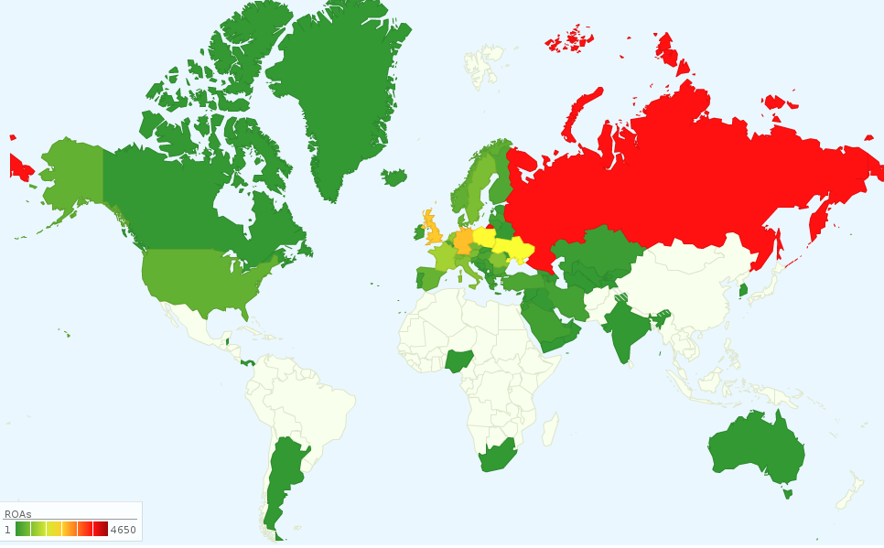
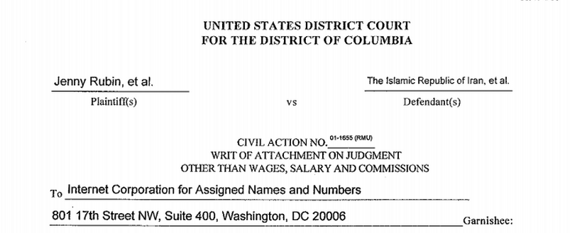
How RPKI changes the landscape
RIRs (and their subdelegates) can stop traffic by revoking ROAs and RPKI certificates
This was not possible before, IP allocations were one time
States seem to want the ability to takedown IP prefixes…
Dutch court ordered RIPE to lockdown prefixes registration (Nov’11)
US court issued a writ of attachment on Iran’s IP prefixes (June’14)
IP allocation does not reflect jurisdiction.
# of RIPE ROAs by country (from our model RPKI)

Slide 24
Dealing with this new power
Proposals to require consent of effected parties before a certificate can be revoked
Inherent tradeoff between ability to revoke misbehaving AS and possibility of RPKI abuse

Slide 25
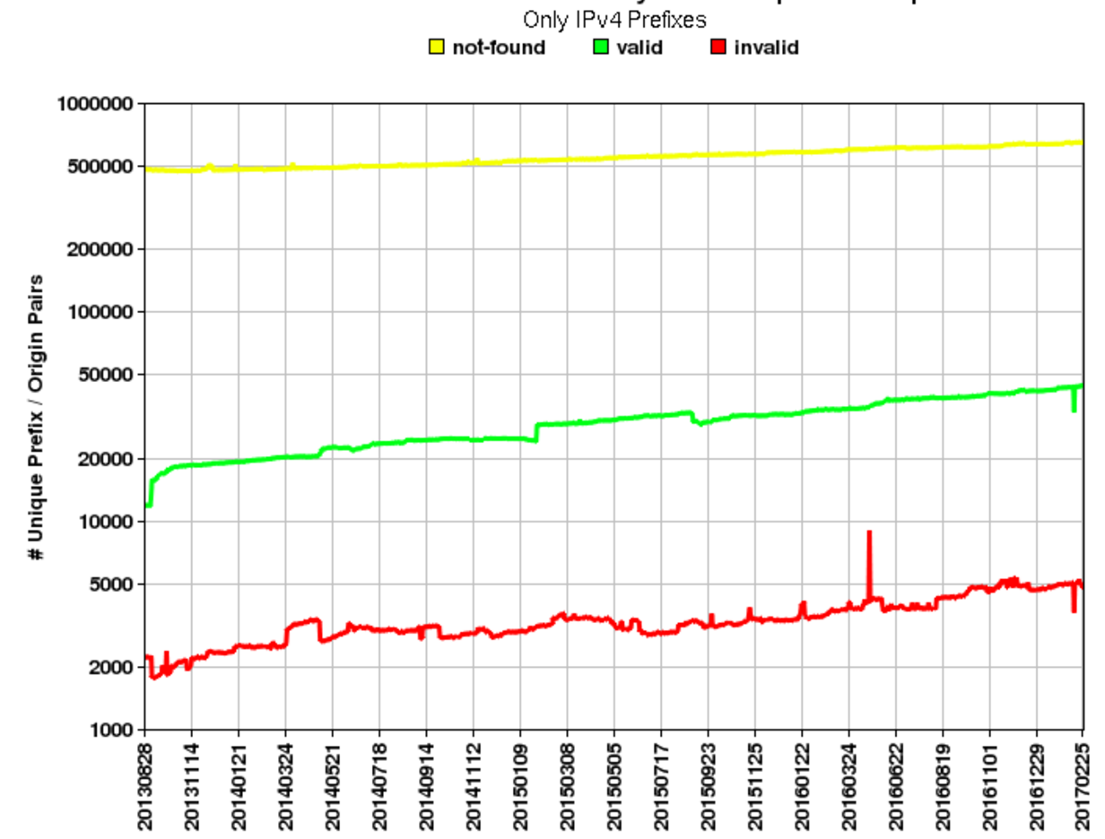
RPKI Deployment

Slide 26
RPKI Deployment

