Slide 1
CSE 4095 Transport Layer Security TLS

Slide 2
So far…
Link layer security
In particular, security for WiFi network
IP (network) layer security
IPSec and its usage for VPNs
BGP security
We have already seen (flavors of) TLS
WiFi security: EAP-TLS, EAP-TTLS
TLS used in VPNs
TLS
Most important security protocol for the Internet!

Slide 3
SSL/TLS
SSL (Secure Sockets Layer), predecessor of TLS
mechanisms: [Woo 1994], implementation: Netscape
SSL V1 never published (many flaws)
SSL V2 1995, deprecated in 2011
SSL V3 1996, deprecated in 2015
TLS (Transport Layer Security)
Substitute SSL in 1999; standardized by IETF
TLS 1.0, RFC 2246, 1999
TLS 1.1, RFC 4346, 2006
TLS 1.2, RFC 5246, 2008
TLS 1.3, working draft as of now

Slide 4
Goals of SSL/TLS
Between two end hosts
Allows client and server to communicate while preventing eavesdropping and tampering
Provide
Confidentiality (symmetric key encryption)
Message integrity check (through MAC)
Authentication (public key crypto)

Slide 5
Usage of SSL/TLS
Implemented in all (major) web browsers
Widely used in web browsing (HTTPS), email, instant messaging, voice-over-IP (VoIP), …
Major websites (including Google, YouTube, Facebook) use TLS
…

Slide 6
Think about Google or YouTube
Desired properties
Indeed the other side is Google or YouTube server
Confidentiality: your query, the video you choose
Content from Google or YouTube has not been modified
Does TLS give you all the desired properties?

Slide 7
SSL/TLS and TCP/IP
Application
Application
SSL/TLS
TCP
TCP
IP
IP
normal application
application with SSL/TLS
SSL/TLS: user-level process
SSL/TLS provides API to any application that uses TCP
SSL libraries/classes readily available for programming languages (C, Java, python…)

Slide 8
TLS for UDP?
Datagram Transport Layer Security (DTLS)
First proposed in NDSS, 2004
RFC 4347, 2006
Applications
in VPN
some web browsers for real-time communication
…

Slide 9
TLS
Handshaking protocol
enable authentication and session key establishment
peers agree upon security parameters for the record layer
report error conditions
Record protocol
Lower layer protocol to support handshaking protocol and application data protocol

Slide 10
Handshaking protocol
Three sub-protocols
Handshake Protocol
Change Cipher Spec Protocol
Alert Protocol

Slide 11
Handshake Protocol Overview
Runs between a client and a server
e.g., client: web browser, server: website
Negotiate version of the protocol and the set of cryptographic algorithms to be used
Interoperability between different implementations
Authenticate server and client (optional)
Use digital certificates to learn each other’s public keys and verify each other’s identity
Often only the server is authenticated
Use public keys to establish a shared secret

Slide 12
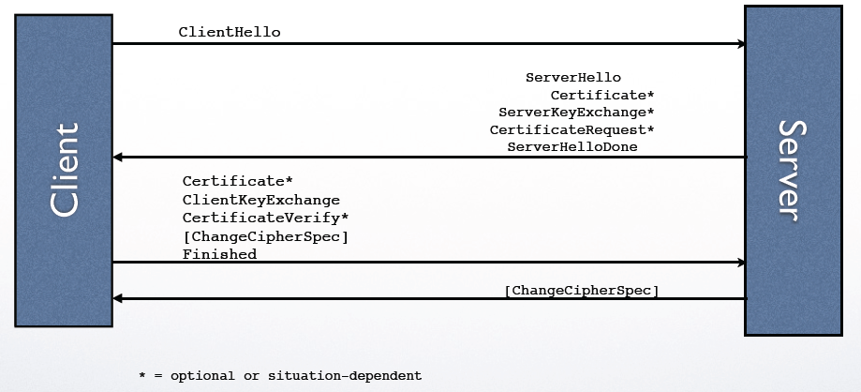
Handshake Protocol Diagram

Slide 13
TLS connection parameters
Two connection ends (client, server)
Bulk encryption algorithm
MAC algorithm
Compression algorithm
Master secret (48 bytes)
Client random (32 byte)
Server random (32 byte)

Slide 14
ClientHello
ClientRandom structure (32 bytes)
Client Timestamp
Random 28 byte string
SessionID
can be empty / it is used for resuming a previous session
Ciphersuite list
List of cryptographic algorithms supported by the client
Key exchange algorithm, bulk encryption algorithm, MAC algorithm, and PRF
Compression list
List of compression algorithms

Slide 15
ClientHello Example
TLS 1.0

Slide 16
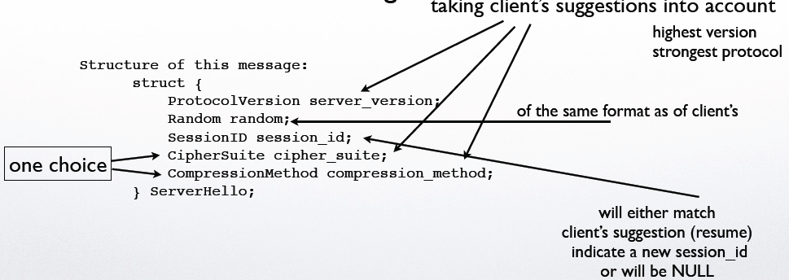
ServerHello

Slide 17
ServerHello Example

Slide 18
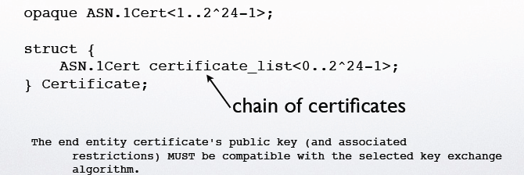
Server Certificate
server provides its certificate to authenticate its name on the public-key it provides to the client
Certificate type MUST be X.509v3, unless explicitly negotiated otherwise

Slide 19
Other messages from server
Certificate: server provides its certificate to authenticate its name on the public-key it provides to the client
Certificate type MUST be X.509v3, unless explicitly negotiated otherwise
ServerKeyExchange: will contain public key info in case the info in the Certificate message is not sufficient (or this message has not been provided at all)
CertificateRequest : will prompt the client to send a certificate to authenticate itself (typically not used)
Notes:
Serverkeyexchange: conveys cryptographic information to allow the client to communicate the premaster secret: a Diffie-Hellman public key with which the client can complete a key exchange (with the result being the premaster secret) or a public key for some other algorithm.

Slide 20
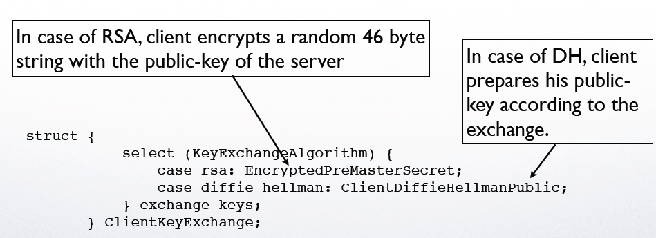
ClientKeyExchange message
Used to set the premaster secret that will allow each side to agree upon the same pre-master secret.
By transmitting the RSA-encrypted secret or Diffie-Hellman parameters

Slide 21
Client Authentication
CertificateRequest : server will use this message to request a certificate-based authentication from the client.
Certificate : response to a CertificateRequest message. This will be sent before ClientKeyExchange

Slide 22
Client Authentication
CertificateRequest : server will use this message to
request a certificate-based authentication from the client.
Certificate : response to a CertificateRequest message. This will be sent before ClientKeyExchange
CertificateVerify : if client’s certificate has signing capability, this message will be a digital signature of all handshake messages so far. This will be sent after ClientKeyExchange

Slide 23
Computing master secret
convert the pre_master_secret into the master_secret
Master secret 48 bytes
master_secret = PRF(pre_master_secret, "master secret", ClientHello.random + ServerHello.random) [0..47];

Slide 24
Key generation
master secret is expanded into a sequence of secure bytes
split into
client MAC key
server MAC key
client encryption key
server encryption key
client initialization vector (IV)
server initialization vector (IV)

Slide 25
Finished message
To verify key exchange and authentication processes were successful
It is the first message protected with the just negotiated algorithms, keys, and secrets
Recipients of Finished messages MUST verify that the contents are correct
By sending verify_data
PRF(master_secret, finished_label, Hash(handshake_messages))
use all handshake msgs up to, but not including this msg

Slide 26
TLS Example

Slide 27
Why need two random nonces?
Two random nonces
client.random in ClientHello
server.random in ServerHello
Deal with playback attacks
They are used to calculate master secret key
Different nonces lead to different master secret key, and hence different sub-keys

Slide 28
If no random nonces is being used
Suppose that an attack records all messages between client (Alice) and server (Bob)
Initial messages are not encrypted
Later messages are encrypted
e.g., This is a transaction that Alice orders a laptop from Bob (Amazon.com)
Attacker replays all messages at a later time
Same master key will be established between attacker and server (Amazon.com)
No client authentication
Alice will be charged to get another laptop!
Attacker can launch the attack although he does not understand every message

Slide 29
Why need Finished message?
protect handshake from tampering (Finished messages are encrypted)
client typically offers range of algorithms, some strong, some weak
man-in-the middle could delete stronger algorithms from list
Server is forced to choose a weak algorithm
Verify server and client have the same master key

