Slide 1
CSE 4095 Transport Layer Security TLS, Part II

Slide 2
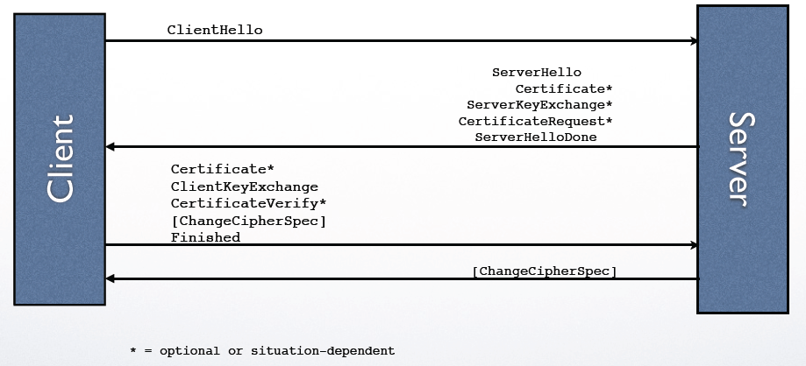
Handshake Protocol Diagram

Slide 3
Recall handshake protocol
ClientHello
ServerHello, Certificate*, ServerHelloDone
ClientKeyExchange, Finished
Finished from server side

Slide 4
TLS: sharing session keys
Session key: used only for a session and then discarded
Use asymmetric ciphers to exchange or generate keying materials to derive session keys
Key exchange
Client uses asymmetric encryption to send a pre-master secret securely to the server
Key generation
Two sides exchange unencrypted components; both then derive symmetric session

Slide 5
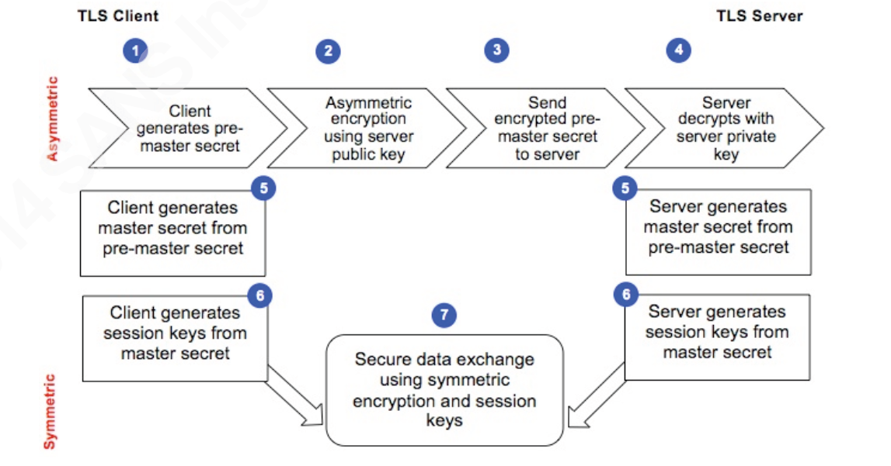
Key exchange

Slide 6
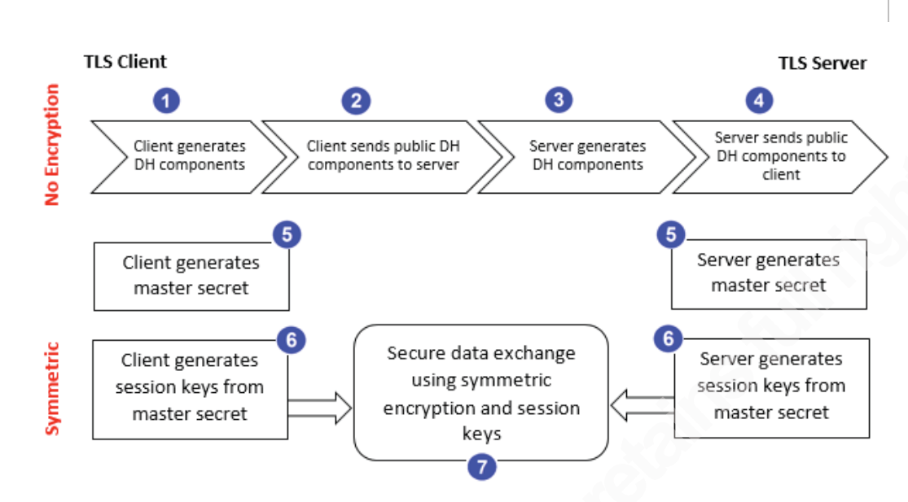
Key generation

Slide 7
One-time session key
Used with Deffie-Hellman
Generate ephemeral DH key, used to derive session key
Provide perfect forward secrecy
compromise of a server’s private key would not compromise past sessions
session keys for those past sessions are the only keys that will decrypt the session’s data

Slide 8
Perfect forward secrecy
compromising server’s private key would not compromise past sessions
Difficult to achieve for RSA
Pre-master key encrypted by server’s private key, and is sent over network
DH with ephemeral key
session keys for past sessions are the only keys that will decrypt the session’s data
Keys not transmitted over network

Slide 9
Summary of key exchange/generation
Three ways:
RSA
DH long-term keys
DH ephemeral keys: provides perfect forward secrecy

Slide 10
SeverKeyExchange
sent by the server only when the server Certificate message (if sent) does not contain enough data to allow the client to exchange a premaster secret
will be sent immediately after the server Certificate message (or the ServerHello message, if this is an anonymous negotiation (not recommended in practice))

Slide 11
SeverKeyExchange (cont’d)
Signature is used to verify identity of server

Slide 12
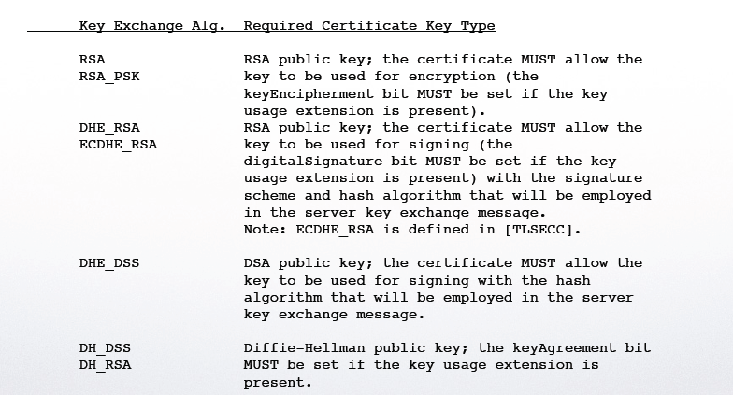
Sever key exchange alg. & certificate key type

Slide 13
Client certificate
Only sent if the server requests a certificate
Send client certificate chain to server
If no suitable certificate, must send certificate message of length zero; server decides to proceed or fail
Server uses certificate to
verifying the CertificateVerify message (when the client authentication is based on signing) or calculating the premaster secret (for non-ephemeral Diffie-Hellman)

Slide 14
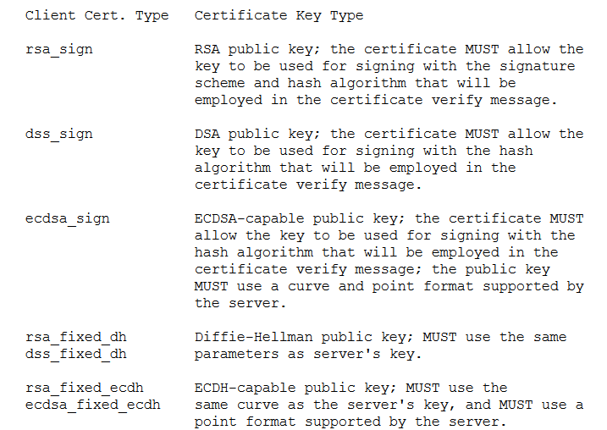
Client certificate alg. & key type

Slide 15
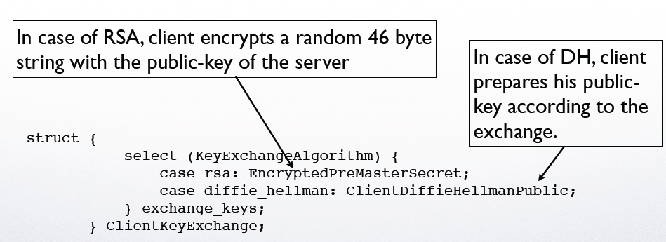
ClientKeyExchange message
Used to set the premaster secret that will allow each side to agree upon the same pre-master secret.
RSA: send RSA-encrypted secret
DH fixed, DH-ephemeral: send DH parameters
If client has sent certificate containing a static DH exponent, then this message must be empty

Slide 16
Client CertificateVerify
This message is only sent following a client certificate that has signing capability (i.e., all certificates except those containing fixed Diffie-Hellman parameters).
Basically contain a signature of all the handshake messages, but not including this one
This message is used to provide explicit verification of a client certificate.

Slide 17
Alert protocol (RFC 2246)
When things go wrong an alert is generated
session ends or the recipient is given the opportunity to continue
What can go wrong
bad_certificate
unsupported_certificate
certificate_expired
handshake_failure
unknown_ca
…

Slide 18
ChangeCipherSpec
Sent by both the client and the server to notify the receiving party that subsequent records will be protected under the newly negotiated CipherSpec and keys
is sent during the handshake after the security parameters have been agreed upon, but before the verifying Finished message is sent
Short message
only contain record header and value of 1
Mandatory, not encrypted, indicating all later messages will be encrypted

Slide 19
SSL/TLS connection
handshake: ClientHello
handshake: ServerHello
handshake: Certificate
handshake: ServerHelloDone
handshake: ClientKeyExchange
ChangeCipherSpec
everything
henceforth
is encrypted
handshake: Finished
ChangeCipherSpec
handshake: Finished
application_data
application_data
Alert: warning, close_notify
TCP FIN follows

Slide 20
Why need close_notify in TLS?
TCP FIN marks the end of a TCP connection
Is close_notify needed?
TCP FIN indicated by a bit in TCP header, not encrypted
close_notify is a message in Alert protocol, which is encrypted
attacker can send a TCP FIN before the end of the session,
which cannot be detected if there is no close_notify message

Slide 21
Certificate verification flaws (due to bad implementation)
Check validity of certificate but don’t check common name.
Check common name but fail to verify the whole chain of certificates.
Check everything but allow non-CA signing certificates to be used for issuing certificates.

Slide 22
TLS protocols
Handshaking protocol
Handshake Protocol
Change Cipher Spec Protocol
Alert Protocol
Record protocol
Lower layer protocol to support handshaking protocol and application data protocol

Slide 23
Record protocol
4 types of records
Handshake records
ChangeCipherSpec records
Alert records
application data records

Slide 24
Record Protocol
data
data
fragment
MAC
data
fragment
MAC
record
header
encrypted
data and MAC
record
header
encrypted
data and MAC
Divide data into fragments
Each fragment up to 2¹⁴ bytes (~16 Kbytes)
Data and MAC encrypted using symmetric key
Record header: content type; version; length

Slide 25
SSL/TLS record format
1 byte
2 bytes
3 bytes
content
type
length
SSL version
data
MAC
data and MAC encrypted (symmetric algorithm)

Slide 26
MAC in record
keyed MAC (e.g., HMAC) to protect message integrity
Generated as
MAC(MAC_write_key, seq_num + TLSCompressed.type + TLSCompressed.version + TLSCompressed.length + TLSCompressed.fragment); where "+" denotes concatenation, MAC(): MAC algorithm agreed upon earlier, seq_num: sequence number of the record

Slide 27
Questions on MAC
Why include both header and content?
Why need to include sequence number?
Why no need to include record sequence number explicitly in record?
Detect modification in header
MAC detect whether a record has been tampered with;
record sequence number detects tampering in record order
No need to include sequence number since TCP provides in-order
Delivery; two sides just counter independently

Slide 28
Summary
TLS: de facto standard for Internet security
“The primary goal of the TLS protocol is to provide privacy and data integrity between two communicating applications”
Two main protocols
Handshaking protocol
Record protocol

Slide 29
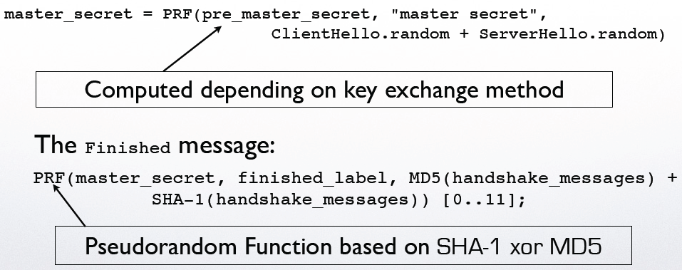
The Master Secret (48 bytes)

