Slide 1
CSE 4095 TLS Attacks Continued

Slide 2
TLS Attack Overview
Saw several subtle problems with TLS:
RSA does not prevent message manipulation
Lead to development of OAEP padding in TLS 1.1 and 1.2
CBC mode of operation has multiple vulnerabilities
Banning of CBC in TLS 1.0, move to RC4
Development of encryption mechanisms that simultaneously check integrity (authenticated encryption)
RC4 stream cipher is broken
No good record encryption schemes in TLS 1.0

Slide 3
More attacks
Focus on two attacks:
CRIME targets compression
LOGJAM targets protocol version
Discuss TLS 1.3 Draft

Slide 4
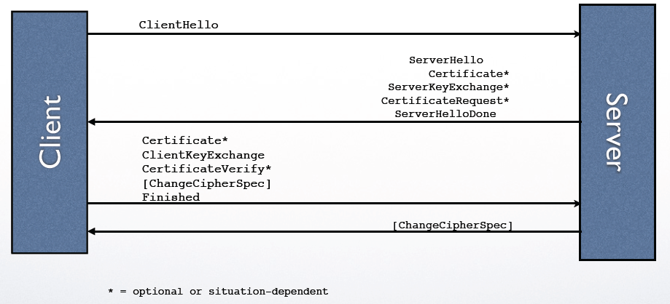
Handshake Protocol Diagram
Focus of first attack

Slide 5
CRIME
Compression Ratio Info-Leak Made Easy developed by Rizzo and Duong (also developed BEAST attack)
Attack will have similar attack scenario to BEAST attack
Will target completely different part of protocol

Slide 6
CRIME Attack
Client and Server Record Protocol
Compressed/Encrypted/MAC’d Messages
Attacker tries to insert malicious data into record protocol
If attacker has guess x for plaintext block, can insert P1 ⊕ C1 ⊕ C0 into stream and check correctness
As a result can learn about client’s private data
How to actually pull this off?

Slide 7
CRIME Attack
Cookie 1
Evil.com
1. Provides client with javascript
Cookie 1
Cookie 2 Cookie 3
Cookie 1
Guess for Cookie
Initiates connection to legitimate site
TLS connection automatically occurs
Client provides cookies to site automatically
Applet inserts plaintext blocks and guesses cookie values
Can initiate connection multiple times for multiple guesses
Relays values back to Evil.com
Not-Evil.com
New mechanism for checking if guess is correct

Slide 8
Compression
Most compression on the Internet uses DEFLATE
Session is vulnerable if compression is used either by application or TLS

Slide 9
DEFLATE
Lossless compression mechanism (means there are no errors)
Two sub algorithms: LZ77 and Huffman coding
LZ77 replaces substrings that have appeared prior with a reference (distance backwards and how many characters to substitute)
Google is so googley is replaced with: Google is so g(-13,5)y

Slide 10
Huffman Coding
Replaces common bytes with short values
Construct binary tree where weight of left/right subtree are equal
Example: `this is an example of a huffman tree’
a | e | f | h | i | l | m | n | o | p | r | s | _ | t | u | x
4 | 4 | 3 | 2 | 2 | 1 | 2 | 2 | 1 | 1 | 1 | 2 | 7 | 2 | 1 | 1
010 | 000 | 1101 | 1010 | 1000 | 11001 | 0111 | 0010 | 00110 | 10011 | 11000 | 1011 | 111 | 0110 | 00111 | 10010

Slide 11
Huffman Coding Tree
36
16
20
8
8
8
12
‘a’ 4
‘e’ 4
4
4
4
4
5
‘ ’ 7
‘t’ 2
‘m’ 2
‘n’ 2
2
‘i’ 2
2
‘h’ 2
‘s’ 2
2
‘f’ 3
‘o’ 1
‘u’ 1
‘x’ 1
‘p’ 1
‘r’ 1
‘l’ 1

Slide 12
DEFLATE
Lossless compression mechanism (means there are no errors)
Two sub algorithms: LZ77 and Huffman coding
In both sub-algorithms if a block already appears in the text it will be compressed to smaller size than new block
Can use this to check guesses

Slide 13
CRIME Attack
Cookie 1
Evil.com
1. Provides client with javascript
Cookie 1
Cookie 2 Cookie 3
Cookie 1
Guess for Cookie
The guess for cookie can have multiple parts
The amount they are compressed indicates redundancy with Cookie 1
Rest of attack proceeds just like BEAST
Attack worked by 45% of browsers and 40% of TLS servers including Dropbox, Github
Takes only 6 requests to learn one byte, very fast
Not-Evil.com

Slide 14
CRIME Mitigation
What went wrong?
What should be fixed?
Extended in BREACH attack by Prado, Harris, and Gluck
Does not rely on TLS compression, targets HTTP compression
Length Randomization
Randomize cookies

Slide 15
Logjam attack
Protocol Downgrade
Export compliance: in the early 1990s cryptography was classified as a munition and its export is controlled by the US state department
Many servers have two sets of Diffie-Hellman parameters: standard ones (1024 bit or 2048 bits) and export ones (512 bits)
No modern browser asks to use 512 bit export Diffie Hellman
Cryptanalytic attack on Diffie Hellman

Slide 16
Core of handshake protocol
Version, CR, Ciphersuites= DHE
Chosen ciphersuite =DHE, SR, Cert, g, p, g^{b}, Sig(CR, SR, g, g^{b})
Client
Server
Client Key gª, ChangeCipherSpec, Finished
ChangeCipherSpec, Finished= Integrity(master_secret, transcript)
Why can’t I change the ciphersuite list?

Slide 17
Core of handshake protocol
Version, CR, Ciphersuites= DHE
Attacker
Version, CR, Ciphersuites= None
Chosen ciphersuite =None, SR
Client
Server
Alert
Was not in the client list, client aborts

Slide 18
Core of handshake protocol
Version, CR, Ciphersuites= DHE, DHEExport
Version, CR, DHEExport
Attacker
DHEExport
Chosen ciphersuite =DHE, SR, Cert, g, p, g^{b}, Sig(CR, SR, g, g^{b})
Client
Server
Client Key gª, ChangeCipherSpec, Finished
ChangeCipherSpec, Finished= Integrity(master_secret, transcript)
Finished messages should not match: two parties have different views of transcript

Slide 19
Changing Ciphersuites
Because ciphersuites and version numbers are included in the finished message it should not be possible for an attacker to change the ciphersuite
However, security of the handshake messages depends on the selected ciphersuite
If an attacker can break the security of the selected ciphersuite, can produce legitimate looking finished messages

Slide 20
Logjam Attack
Version, CR, Ciphersuites= DHE,
Attacker
Version, CR, DHEExport
Chosen ciphersuite =DHE, SR, Cert, g, p, g^{b}, Sig(CR, SR, g, g^{b})
Client
Server
Client Key gª, ChangeCipherSpec, Finished
Attacker
Needs to compute b
Only 512 bits
ChangeCipherSpec, Finished
Does not forge signature, Client is unaware it is using export

Slide 21
Breaking Diffie-Hellman
Attacker must be able to compute b in a reasonable time (before client aborts connection)
Effort in breaking Diffie-Hellman can be divided into two parts, precomputation for a prime p, and finding single b from a value gª mod p
Precomputation took 90,000 core hours
Individual log about 70 seconds (on two 18 core machines)
Most servers use predictable primes and only vary p

Slide 22
Logjam
Version, CR, Ciphersuites= DHEExport
Attacker
Version, CR, DHEExport
Chosen ciphersuite =DHE, SR, Cert, g, p, g^{b}, Sig(CR, SR, g, g^{b})
Client
Server
Client Key gª, ChangeCipherSpec, Finished
Attacker
Needs to compute b
Only 512 bits
ChangeCipherSpec, Finished
What went wrong? How to fix it?

Slide 23
TLS 1.3
Currently in development on draft 19 of the standard
Major philosophical changes:
Only use ephemeral keys for agreement
Long-term keys for signing only
Authenticated encryption mode must be used in record layer
No backwards compatibility, entirely new ciphersuites
Client assumes their ciphersuite will be accepted
Handshake takes one message on each side in common case

Slide 24
TLS 1.3 Handshake
Version, CR, Ciphersuites, chosen suite, gª
SR, Cert, g, p, g^{b}, Sig(CR, SR, g, g^{b}), Finished
Client
Server
Finished, Encrypted Data

