Slide 1
Attacking DNS
Lecture 18
Slides adapted from Olaf Kolkman, RIPE
Notes:
© 2002
These slides where produced by Bill Manning (ISI), Ed Lewis (NAI labs) and Olaf M. Kolkman (RIPE NCC).

Slide 2
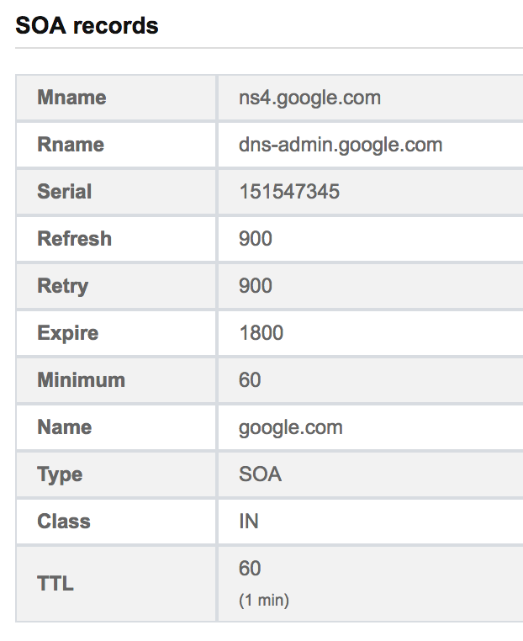
Start of Authority (SOA)
To conclude last class, I mentioned the SOA type but didn’t know its precise purpose
Idea is to give global parameters for the domain you are asking about
Returned by name to server info about all sites of that nameserver
Indicates who to ask for this domain

Slide 3
DNS Types
Type = A / AAAA
Name = domain name
Value = IP address
A is IPv4, AAAA is IPv6
Type = NS
Name = partial domain
Value = name of DNS server for this domain
“Go send your query to this other server”
Name: www.ccs.neu.edu
Type: A
Query
Name: www.ccs.neu.edu
Value: 129.10.116.81
Resp.
Name: ccs.neu.edu
Type: NS
Query
Name: ccs.neu.edu
Value: 129.10.116.51
Resp.

Slide 4
DNS Types, Continued
Type = CNAME
Name = hostname
Value = canonical hostname
Useful for aliasing
CDNs use this
Type = MX
Name = domain in email address
Value = canonical name of mail server
Name: foo.mysite.com
Type: CNAME
Query
Name: foo.mysite.com
Value: bar.mysite.com
Resp.
Name: ccs.neu.edu
Type: MX
Query
Name: ccs.neu.edu
Value: amber.ccs.neu.edu
Resp.

Slide 5
Domain Squatting
Cybersquatting is to register a domain in anticipation of that domain being desirable to another organization
Intent to sell tot hat organization for big profit
For example, You can register “hurricane2013.com”, or “hurricane-in-Texas.com” if you think there will be a big one in Texas in the near future.
Sell it for big profit if it is true!
Domain name purchase is cheap!
Many organizations have to buy all related domain names to prevent cybersquatting
http://en.wikipedia.org/wiki/Cybersquatting

Slide 6
Typosquatting
Register all possible typo domain names for another organization
Should a user accidentally enters an incorrect website address, he may be led to an alternative website owned by a cybersquatter.
Could lead to phishing attack (malicious), or increase web visits (not very malicious)
For example, for “bankofamerica.com”, a cybersquatter could register:
“bankamerica.com”, “bankoamerica.com”, “bankofamerican.com”, “bankfoamerica.com”, ……
Domain name purchase is cheap!

Slide 7
Resolving process & Cache
Question: www.ripe.net A
root-server
www.ripe.net A ?
www.ripe.net A ?
Ask net server @ X.gtld-servers.net (+ glue)
Caching
forwarder
(recursive)
Resolver
192.168.5.10
www.ripe.net A ?
gtld-server
Ask ripe server @ ns.ripe.net (+ glue)
Add to cache
www.ripe.net A ?
192.168.5.10
Glue records identify IP address of referred servers
ripe-server

Slide 8
Aliasing and Load Balancing
One machine can have many aliases
www.reddit.com
david.choffnes.com
www.foursquare.com
alan.mislo.ve
www.huffingtonpost.com
*.blogspot.com
One domain can map to multiple machines
www.google.com

Slide 9
Content Delivery Networks
DNS responses may vary based on geography, ISP, etc

Slide 10
DNS Query Format
Operates over UDP, destination port is 53
MAC Header
IP Header
Trans. ID
Flags
# Queries
Source port = 1100
Dest port = 53
16 bit increasing number
# Answers
# Authorities
Additional Resource Records
Queries:
Name, Type, Class

Slide 11
Matching Responses
A DNS resolver (or recursive nameserver) uses the following values to match responses:
The source port (selected at startup)
The transaction ID
The asked query

Slide 12
Attacking DNS integrity
Our goal will be compromise the integrity of a recursive name server
Simplest attack strategy:
root-server
gtld-server
Adversary needs to be between client and some server in the chain
ripe-server
Creates response that points to their server and sends it to client, client will ignore legitimate response (the trans will be closed)

Slide 13
Exercise 1
What natural defenses does DNS provide?
How does the distributed nature of DNS help?
root-server
gtld-server
Adversary needs to be between client and some server in the chain
ripe-server
Creates response that points to their server and sends it to client, client will ignore legitimate response (the trans will be closed)

Slide 14
Exercise 1
Client may not ask query
May ask different server
May not be able to respond before server
root-server
How to overcome these limitations?
gtld-server
ripe-server

Slide 15
Cache Poisoning
root-server
google.com?
google.com 67.218.93.152
google.com?
gtld-server
ripe-server
Client listens to (and caches) the first response
google.com 123.123.123.123

Slide 16
Cache Poisoning
What does an adversary need to execute this attack?
root-server
gtld-server
ripe-server

Slide 17
Cache Poisoning
What does an adversary need to execute this attack?
root-server
gtld-server
Query knowledge, timing, trans ID., source port
ripe-server

Slide 18
Gaining knowledge
The source port is a predictable value that is chosen at server initialization
Transaction ID in early servers was an incrementing value
Lets assume that it’s a random 16-bit value

Slide 19
Cache Poisoning
root-server
google.com?
google.com 67.218.93.152
google.com?
gtld-server
ripe-server
Client listens to (and caches) the first response with correct TID
google.com 123.123.123.123 TID = 1 google.com 123.123.123.123 TID = 2 google.com 123.123.123.123 TID = 3 google.com 123.123.123.123 TID = 4

Slide 20
Gaining knowledge
The source port is a predictable value that is chosen at server initialization
Transaction ID in early servers was an incrementing value
Lets assume that it’s a random 16-bit value
Race for attacker to send correct TID before legitimate response
How many responses required?
Approximately 2¹⁶
How to know when query will be made and to what domain?

Slide 21
Cache Poisoning
root-server
google.com?
google.com google.com google.com google.com
google.com?
google.com 67.218.93.152
gtld-server
ripe-server
Client listens to (and caches) the first response with correct TID

Slide 22
Gaining knowledge
Attacker can initiate query if on the DNS server internal network or the DNS server accepts outside requests
Do DNS servers accept outside queries?
Still needs to learn source port and TID

Slide 23
Number of open DNS resolvers

Slide 24
How will the attacker get his entry into the cache? 2 ways
1. Tell resolver that NS for victim is at adversary’s IP
Issue query: subdomain.attacker.example IN A
Attacker’s response:
Answer: (no response)
Authority Section: attacker.example. 3600 IN NS ns.target.example.
Additional Section: ns.target.example. IN A w.x.y.z
Adversary says “authoritative server for my domain is ns.target.example and oh by the way here is the IP for it (adversary’s IP)

Slide 25
How will the attacker get his entry into the cache? 2 ways
2. Redirect the NS record to the adversary’s domain
Issue query: subdomain.attacker.example IN A
Answer: (no response)
Authority section:
Target.example. 3600 IN NS ns.attacker.example.
Additional section:
Ns.attacker.example. IN A w.x.y.z
The attacker has inserted an unrelated piece of information that will be cached by the server (that target.example.’s ADNS is ns.attacker.example.)

Slide 26
Impact of poisoning
Don’t have to claim a single address, can immediately take over a while domain
Main barrier to attack is the recursive resolver not having a cached record
Exercise: how can we make this attack more difficult (without changing DNS)?
Don’t accept external queries
Randomize source port
Randomize TID (not really helpful)

Slide 27
TLS to the rescue
TLS should provide authentication when we connect to a webserver
If we are redirected to a bad site that claims to be google.com they won’t have a valid certificate…

Slide 28
Subverting TLS
Chase.com chase.com…
CA
Certificate request for chase.com
Evil address
chase.com?
Valid certificate for chase.com
Attacker can now freely execute attacker against other hosts

Slide 29
Subverting TLS
Attack extends if the CA sends an email to verify hostname
Works against any domain validated certificate

Slide 30
TLS Attack
This attack is easy to iterate
You can ask for new certificates as the cache clears and try until successful
Does not work to get extensively validated certs
Some CAs restrict the usage of domain validated certs (don’t allow authentication)
Browsers use cert pinning to prevent this
Need more extensive defenses to strengthen DNS

Slide 31
DNS Defense
Seems to require updates to DNS that make it more security aware
Want to learn from BGP/IPv6 deployment, don’t want to require large scale replacement of internet infrastructure

