Slide 1
Intro to Cryptography & Symmetric Key Cryptography

Slide 2
Why do we care?
Cryptography is a basic tool used to protect communications between participants in transit and at rest storage
Often necessary but insufficient to stop malicious activity
This class will necessarily be brief in its review of cryptography, come see one of us for resources if you want to know more

Slide 3
Who can see my texts?

Slide 4
Who can see my texts?

Slide 5
The language of cryptography
Alice’s
encryption
key
Bob’s
decryption
key
K
K
K
A
B
plaintext
encryption
algorithm
ciphertext
decryption
algorithm
plaintext
m plaintext message
cipher: method of encrypting
Enc(K_{A},m)=c ciphertext, encrypted with key K_{A}
m = Dec(K_{B},Enc(K_{A},m))

Slide 6
Symmetric & asymmetric key cryptography
Alice’s
encryption
key
Bob’s
decryption
key
K
K
K
A
B
plaintext
encryption
algorithm
ciphertext
decryption
algorithm
plaintext
Symmetric key cryptography: same key for encryption and decryption, K_{A}=K_{B}
Asymmetric key cryptography: encryption and decryption keys are not the same, K_{A}≠K_{B} (covered next class)

Slide 7
Kerckhoffs’s principle
By Auguste Kerckhoffs (1835 –1903):
Dutch linguist and cryptographer
A cryptosystem should be secure even if everything about the system, except the key, is public knowledge
The security of a cryptosystem should depend on the secrecy of the key, not the algorithm
More broadly, a system designer should be aware what must be private for security

Slide 8
Exercise: Defining security
Alice’s
encryption
key
Bob’s
decryption
key
K
K
A
B
plaintext
encryption
algorithm
ciphertext
decryption
algorithm
plaintext
Using the diagram above, try and define what properties a cryptosystem should have
Be explicit about what the adversary can do and their goals
Be as precise as possible, take five minutes

Slide 9
Security definitions
Possible goals:
  Determine which of two messages was sent
  Recover key
  Change message being sent
  Make message unreadable
Possible capabilities:
  See a single ciphertext
  See ciphertexts and know plaintext
  Choose plaintexts and see ciphertext
  Choose plaintext adaptively and see ciphertext
  Create ciphertexts and see if decryption works

Slide 10
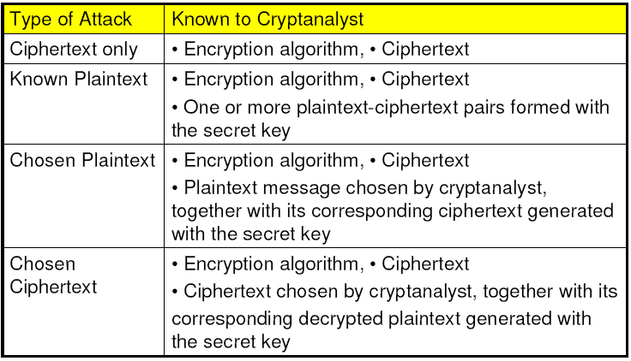
Cryptanalysis scheme

Slide 11
Unconditional vs. Computational Security
Unconditional security
  No matter how much computer power is available, the cipher cannot be broken
  Ciphertext provides insufficient information to uniquely determine the corresponding plaintext
  Few practical schemes qualify
Computational security
  The cost of breaking the cipher exceeds the value of the encrypted info
  The time required to break the cipher exceeds the useful lifetime of the info
Notes:
Unconditional security would be nice, but the only known such cipher is the one-time pad (later). For all reasonable encryption algorithms, have to assume computational security where it either takes too long, or is too expensive, to bother breaking the cipher.

Slide 12
Symmetric Key Cryptography

Slide 13
Requirements
Assume encryption algorithm is known
Two requirements for secure use of symmetric encryption:
  Strong encryption algorithm
  Secret key known only to sender / receiver
Implies a secure channel to distribute key
Notes:
Generally assume that the algorithm is known.
This allows easy distribution of s/w and h/w implementations.
Hence assume just keeping key secret is sufficient to secure encrypted messages.
Have plaintext X, ciphertext Y, key K, encryption alg Ek, decryption alg Dk.

Slide 14
Caesar Cipher
Earliest known symmetric (substitution) cipher
Replaces each letter with another k letters away
Example:
  PHHW PH DIWHU WKH WRJD SDUWB
Encryption key: ?
Brute force analysis: ?
Notes:
Substitution ciphers form the first of the fundamental building blocks of cryptographic systems. The core idea is to replace one basic unit (letter/byte) with another. Whilst the early Greeks described several substitution ciphers, the first attested use in military affairs of one was by Julius Caesar, described by him in Gallic Wars (cf. Kahn pp83-84). Still call any cipher using a simple letter shift a caesar cipher.
Note: when letters are involved, the following conventions are used in this course: Plaintext is always in lowercase; ciphertext is in uppercase; key values are in italicized lowercase.

Slide 15
Caesar Cipher
Earliest known symmetric (substitution) cipher
Replaces each letter with another k letters away
Example (k=3):
  PHHW PH DIWHU WKH WRJD SDUWB
  meet me after the toga party
a | b | c | d | e | f | g | h | i | j | k | l | m | n | o | p | q | r | s | t | u | v | w | x | y | z
D | E | F | G | H | I | J | K | L | M | N | O | P | Q | R | S | T | U | V | W | X | Y | Z | A | B | C
Encryption key: ?
Brute force analysis: ?
Notes:
Substitution ciphers form the first of the fundamental building blocks of cryptographic systems. The core idea is to replace one basic unit (letter/byte) with another. Whilst the early Greeks described several substitution ciphers, the first attested use in military affairs of one was by Julius Caesar, described by him in Gallic Wars (cf. Kahn pp83-84). Still call any cipher using a simple letter shift a caesar cipher.
Note: when letters are involved, the following conventions are used in this course: Plaintext is always in lowercase; ciphertext is in uppercase; key values are in italicized lowercase.

Slide 16
Mono-alphabetic cipher
substitute one letter for another
plaintext: abcdefghijklmnopqrstuvwxyz
ciphertext: mnbvcxzasdfghjklpoiuytrewq
e.g.:
Plaintext: bob. i love you. alice
ciphertext: nkn. s gktc wky. mgsbc
Encryption key: mapping from set of 26 letters
to set of 26 letters

Slide 17
Mono-alphabetic Cipher Security
26! = 4 x 10²⁶ keys
Is that secure?
Problem is language characteristics
  Human languages are redundant
  Letters are not equally commonly used

Slide 18
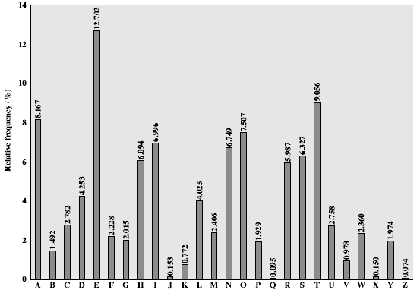
English Letter Frequencies
Notes:
This graph is based on counts done at ADFA in the late 1980's, and used to develop the tables published in Seberry & Pieprzyk [SEBE89].
Note that all human languages have varying letter frequencies, though the number of letters and their frequencies varies.
Seberry & Pieprzyk [SEBE89] Appendix A has graphs for 20 languages (most European & Japanese & Malay).

Slide 19
Example Cryptanalysis
Given ciphertext:
  UZQSOVUOHXMOPVGPOZPEVSGZWSZOPFPESXUDBMETSXAIZ
  VUEPHZHMDZSHZOWSFPAPPDTSVPQUZWYMXUZUHSX
  EPYEPOPDZSZUFPOMBZWPFUPZHMDJUDTMOHMQ
Count relative letter frequencies
Guess P & Z are e and t
Guess ZW is th and hence ZWP is the
Proceeding with trial and error finally get:
  it was disclosed yesterday that several informal but
  direct contacts have been made with political
  representatives of the viet cong in moscow

Slide 20
One-Time Pad
By G. Vernham (1918) and J. Mauborgne
random sequence of 0s and 1s XORed to plaintext, no repetition of keys
Perfectly secure: ciphertext bears no statistical relationship to the plaintext (Shannon 1945)
Not practical
  For any plaintext, it needs a random key of the same length - hard to generate large amount of keys
  Have problem of safe distribution of key
Notes:
The One-Time Pad is an evolution of the Vernham cipher, which was invented by Gilbert Vernham in 1918, and used a long tape of random letters to encrypt the message. An Army Signal Corp officer, Joseph Mauborgne, proposed an improvement using a random key that was truly as long as the message, with no repetitions, which thus totally obscures the original message.
Since any plaintext can be mapped to any ciphertext given some key, there is simply no way to determine which plaintext corresponds to a specific instance of ciphertext.

Slide 21
Modern symmetric ciphers
Block ciphers
  operating on fixed-length groups of bits, called blocks
  e.g., DES, AES
Stream ciphers
  Operate on bits (or one byte)
  e.g., one-time pad, RC4, RC5
Capable to encrypting multiple messages, cannot be information-theory secure

Slide 22
Security definitions
Possible goals:
  Determine which of two messages was sent
  Recover key
  Change message being sent
  Make message unreadable
Possible capabilities:
  See a single ciphertext
  See ciphertexts and know plaintext
  Choose plaintexts and see ciphertext
  Choose plaintext adaptively and see ciphertext
  Create ciphertexts and see if decryption works

Slide 23
Two basic security principles
Confusion
  There is no simple relationship between the key and ciphertext
  Each bit of ciphertext should depend on many bits of the key
Diffusion
  Any statistics about plaintext are equally distributed through ciphertext
  Changing a single bit of plaintext should change each bit of ciphertext with prob. ½ over the choice of key

Slide 24
Efficiency matters
Encryption is not useful if it can’t keep up with data rates
Even our phone can send 10^10bits/sec. Need encryption on the scale of nanoseconds.
Important for encryption to be composed of operations that computers do quickly
Ideally should be easily implemented in hardware

Slide 25
Block cipher
Messages to be processed in fixed-length blocks of k bits (e.g., k=64)
Ideally through 1-1 mapping table
  Not practical, table size 64x2^64=2^70=10^21 bits when k=64
Typically based on the concept of iterated product cipher (by Claude Shannon)
  Using simple operations: substitution, permutation
Example: Feistel cipher

Slide 26
Feistel cipher (1973)
Use product cipher
  Executing two or more simple ciphers in sequence so the final product is cryptographically stronger than any of the components
Alternate substitution and permutation
Based on Shannon’s concepts of confusion and diffusion (1945)

Slide 27
Confusion and Diffusion
Diffusion: dissipates statistical structure of plaintext over bulk of ciphertext
  By having each ciphertext digit be affected by more than one plaintext digit
Confusion: to obscure the statistical dependence between the encryption key and the ciphertext
  simple linear substitution generates little confusion
  achieved by using complex substitution algorithms
Notes:
diffusion – dissipates statistical structure of plaintext over bulk of ciphertext
confusion – makes relationship between ciphertext and key as complex as possible
Confusion
• Make it difficult to determine how message and key are transformed into cipher text
• Complex relationship between plaintext, key, and ciphertext
• Done through substitution
Diffusion
• Widely spread the information from the message or key across the cipher text
• Done through transposition (permutation)

Slide 28
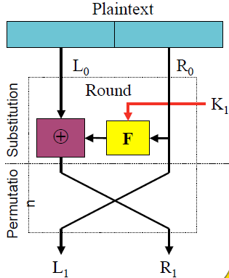
Feistel Cipher
Encrypts in rounds
L0 = Left half of input
R0= right half of input

Slide 29
DES (Data Encryption Standard)
US encryption standard [NIST 1993]
56-bit symmetric key, 64-bit plaintext input
Follow Feistel network
  block of plain text is split into two equal-sized halves
  round function is applied to one half, using a subkey; the output is XORed with the other half
  two halves are then swapped

Slide 30
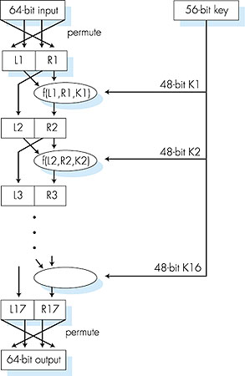
DES operation
initial permutation
16 identical “rounds” of function application, each using different 48-bit key
final permutation

Slide 31
Brute Force Search
Always possible to simply try every key
Assume either know / recognize plaintext
Key Size (bits) | Number of Alternative Keys | Time needed (1 decryption/µs) | Time needed (10⁶ decryptions/µs)
32 | 2³² = 4.3 × 10⁹ | 2³¹ µs = 35.8 minutes | 2.15 milliseconds
56 | 2⁵⁶ = 7.2 × 10¹⁶ | 2⁵⁵ µs = 1142 years | 10.01 hours
128 | 2¹²⁸ = 3.4 × 10³⁸ | 2¹²⁷ µs = 5.4 × 10²⁴ years | 5.4 × 10¹⁸ years
168 | 2¹⁶⁸ = 3.7 × 10⁵⁰ | 2¹⁶⁷ µs = 5.9 × 10³⁶ years | 5.9 × 10³⁰ years
26 characters (permutation) | 26! = 4 × 10²⁶ | 2 × 10²⁶ µs = 6.4 × 10¹² years | 6.4 × 10⁶ years

Slide 32
Strength of DES
56-bit key length
  2^56=7.2x10^16 possible keys
  Not enough for modern computers, or networks of computers
no known good analytic attack that exploits the characteristics of DES algorithm
making DES more secure:
  3DES: encrypt with K₁, decrypt with K2, encrypt with K3
  Different keying options lead to 168, 112, 56-bit key lengths

Slide 33
AES: Advanced Encryption Standard
symmetric-key NIST standard, replaced DES (Nov 2001)
Based on substitution-permutation network, not Feistel network
process data in 128 bit blocks
128, 192, or 256 bit keys
brute force decryption (try each key) taking 1 sec on 56-bit DES, takes 149 trillion years for 128-bit AES

Slide 34
AES Structure
Four basic operations: infuse key, substitution, transposition, mixing

Slide 35
AES Structure
Four basic operations: infuse key, substitution, transposition, mixing

Slide 36
AES Structure
Four basic operations: infuse key, substitution, transposition, mixing
2 | 3 | 1 | 1
1 | 2 | 3 | 1
1 | 1 | 2 | 3
3 | 1 | 1 | 2

Slide 37
Breaking AES
AES is the repetition of many simply operations
Seems like it should be easy to break?
Cryptoanalysis is very good at linear operations
Substitution (S-Box) is only nonlinear step
Incredibly value target, millions to billions in research in breaking algorithm
Best known attack removes approximately 2 bits of key strength current strength is 126.1 bits Bogdanov et al. 2011
A good block cipher does not ensure security!

Slide 38
Mode of operation
Block cipher: take b-bit block
Mode of operation: deal w/ data longer than one block; pad last block (if needed)
  Electronic codebook (ECB)
  Cipher block chaining (CBC)
  Cipher feedback (CFB)
  Output feedback (OFB)
  Counter (CTR)
  Galois Counter (GCM)

Slide 39
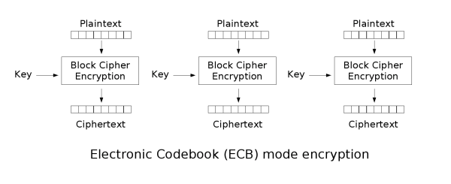
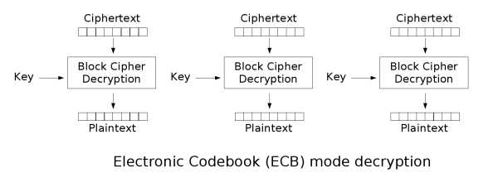
ECB: Electronic Codebook

Slide 40
Vulnerabilities of ECB
Identical plaintext blocks are encrypted into Identical ciphertext blocks
Expose structure of message
Not recommended for use in cryptographic protocols
Can be used to transmit short values (e.g., an encryption key)

Slide 41

Comparison between ECB and other modes
Original image | Encrypted using ECB mode | Modes other than ECB result in pseudo-randomness

Slide 42

Comparison between ECB and other modes
Original image | Encrypted using ECB mode | Modes other than ECB result in pseudo-randomness

Slide 43

Comparison between ECB and other modes
Original image | Encrypted using ECB mode | Modes other than ECB result in pseudo-randomness

Slide 44
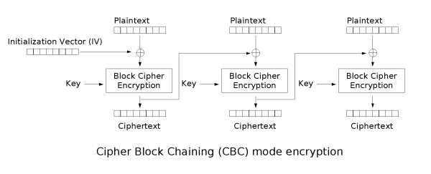
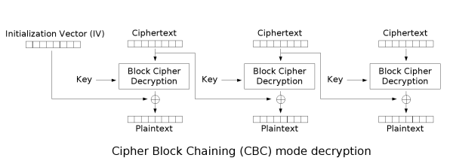
Cipher-block Chaining (CBC)

Slide 45
CBC
Identical plaintext blocks are encrypted into different ciphertext blocks
  each block of plaintext is XORed with the previous ciphertext block before being encrypted
Initialization vector (IV) is used in the first block
  IV: even when the same plaintext is encrypted multiple times independently with the same key, distinct ciphertexts are produced
  IV not reused under the same key
Will revisit vulnerabilities of CBC later in class
Most modes of operation vulnerable to modification

Slide 46
Summary
Intro to cryptography
  Basic ingredients
  Types of attacks
Intro to symmetric key cryptography
  Block cipher and stream cipher
  Feistel cipher
  DES & AES
  Modes of operation

