Slide 1
CSE 4095
Lecture 20 DNS Sec Slides adapted from Olag Kampman

Slide 2
DNSSEC Mechanisms
New Resource Records
Setting Up a Secure Zone
Delegating Signing Authority

Slide 3
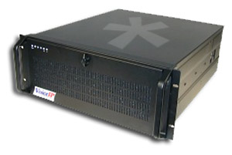
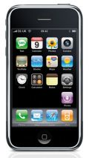
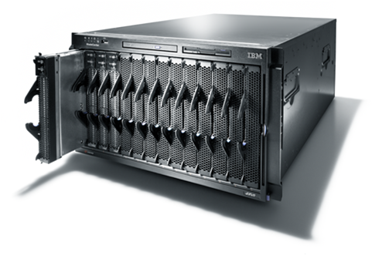
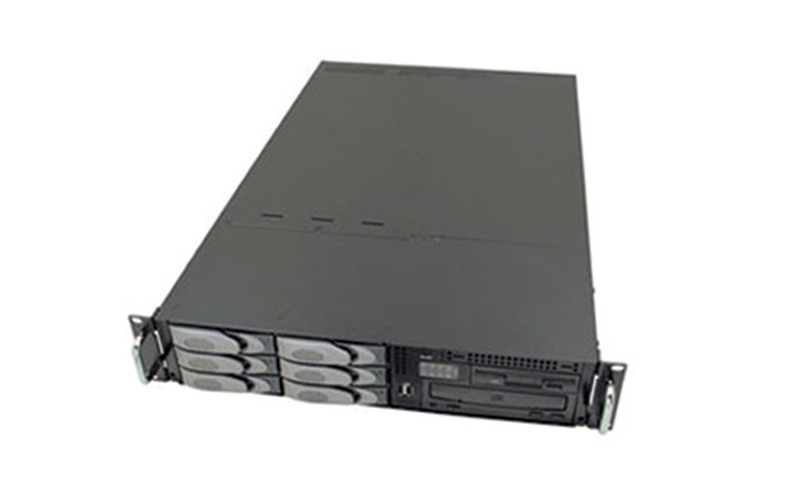
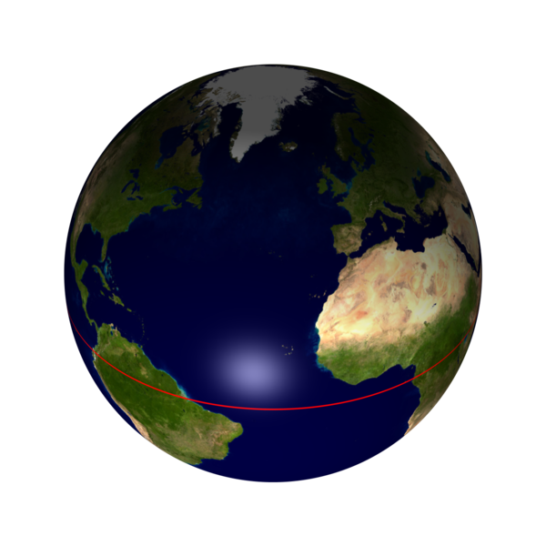
Data flow through the DNS
Where are the vulnerable points?
Registrars
& Registrants
Server vulnerability
Secondary
DNS
Man in the Middle
primary
DNS
spoofing
&
Man in the Middle
Registry
Secondary
DNS

Slide 4
DNSSEC protects all these end-to-end
As an aside: There is a protection mechanism against the man in the middle: TSIG (transaction signature, see RFC 2845)
Provides one hop security
TSIG is operationally deployed today
Based on shared secret: not scalable

Slide 5
What does DNSSEC provide
provides message authentication and integrity verification through cryptographic signatures
You know who provided the signature
No modifications between signing and validation
It does not provide authorization
It does not provide confidentiality
It does not provide protection against DDOS

Slide 6
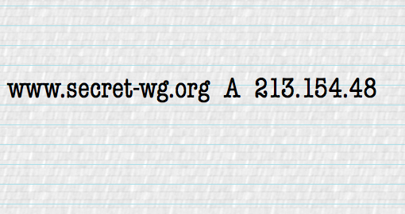
Apply Sig
Data flow through the DNS
End to end security
Registrars
& Registrants
OK
Secondary
DNS
OK
Validate Sig
primary
DNS
Registry
Secondary
DNS

Slide 7
Trust and Confidence
DNS system
Registry system
DNSSEC enables confidence in the DNS
It does not change the trust we put in the Registry/Registrar procedures
Although introduction of DNSSEC may improve some of the procedures
Root and TLD still need good practices

Slide 8
Mechanisms used
1 | RSA/MD5 |  | Must Not Implement
3 | DSA/SHA-1 |  | Optional
5 | RSA/SHA-1 | RFC 3110 | Required
7 | RSASHA1-NSEC3-SHA1 | RFC 5155 | Recommended
8 | RSA/SHA-256 | RFC 5702 | Recommended
10 | RSA/SHA-512 |  | Recommended
12 | GOST R 34.10-2001 | RFC 5933 | Optional
13 | ECDSA/SHA-256 | RFC 6605 | Recommended
14 | ECDSA/SHA-384 |  | Recommended

Slide 9
Three new components
Private Key: kept private and stored locally
Public Keys: Published in the DNS as a DNSKEY Resource Record
Signatures: Published in the DNS as a RRSIG Resource Record

Slide 10
Signing is done per Zone
Each zone has one or more key-pairs for signing
If you have the public keys from a zone you can validate signatures made with the corresponding private keys
However, signing a complete zone does not scale

Slide 11
RRs and RRSets
Resource Record:
name TTL class type rdata
www.nlnetlabs.nl. 7200 IN A 192.168.10.3
RRset: RRs with same name, class and type:
www.nlnetlabs.nl. 7200 IN A 192.168.10.3
A 10.0.0.3
A 172.25.215.2
RRsets are the atomic data units in the DNS
RRsets are signed, not the individual RRs

Slide 12
DNSKEY RDATA
16 bits: FLAGS
8 bits: protocol
8 bits: algorithm
N*32 bits: public key
nlnetlabs.nl. 3600 IN DNSKEY 256 3 5 (
AQOvhvXXU61Pr8sCwELcqqq1g4JJ
CALG4C9EtraBKVd+vGIF/unwigfLOA
O3nHp/cgGrG6gJYe8OWKYNgq3kDChN)
Notes:
1 1 1 1 1 1 1 1 1 1 2 2 2 2 2 2 2 2 2 2 3 3
0 1 2 3 4 5 6 7 8 9 0 1 2 3 4 5 6 7 8 9 0 1 2 3 4 5 6 7 8 9 0 1
+-+-+-+-+-+-+-+-+-+-+-+-+-+-+-+-+-+-+-+-+-+-+-+-+-+-+-+-+-+-+-+-+
| flags | protocol | algorithm |
+-+-+-+-+-+-+-+-+-+-+-+-+-+-+-+-+-+-+-+-+-+-+-+-+-+-+-+-+-+-+-+-+
| /
/ public key /
/ /
+-+-+-+-+-+-+-+-+-+-+-+-+-+-+-+-+-+-+-+-+-+-+-+-+-+-+-+-+-+-+-+-|
Flags:
                                             
   

   
When dealing with ZONE data NAMTYPE is set to 01.
If bit 0 and 1 are both 0 then the key can be used for authentication and confidentiality. DNSSEC normally sets these two bits to 0.
If bit 0 and 1 are set, then there is NO key and the RR stops after the algorithm octet.
Flags 0XC100 = 49408
Protocol: For DNSSEC the protocol is 3. IPSEC would have 4 in the protocol field.
Algorithm: 1 RSA/MD5 [RFC 2537]
2 Diffie-Hellman [RFC 2539] - optional, key only
3 DSA [RFC 2536] – Mandatory in implementations
4 reserved for elliptic curve crypto
5 RSA/SHA1 [RFC3110] – Mandatory in implementations
There are developments to restrict the use of KEYs to DNSSEC only. So only allow protocol 3 and drop some of the flags see: draft-ietf-dnsext--restrict-key-for-dnssec-??.txt

Slide 13
RRSIG RDATA
16 bits - type covered
8 bits - algorithm
8 bits - nr. labels covered (used for wildcard queries)
32 bits - original TTL
nlnetlabs.nl. 3600 IN RRSIG A 5 2 3600 (
20050611144523 20050511144523 3112 nlnetlabs.nl.
VJ+8ijXvbrTLeoAiEk/qMrdudRnYZM1VlqhN
vhYuAcYKe2X/jqYfMfjfSUrmhPo+0/GOZjW
66DJubZPmNSYXw== )
32 bit - signature expiration
32 bit - signature inception
16 bit - key tag
signer’s name
Notes:
1 1 1 1 1 1 1 1 1 1 2 2 2 2 2 2 2 2 2 2 3 3
0 1 2 3 4 5 6 7 8 9 0 1 2 3 4 5 6 7 8 9 0 1 2 3 4 5 6 7 8 9 0 1
+-+-+-+-+-+-+-+-+-+-+-+-+-+-+-+-+-+-+-+-+-+-+-+-+-+-+-+-+-+-+-+-+
| type covered | algorithm | labels |
+-+-+-+-+-+-+-+-+-+-+-+-+-+-+-+-+-+-+-+-+-+-+-+-+-+-+-+-+-+-+-+-+
| original TTL |
+-+-+-+-+-+-+-+-+-+-+-+-+-+-+-+-+-+-+-+-+-+-+-+-+-+-+-+-+-+-+-+-+
| signature expiration |
+-+-+-+-+-+-+-+-+-+-+-+-+-+-+-+-+-+-+-+-+-+-+-+-+-+-+-+-+-+-+-+-+
| signature inception |
+-+-+-+-+-+-+-+-+-+-+-+-+-+-+-+-+-+-+-+-+-+-+-+-+-+-+-+-+-+-+-+-+
| key tag | |
+-+-+-+-+-+-+-+-+-+-+-+-+-+-+-+-+ signer's name +
| /
+-+-+-+-+-+-+-+-+-+-+-+-+-+-+-+-+-+-+-+-+-+-+-+-+-+-+-+-+-+-+-+-/
/ /
/ signature /
/ /
+-+-+-+-+-+-+-+-+-+-+-+-+-+-+-+-+-+-+-+-+-+-+-+-+-+-+-+-+-+-+-+-+
In the example above the algorithm is type 1 (RSA), the key tag is 3122 and the signer’s name is bla.foo; Kbla.foo+001+3122 is the key used to sign. The A record that has the same label as this SIG.
The labels covered field is to help the resolver tell that the answer is a result of wildcard substitution.

Slide 14
Validate Public Keys
Make sure you get them from the appropriate entity and configure them as trust-anchors
If you validate against the wrong public key there is a problem again
For DNSSEC: key distribution through the DNS
Ideally only one key needed: that of the root of the DNS hierarchy (more on that later)

Slide 15
Delegating Signing Authority
Chains of Trust

Slide 16
Locally Secured Zones
Delegate Signing Security
.
NS and DS
NS & DS
com.
net.
money.net.
os.net.
kids.net.
Secure entry points
corp
dop
mac
unix
nt
marnick
dev
market
dilbert

Slide 17
Using the DNS to Distribute Keys
Secured islands make key distribution problematic
Distributing keys through DNS:
Use one trusted key to establish authenticity of other keys
Building chains of trust from the root down
Parents need to sign the keys of their children
Only the root key needed in ideal world
Parents always delegate security to child

Slide 18
Delegation Signer (DS)
Delegation Signer (DS) RR indicates that:
delegated zone is digitally signed
indicated key is used for the delegated zone
Parent is authorative for the DS of the child’s zone
Not for the NS record delegating the child’s zone!
DS should not be in the child’s zone

Slide 19
DS RDATA
16 bits: key tag
8 bits: algorithm
8 bits: digest type
20 bytes: SHA-1 Digest
$ORIGIN nlnetlabs.nl.
lab.nlnetlabs.nl. 3600 IN NS ns.lab.nlnetlabs.nl
lab.nlnetlabs.nl. 3600 IN DS 3112 5 1 ( 239af98b923c023371b52
1g23b92da12f42162b1a9 )
Notes:
draft-ietf-dnsext-delegation-signer-xx.txt
1 1 1 1 1 1 1 1 1 1 2 2 2 2 2 2 2 2 2 2 3 3
0 1 2 3 4 5 6 7 8 9 0 1 2 3 4 5 6 7 8 9 0 1 2 3 4 5 6 7 8 9 0 1
+-+-+-+-+-+-+-+-+-+-+-+-+-+-+-+-+-+-+-+-+-+-+-+-+-+-+-+-+-+-+-+-+
| type covered | algorithm | digest type |
+-+-+-+-+-+-+-+-+-+-+-+-+-+-+-+-+-+-+-+-+-+-+-+-+-+-+-+-+-+-+-+-+
| SHA-1 digest |
+-+-+-+-+-+-+-+-+-+-+-+-+-+-+-+-+-+-+-+-+-+-+-+-+-+-+-+-+-+-+-+-+
| 20 bytes |
+-+-+-+-+-+-+-+-+-+-+-+-+-+-+-+-+-+-+-+-+-+-+-+-+-+-+-+-+-+-+-+-+
| |
+-+-+-+-+-+-+-+-+-+-+-+-+-+-+-+-+-+-+-+-+-+-+-+-+-+-+-+-+-+-+-+-+
| |
+-+-+-+-+-+-+-+-+-+-+-+-+-+-+-+-+-+-+-+-+-+-+-+-+-+-+-+-+-+-+-+-+
| |
+-+-+-+-+-+-+-+-+-+-+-+-+-+-+-+-+-+-+-+-+-+-+-+-+-+-+-+-+-+-+-+-+
Note that the same 20 bytes hash is also used in the creation of a RSA SHA1 signature. The crypto strength of the pointer is thus comparable to the crypto strength of the signature over the key. In other words you do not weaken the chain of trust.

Slide 20
Key Problem
Interaction with parent administratively expensive
Should only be done when needed
You might want to lock these in hardware
Signing zones should be fast
Memory restrictions
Space and time concerns
Operational exposure higher

Slide 21
More Than One Key: KSK and ZSK
RRsets are signed, not RRs
DS points to specific key
Signature from that key over DNSKEY RRset transfers trust to all keys in DNSKEY RRset
Key that DS points to only signs DNSKEY RRset
Key Signing Key (KSK)
Other keys in DNSKEY RRset sign entries in zone
Zone Signing Key (ZSK)

Slide 22
The Important Considerations
KSK and ZSK have different ‘shielding’ properties: KSK on smartcard, ZSK on disk
ZSK needs ‘daily’ or permanent use.
KSK less frequent
ZSK change needs no involvement with 3rd parties
KSK may need uncontrolled cooperation from 3rd parties

Slide 23
Initial Key Exchange
Child needs to:
Send key signing keyset to parent
Parent needs to:
Check childs zone
for DNSKEY & RRSIGs
Verify if key can be trusted
Generate DS RR

Slide 24
Walking the Chain of Trust
Locally configured
Trusted key: . 8907
1
$ORIGIN .
. DNSKEY (…) 5TQ3s… (8907) ; KSK
DNSKEY (…) lasE5… (2983) ; ZSK
2
4
RRSIG DNSKEY (…) 8907 . 69Hw9..
$ORIGIN net.
net. DS 7834 3 1ab15…
RRSIG DS (…) . 2983
net. DNSKEY (…) q3dEw… (7834) ; KSK
DNSKEY (…) 5TQ3s… (5612) ; ZSK
3
5
RRSIG DNSKEY (…) 7834 net. cMas...
7
foo.net. DS 4252 3 1ab15…
RRSIG DS (…) net. 5612
6
$ORIGIN foo.net.
foo.net. DNSKEY (…) rwx002… (4252) ; KSK
DNSKEY (…) sovP42… (1111) ; ZSK
8
RRSIG DNSKEY (…) 4252 foo.net. 5t...
www.foo.net. A 193.0.0.202
RRSIG A (…) 1111 foo.net. a3...
9
Notes:
0. Root (".") KSK is manually configured into all resolvers as "trusted key";
1. Root zone itself contains KSK and ZSK (2983)
2. ... and the signature over the ZSK _with_ (by) the trusted KSK.
3. DS record of the child ("net") is signed with the ZSK (note: italic style).
---
4. DS record in the "root" zone points to the KSK of the "net" zone.
5. With the KSK, the ZSK of the "net" zone is signed, which produces the SIG record over the KSK (by the ZSK).
6. ZSK is also used to sign the DS record of "foo(.net)".
---
All over again:
7. DS record in he parent ("net") points to the KSK of "foo.net".
"foo.net" has two keys: KSK and ZSK;
8. KSK is used to sign the ZSK
(hence, SIGnature by KSK over ZSK)
9. ZSK (italic) is used to sign the zone data, including the A record for "www" (hence, SIGnature by ZSK over A)

Slide 25
Chain of Trust Verification, Summary
Data in zone can be trusted if signed by a Zone-Signing-Key
Zone-Signing-Keys can be trusted if signed by a Key-Signing-Key
Key-Signing-Key can be trusted if pointed to by trusted DS record
DS record can be trusted
if signed by the parents Zone-Signing-Key
or
DS or DNSKEY records can be trusted if exchanged out-of-band and locally stored (Secure entry point)

Slide 26
Where are we
DNSKEY
RRSIG
DS

Slide 27
Offline Signing and Denial of Existence
Problems with on-the-fly signing
Private key needs to be stored on an Internet facing system
Signing is a CPU expensive operation
How does one provide a proof that the answer to a question does not exist?

Slide 28
NSEC RDATA
Points to the next domain name in the zone
also lists what are all the existing RRs for “name”
NSEC record for last name “wraps around” to first name in zone
N*32 bit type bit map
Used for authenticated denial-of-existence of data
authenticated non-existence of TYPEs and labels
Example:
www.nlnetlabs.nl. 3600 IN NSEC nlnetlabs.nl. A RRSIG NSEC

Slide 29
NSEC Records
NSEC RR provides proof of non-existence
If the servers response is Name Error (NXDOMAIN):
One or more NSEC RRs indicate that the name or a wildcard expansion does not exist
If the servers response is NOERROR:
And empty answer section
The NSEC proves that the QTYPE did not exist
More than one NSEC may be required in response
Wildcards

Slide 30
NSEC Walk
NSEC records allow for zone enumeration
Providing privacy was not a requirement at the time
Zone enumeration is a deployment barrier (why?)
Solution has been developed: NSEC3
RFC 5155
Complicated piece of protocol work
Hard to troubleshoot
Only to be used over Delegation Centric Zones

Slide 31
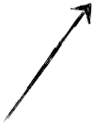
NSEC3
page
Creates a linked list of the hashed names
Non-existence proof of the hash shows non-existence of original
Dictionary attack barriers:
Salt
Iterations
A
H(N)
C
H(C)
N
H(Z)
Z
H(A)
© 2006-2012 NLnet Labs, Licensed under a Creative Commons Attribution 3.0 Unported License.

Slide 32
New Resource Records
Three Public key crypto related RRs
RRSIG: Signature over RRset made using private key
DNSKEY: Public key, needed for verifying a RRSIG
DS: Delegation Signer; ‘Pointer’ for building chains of authentication
One RR for internal consistency
NSEC and NSEC3: Indicates which name is the next one in the zone and which typecodes are available for the current name
authenticated non-existence of data

Slide 33
Other Keys in the DNS
DNSKEY RR can only be used for DNSSEC
Keys for other applications need to use other RR types
CERT
For X.509 certificates
Application keys under discussion/development
IPSECKEY
Need to be careful about overloading DNS system

Slide 34
DNS Sec Deployment
Notes:
https://en.wikipedia.org/wiki/List_of_Internet_top-level_domains https://en.wikipedia.org/wiki/Domain_Name_System_Security_Extensions#Deployment

