Slide 1
CSE 4095
Lecture 21 – Bitcoin Digital Money and Currency
Slides adapted from Claudio Orlandi

Slide 2
What do we want out of money?
In this class we’ll cover properties of Bitcoin, start with a review of basic money
Durability
Portability
Acceptability/Fungibility
Limited Supply/Scarcity (also shouldn’t be destroyed)
Divisibility
Uniformity (within denomination)
In the physical world, limited supply implies that duplication should be hard

Slide 3
Double Spending
People should not be able to spend the same money twice
In the physical world this is accomplished by physically transferring the good
In most electronic systems there is a central ledger that transactions are recorded on, same money can’t be spend twice
Requires central authority
Traditional credit cards – end of day verification
Chip & PIN/Chip & Sign –online verification
Is it possible to prevent this behavior without having a central authority?

Slide 4
Outline
Part 0: a little history
Part 1: TheoryCoin
How to create coins
How to transfer coins
How to store coins
Part 2: diff( , )
Part 3: Problems and issues

Slide 5
The advent of Bitcoin
2009: Bitcoin announced by Satoshi Nakamoto
Pseudonym for person or group of person
2009-2011: slow start…
2011-2013: Silk Road and Dread Pirate Roberts
End 2013: Bitcoin price skyrockets
and the world notices!

Slide 6
Outline
Part 0: a little history
Part 1: TheoryCoin
How to create coins
How to transfer coins
How to store coins
Part 2: diff( , )
Part 3: Problems and issues

Slide 7
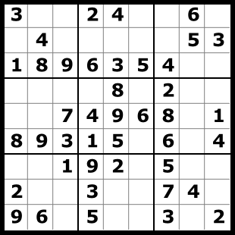
TheoryCoin: How to create money
Everyone tries to solve a puzzle
The first one to solve the puzzle gets 1 TC
The solution of puzzle i defines puzzle i+1

Slide 8
TheoryCoin: How to create money
How long does this puzzle take to solve?
L ∈ {0,1}*
R ∈ {0,1}*
SolvePuzzle(L){
repeat{
R = my_name || i++
T = H(L,R)
}while(T ≠ 0^{d})
return R
}
H
(a random function)
T ∈ {0,1}^{d}
The puzzle: given L, find R
such that T=0^{d}
* aka Proof-of-Work

Slide 9
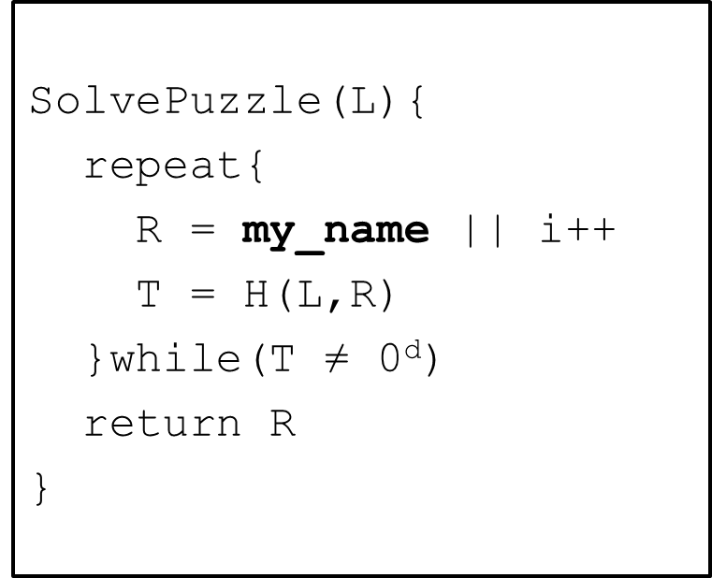
TheoryCoin: (coins to ppl) How to create money
x₀ = Start!
x₁ =(P₁, i₁)
x₂=(P₂, i₁)
x₃=(P₃, i₃)
H
H
H
P₂
x₁
x₂
x3
000…000
000…000
000…000
x₂
P₁
x₁
x₃
P₃
* aka the blockchain

Slide 10
TheoryCoin: How to create money
x₃=(P₃, i₃)
x₆=(P₃, i₆)
x₇=(P₃, i₇)
x₀=Start!
x₁=(P₁, i₁)
x₂=(P₂, i₂)
x₄=(P₄, i₄)
x₅=(P₅, i₅)
The longest current chain is the one that should be worked on, can have small forks but should get winner eventually

Slide 11
TheoryCoin: How to create money
Recap:
Solve the next puzzle → get a coin
To “solve” puzzle i find x_{i} s.t H(x_{i-1},x_{i})=0^{d}
The longest chain defines “next puzzle”
The name in block x_{i} “gets” coin i.

Slide 12
Outline
Part 0: a little history
Part 1: TheoryCoin
How to create coins
How to transfer coins
How to store coins
Part 2: diff( , )
Part 3: Problems and issues

Slide 13
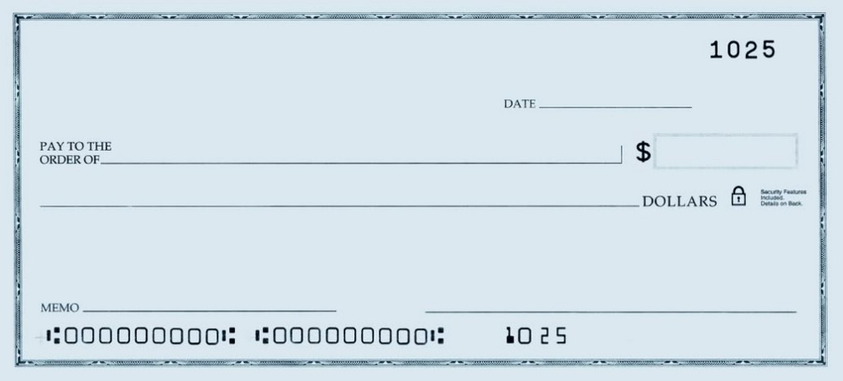
TheoryCoin: How to transfer money
(Digital) Signatures
Only you can sign
Everyone can verify
You cannot deny
Give coin 3 to Jesper
Claudio

Slide 14
TheoryCoin: How to transfer money
Gen
“Your pin code”
“Your username”
secret key
public key
message
message, signature
accept/reject
Sign
Verify

Slide 15
TheoryCoin: How to transfer money
If Ver(pk3,m,s) = accept
and
P3 owns coin 3
then return accept
m=“P3 gives coin 3 to P1”
s=Sig(sk3,m)
P₃
P₁

Slide 16
TheoryCoin: How to transfer money
m1=“P3 gives coin 3 to P1”
s1=Sig(sk3,m1)
P₁
accept
P₃
Nothing to prevent P3 from producing multiple transfers, need way to ensure this is unique
P₂
accept
m2=“P3 gives coin 3 to P2”
s2=Sig(sk3,m2)
* aka double spending

Slide 17
TheoryCoin: How to transfer money
write (m1,s1)
read (m1,s1)
P₁
write (m4,s4)
accept
...
(m1,s1)
...
(m2,s2)
...
(m4,s4)
P₃
write (m2,s2)
read (m2,s2)
P₂
reject
read (m4,s4)
P₄
m1 = “P3 gives coin 3 to P1”
s1 = Sig(sk3,m1)
m2 = “P3 gives coin 3 to P2”
s2 = Sig(sk3,m2)
m4 = “P1 gives coin 3 to P4”
s4 = Sig(sk1,m4)
Such a solution requires a central bulletin board, how can we decentralize?

Slide 18
Outline
Part 0: a little history
Part 1: TheoryCoin
How to create coins
How to transfer coins
How to store coin ownership
Part 2: diff( , )
Part 3: Problems and issues

Slide 19
TheoryCoin: How to store money
Main Idea:
Record transfers in the blockchain

Slide 20
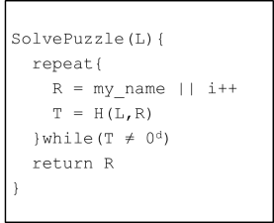
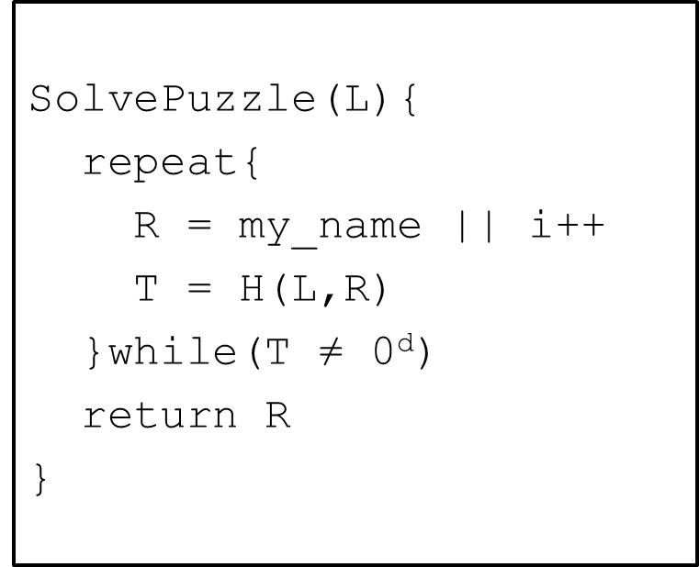
TheoryCoin: How to store money
SolvePuzzle(L,...){
repeat{
R = my_name||(m,s)|| i++
T = H(L,R)
}while(T ≠ 0^{d})
return R
}
P₁
(m,s)
P₃
(m,s)
P₂
(m,s)
P₄
P3 broadcasts transaction, is not accepted until incorporated into block chain
x₄=(P4, (m,s), i₄)

Slide 21
Preventing double spending
The receiver wants to be sure that transaction is part of the “final” blockchain and cannot be undone
x₃=(P₃, i₃)
x₆=(P₃, i₆)
x₇=(P₃, i₇)
x₀=Start!
x₁=(P₁, i₁)
x₂=(P₂, i₂)
x₄=(P₄, i₄)
x₅=(P₅, i₅)
Wait to accept until transaction is several blocks back in the chain
Adversary’s ability to rewrite blocks decreases exponentially with number of blocks IF they control less than 50% of processing

Slide 22
Outline
Part 0: a little history
Part 1: TheoryCoin
How to create coins
How to transfer coins
How to store coins
Part 2: diff( , )
Part 3: Problems and issues

Slide 23
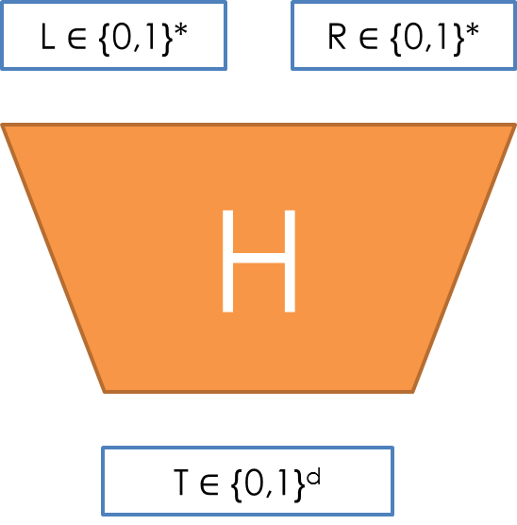
diff( , ) How is money created in Bitcoin?
New block every ~10 mins
d adjusted every ~2000 blocks
H = 2-SHA2
Initial reward: 50 BTC
Halved every ~4 years (now 6 BTC)
http://www.bitcoinblockhalf.com/

Slide 24
diff( , ) How is money transferred in Bitcoin?
Example: P1 wants to give 60 to P2
P1 gives 60 to P2
P2 gives 42 to P3
... gives 50 to P1
P2 gives 17 to P2
P1 gives 14 to P1
… gives 25 to P1
Transaction fee 1
Transaction fee 1
Transaction fee is given to miner (will be only incentive when 21 million produced)

Slide 25
diff( , ) How is money stored in Bitcoin?
Transaction in orphaned blocks are invalid
Wait 6 blocks (~1 hour) before accepting transaction.
What are the consequences of this?
Checkpoints to prevent complete history rollback.
All transaction are stored in the blockchain
(Currently ~14 GB)

Slide 26
Outline
Part 0: a little history
Part 1: TheoryCoin
How to create coins
How to transfer coins
How to store coins
Part 2: diff( , )
Part 3: Problems and issues

Slide 27
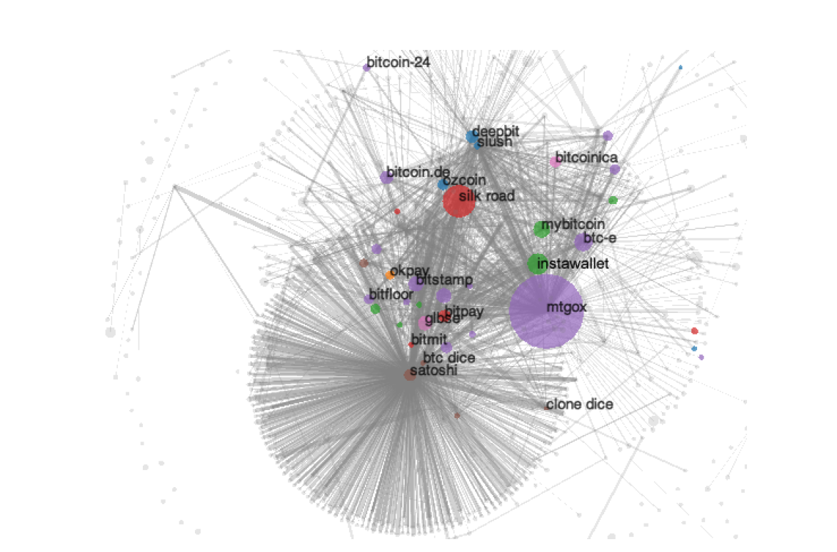
Anonymity?
Problem:
Every transaction ever made is recorded forever
Solution?
Use new identity for each transaction
How to transfer bitcoins between identities?
But:
Heuristics allow to cluster identities
Anonymous alternatives:
Zerocoin, Zerocash…

Slide 28
Users? (and their devices)
Unfortunate property of DSA
This address
1HKywxiL4JziqXrzLKhmB6a74ma6kxbSDj
probably stole around $48,000 this way
(due to bug in Android Java based random generator)
Sig(sk,m1,r)
Extractor
sk
Sig(sk,m2,r)

Slide 29
Programmable money?
“Bitcoin uses a scripting system for transactions. Forth-like, Script is simple, stack-based, and processed from left to right. It is purposefully not Turing-complete, with no loops.”
E.g., “P1 gives 1 BTC to P2 if at least 2 out of (P1,P2,P3) sign this transaction”
Functionality: more than money?
Security: malware payments?

Slide 30
Mining pools
Solving puzzles (mining) is hard!
Miners join pools and share work/reward
How to optimally split work?
Mechanism design?
rational miner?
how to allocate reward?

Slide 31
Legality?
Many countries claim exclusive right to produce money
Bitcoin may become a problem as government may lose out on taxes
https://en.wikipedia.org/wiki/Legality_of_bitcoin_by_country
In the US currently considered a commodity (similar to gold, silver, etc.)
Mining is subject to self employment tax
Some states are trying to regulate
Legal status still very much in the air

Slide 32
Sources:
Learn about signatures/ecash/cryptography at csaudk https://services.brics.dk/java/courseadmin/crypto/ https://services.brics.dk/java/courseadmin/cpt https://services.brics.dk/java/courseadmin/CryCom
Story of Chaum and DigiCash (to be taken with a grain of salt) http://cryptome.org/jya/digicrash.htm
Bitcoin paper and announcement http://article.gmane.org/gmane.comp.encryption.general/12588/ http://www.mail-archive.com/cryptography@metzdowd.com/msg10142.html
This pizza cost 750,000 usd http://motherboard.vice.com/blog/this-pizza-is-worth-750000
Lily Allen turns down btcs https://twitter.com/lilyallen/statuses/419942070770741249
Signature attack http://eprint.iacr.org/2013/734
Deanonymizing http://cseweb.ucsd.edu/~smeiklejohn/files/imc13.pdf http://eprint.iacr.org/2012/584
Zerocoin/Zerocash http://zerocoin.org/
Graphs, stats etc www.blockchain.info
Comparison with Altcoins http://www.coinwarz.com/cryptocurrency
Bitcoin stolen from TV http://nymag.com/daily/intelligencer/2013/12/bloomberg-anchors-christmas-bitcoin-gets-stolen.html
Visa/Mastercard vs Wikileaks http://www.forbes.com/sites/andygreenberg/2010/12/07/visa-mastercard-move-to-choke-wikileaks/
Not in the talk, but very interesting:
Silkroad essentials http://exitevent.com/privacy-tor-btc-and-what-the-silk-road-crackdown-means-to-you-131112.asp http://arstechnica.com/tech-policy/2013/10/how-the-feds-took-down-the-dread-pirate-roberts/ http://pando.com/2014/01/02/with-130m-of-bitcoin-wealth-and-plans-to-sell-the-fbi-could-rattle-the-virtual-currency-cage
The value overflow bug https://en.bitcoin.it/wiki/Common_Vulnerabilities_and_Exposures#CVE-2010-5139
The March 2013 chain fork https://bitcoin.org/en/alert/2013-03-11-chain-fork
Buggy transaction, mistery miner https://blockchain.info/tx-index/3618498/4005d6bea3a93fb72f006d23e2685b85069d270cb57d15f0c057ef2d5e3f78 https://bitcointalk.org/index.php?topic=67634.0
The problem with “checkpointed” bitcoin http://www.links.org/files/decentralised-currencies.pdf
This presentation contains copyrighted images the use of which has not always been specifically authorized by the copyright owner. I am making the material available for educational purposes only and I believe this constitutes a 'fair use'.

