Slide 1
CSE 4905
Denial of Service Attacks

Slide 2
Denial-of-Service (DoS) Attack
The NIST Computer Security Incident Handling Guide defines a DoS attack as:
“An action that prevents or impairs the authorized use of networks, systems, or applications by exhausting resources such as CPU, memory, bandwidth, or disk space.”
Notes:
Denial of service is a form of attack on the availability of some service. In the context
of computer and communications security, the focus is generally on network
services that are attacked over their network connection. We distinguish this form
of attack on availability from other attacks, such as the classic acts of god, that
cause damage or destruction of IT infrastructure and consequent loss of service.
The NIST Computer Security Incident Handling Guide [SCAR08] defines
denial-of-service (DoS) attack as follows:
A denial of service (DoS) is an action that prevents or impairs the authorized
use of networks, systems, or applications by exhausting resources such as central
processing units (CPU), memory, bandwidth, and disk space.

Slide 3
Denial-of-Service (DoS)
A form of attack on the availability of some service
Categories of resources that could be attacked are:
  Network bandwidth: try to reach the capacity of the network links connecting a server to external Internet
  System resources: try to overload or crash network handling software (e.g., buffer, tables of open connections, …)
  Application resources: try to crash a specific application, e.g., web server
Notes:
From this definition, you can see that there are several categories of resources
that could be attacked:
• Network bandwidth
• System resources
• Application resources
Network bandwidth relates to the capacity of the network links connecting a server
to the wider Internet. For most organizations, this is their connection to their Internet
service provider (ISP), as shown in the example network in Figure 7.1. Usually this
connection will have a lower capacity than the links within and between ISP routers.
This means it is possible for more traffic to arrive at the ISP’s routers over these
higher-capacity links than can be carried over the link to the organization. In this
circumstance, the router must discard some packets, delivering only as many as can
be handled by the link. In normal network operation such high loads might occur
to a popular server experiencing traffic from a large number of legitimate users. A
random portion of these users will experience a degraded or nonexistent service as
a consequence. This is expected behavior for an overloaded TCP/IP network link.
In a DoS attack, the vast majority of traffic directed at the target server is malicious,
generated either directly or indirectly by the attacker. This traffic overwhelms
any legitimate traffic, effectively denying legitimate users access to the server. Some
recent high volume attacks have even been directed at the ISP network supporting
the target organization, aiming to disrupt its connections to other networks. A number
of recent DDoS attacks are listed in [AROR11], with comments on their growth
in volume and impact.
A DoS attack targeting system resources typically aims to overload or crash its
network handling software. Rather than consuming bandwidth with large volumes
of traffic, specific types of packets are sent that consume the limited resources available
on the system. These include temporary buffers used to hold arriving packets,
tables of open connections, and similar memory data structures. The SYN spoofing
attack, which we discuss next, is of this type. It targets the table of TCP connections
on the server.
Another form of system resource attack uses packets whose structure triggers
a bug in the system’s network handling software, causing it to crash. This means the
system can no longer communicate over the network until this software is reloaded,
generally by rebooting the target system. This is known as a poison packet . The
classic ping of death and teardrop attacks, directed at older Windows 9x systems,
were of this form. These targeted bugs in the Windows network code that handled
ICMP (Internet Control Message Protocol) echo request packets and packet fragmentation,
respectively.
An attack on a specific application, such as a Web server, typically involves a
number of valid requests, each of which consumes significant resources. This then
limits the ability of the server to respond to requests from other users. For example,
a Web server might include the ability to make database queries. If a large,
costly query can be constructed, then an attacker could generate a large number of
these that severely load the server. This limits its ability to respond to valid requests
from other users. This type of attack is known as a cyberslam . [KAND05] discusses
attacks of this kind, and suggests some possible countermeasures. Another
alternative is to construct a request that triggers a bug in the server program, causing
it to crash. This means the server is no longer able to respond to requests until
it is restarted.
DoS attacks may also be characterized by how many systems are used to direct
traffic at the target system. Originally only one, or a small number of source systems
directly under the attacker’s control, was used. This is all that is required to send the
packets needed for any attack targeting a bug in a server’s network handling code or
some application. Attacks requiring high traffic volumes are more commonly sent
from multiple systems at the same time, using distributed or amplified forms of DoS
attacks. We discuss these later in this chapter.

Slide 4
Notes:
Figure 7.1
Example Network to Illustrate DoS Attacks

Slide 5
Classic DoS Attacks
Flooding ping command
  overwhelm the capacity of the network connection to the target organization
  packets are discarded as capacity decreases
  Source of the attack is clearly identified unless a spoofed address is used
  Network performance is noticeably affected
Notes:
The simplest classical DoS attack is a flooding attack on an organization. The aim
of this attack is to overwhelm the capacity of the network connection to the target
organization. If the attacker has access to a system with a higher-capacity network
connection, then this system can likely generate a higher volume of traffic than the
lower-capacity target connection can handle. For example, in the network shown
in Figure 7.1 , the attacker might use the large company’s Web server to target the
medium-sized company with a lower-capacity network connection. The attack might
be as simple as using a flooding ping command directed at the Web server in the
target company. This traffic can be handled by the higher-capacity links on the path
between them, until the final router in the Internet cloud is reached. At this point
some packets must be discarded, with the remainder consuming most of the capacity
on the link to the medium-sized company. Other valid traffic will have little chance
of surviving discard as the router responds to the resulting congestion on this link.
In this classic ping flood attack, the source of the attack is clearly identified
since its address is used as the source address in the ICMP echo request packets. This
has two disadvantages from the attacker’s perspective. First, the source of the attack
is explicitly identified, increasing the chance that the attacker can be identified and
legal action taken in response. Second, the targeted system will attempt to respond to
the packets being sent. In the case of any ICMP echo request packets received by the
server, it would respond to each with an ICMP echo response packet directed back
to the sender. This effectively reflects the attack back at the source system. Since
the source system has a higher network bandwidth, it is more likely to survive this
reflected attack. However, its network performance will be noticeably affected, again
increasing the chances of the attack being detected and action taken in response. For
both of these reasons the attacker would like to hide the identity of the source system.
This means that any such attack packets need to use a falsified, or spoofed, address.

Slide 6
Source Address Spoofing
Use forged source addresses
  Usually via the raw socket interface on operating systems
  Makes attacking systems harder to identify
Attacker generates large volumes of packets that have the target system as the destination address
Lead to congestion in the router connected to the final, lower capacity link
Requires network engineers to specifically query flow information from their routers
Backscatter traffic
  Responses to attacks scattered across the Internet
Notes:
A common characteristic of packets used in many types of DoS attacks is the use
of forged source addresses. This is known as source address spoofing. Given sufficiently
privileged access to the network handling code on a computer system, it
is easy to create packets with a forged source address (and indeed any other attribute
that is desired). This type of access is usually via the raw socket interface on
many operating systems. This interface was provided for custom network testing
and research into network protocols. It is not needed for normal network operation.
However, for reasons of historical compatibility and inertia, this interface has been
maintained in many current operating systems. Having this standard interface available
greatly eases the task of any attacker trying to generate packets with forged
attributes. Otherwise an attacker would most likely need to install a custom device
driver on the source system to obtain this level of access to the network, which is
much more error prone and dependent on operating system version.
Given raw access to the network interface, the attacker now generates large
volumes of packets. These would all have the target system as the destination
address but would use randomly selected, usually different, source addresses for
each packet. Consider the flooding ping example from the previous section. These
custom ICMP echo request packets would flow over the same path from the source
toward the target system. The same congestion would result in the router connected
to the final, lower capacity link. However, the ICMP echo response packets, generated
in response to those packets reaching the target system, would no longer
be reflected back to the source system. Rather they would be scattered across the
Internet to all the various forged source addresses. Some of these addresses might
correspond to real systems. These might respond with some form of error packet,
since they were not expecting to see the response packet received. This only adds to
the flood of traffic directed at the target system. Some of the addresses may not be
used or may not reachable. For these, ICMP destination unreachable packets might
be sent back. Or these packets might simply be discarded. Any response packets
returned only add to the flood of traffic directed at the target system.
Also, the use of packets with forged source addresses means the attacking
system is much harder to identify. The attack packets seem to have originated at
addresses scattered across the Internet. Hence, just inspecting each packet’s header
is not sufficient to identify its source. Rather the flow of packets of some specific
form through the routers along the path from the source to the target system must
be identified. This requires the cooperation of the network engineers managing all
these routers and is a much harder task than simply reading off the source address.
It is not a task that can be automatically requested by the packet recipients. Rather
it usually requires the network engineers to specifically query flow information
from their routers. This is a manual process that takes time and effort to organize.
It is worth considering why such easy forgery of source addresses is allowed on
the Internet. It dates back to the development of TCP/IP, which occurred in a generally
cooperative, trusting environment. TCP/IP simply does not include the ability,
by default, to ensure that the source address in a packet really does correspond with
that of the originating system. It is possible to impose filtering on routers to ensure
this (or at least that source network address is valid). However, this filtering needs
to be imposed as close to the originating system as possible, where the knowledge
of valid source addresses is as accurate as possible. In general, this should occur at
the point where an organization’s network connects to the wider Internet, at the
borders of the ISP’s providing this connection. Despite this being a long-standing
security recommendation to combat problems such as DoS attacks, many ISPs
do not implement such filtering. As a consequence, attacks using spoofed-source
packets continue to occur frequently.
There is a useful side effect of this scattering of response packets to some
origi nal flow of spoofed-source packets. Security researchers, such as those with the
Honeynet Project, have taken blocks of unused IP addresses, advertised routes to
them, and then collected details of any packets sent to these addresses. Since no real
systems use these addresses, no legitimate packets should be directed to them. Any
packets received might simply be corrupted. It is much more likely, though, that
they are the direct or indirect result of network attacks. The ICMP echo response
packets generated in response to a ping flood using randomly spoofed source
addresses is a good example. This is known as backscatter traffic . Monitoring the
type of packets gives valuable information on the type and scale of attacks being
used, as described by [MOOR06], for example. This information is being used to
develop responses to the attacks being seen.

Slide 7
SYN Spoofing
Common DoS attack
Attacks the ability of a server to respond to future connection requests by overflowing the tables used to manage them
Thus legitimate users are denied access to the server
Hence an attack on system resources, specifically the network handling code in the operating system
Notes:
Along with the basic flooding attack, the other common classic DoS attack is the
SYN spoofing attack. This attacks the ability of a network server to respond to TCP
connection requests by overflowing the tables used to manage such connections.
This means future connection requests from legitimate users fail, denying them
access to the server. It is thus an attack on system resources, specifically the network
handling code in the operating system.

Slide 8
Notes:
To understand the operation of these attacks, we need to review the three-way
handshake that TCP uses to establish a connection. This is illustrated in Figure 7.2 .
The client system initiates the request for a TCP connection by sending a SYN packet
to the server. This identifies the client’s address and port number and supplies an
initial sequence number. It may also include a request for other TCP options. The
server records all the details about this request in a table of known TCP connections.
It then responds to the client with a SYN-ACK packet. This includes a sequence
number for the server and increments the client’s sequence number to confirm receipt
of the SYN packet. Once the client receives this, it sends an ACK packet to the server
with an incremented server sequence number and marks the connection as established.
Likewise, when the server receives this ACK packet, it also marks the connection
as established. Either party may then proceed with data transfer. In practice, this
ideal exchange sometimes fails. These packets are transported using IP, which is an
unreliable, though best-effort, network protocol. Any of the packets might be lost in
transit, as a result of congestion, for example. Hence both the client and server keep
track of which packets they have sent and, if no response is received in a reasonable
time, will resend those packets. As a result, TCP is a reliable transport protocol, and
any applications using it need not concern themselves with problems of lost or reordered
packets. This does, however, impose an overhead on the systems in managing
this reliable transfer of packets.

Slide 9
Notes:
A SYN spoofing attack exploits this behavior on the targeted server system.
The attacker generates a number of SYN connection request packets with forged
source addresses. For each of these the server records the details of the TCP connection
request and sends the SYN-ACK packet to the claimed source address,
as shown in Figure 7.3 . If there is a valid system at this address, it will respond
with a RST (reset) packet to cancel this unknown connection request. When the
server receives this packet, it cancels the connection request and removes the saved
information. However, if the source system is too busy, or there is no system at the
forged address, then no reply will return. In these cases the server will resend the
SYN-ACK packet a number of times before finally assuming the connection request
has failed and deleting the information saved concerning it. In this period between
when the original SYN packet is received and when the server assumes the request
has failed, the server is using an entry in its table of known TCP connections. This
table is typically sized on the assumption that most connection requests quickly
succeed and that a reasonable number of requests may be handled simultaneously.
However, in a SYN spoofing attack, the attacker directs a very large number of
forged connection requests at the targeted server. These rapidly fill the table of
known TCP connections on the server. Once this table is full, any future requests,
including legitimate requests from other users, are rejected. The table entries will
time out and be removed, which in normal network usage corrects temporary
overflow problems. However, if the attacker keeps a sufficient volume of forged
requests flowing, this table will be constantly full and the server will be effectively
cut off from the Internet, unable to respond to most legitimate connection requests.
In order to increase the usage of the known TCP connections table, the
attacker ideally wishes to use addresses that will not respond to the SYN-ACK with
a RST. This can be done by overloading the host that owns the chosen spoofed
source address, or by simply using a wide range of random addresses. In this case,
the attacker relies on the fact that there are many unused addresses on the Internet.
Consequently, a reasonable proportion of randomly generated addresses will not
correspond to a real host.
There is a significant difference in the volume of network traffic between a
SYN spoof attack and the basic flooding attack we discussed. The actual volume of
SYN traffic can be comparatively low, nowhere near the maximum capacity of the
link to the server. It simply has to be high enough to keep the known TCP connections
table filled. Unlike the flooding attack, this means the attacker does not need
access to a high-volume network connection. In the network shown in Figure 7.1 ,
the medium-sized organization, or even a broadband home user, could successfully
attack the large company server using a SYN spoofing attack.

Slide 10
SYN Flooding Attack
S
SYN_{C1}
Listening…
SYN_{C2}
Spawn a new thread,
store connection data
SYN_{C3}
… and more
SYN_{C4}
… and more
SYN_{C5}
… and more
… and more
… and more

Slide 11
Flooding Attacks
Classified based on network protocol used
Intent is to overload the network capacity on some link to a server or the server itself
Virtually any type of network packet can be used
  ICMP (e.g., ping) flooding
    Some ICMP packets are filtered by firewall, some have to be kept for normal TCP/IP behavior
  UDP flood
  TCP SYN flood
  Normal TCP packets
  …
Notes:
Flooding attacks take a variety of forms, based on which network protocol is being
used to implement the attack. In all cases the intent is generally to overload the
network capacity on some link to a server. The attack may alternatively aim to
overload the server’s ability to handle and respond to this traffic. These attacks flood
the network link to the server with a torrent of malicious packets competing with, and
usually overwhelming, valid traffic flowing to the server. In response to the congestion
this causes in some routers on the path to the targeted server, many packets will be
dropped. Valid traffic has a low probability of surviving discard caused by this flood
and hence of accessing the server. This results in the server’s ability to respond to
network connection requests being either severely degraded or failing entirely.
Virtually any type of network packet can be used in a flooding attack. It simply
needs to be of a type that is permitted to flow over the links toward the targeted system,
so that it can consume all available capacity on some link to the target server. Indeed,
the larger the packet, the more effective is the attack. Common flooding attacks use
any of the ICMP, UDP, or TCP SYN packet types. It is even possible to flood with
some other IP packet type. However, as these are less common and their usage more
targeted, it is easier to filter for them and hence hinder or block such attacks.
The ping flood using ICMP echo request packets we discuss in Section 7.1 is a classic
example of an ICMP flooding attack. This type of ICMP packet was chosen since
traditionally network administrators allowed such packets into their networks, as
ping is a useful network diagnostic tool. More recently, many organizations have
restricted the ability of these packets to pass through their firewalls. In response,
attackers have started using other ICMP packet types. Since some of these should
be handled to allow the correct operation of TCP/IP, they are much more likely to
be allowed through an organization’s firewall. Filtering some of these critical ICMP
packet types would degrade or break normal TCP/IP network behavior. ICMP
destination unreachable and time exceeded packets are examples of such critical
packet types.
An attacker can generate large volumes of one of these packet types. Because
these packets include part of some notional erroneous packet that supposedly
caused the error being reported, they can be made comparatively large, increasing
their effectiveness in flooding the link.
An alternative to using ICMP packets is to use UDP packets directed to some port
number, and hence potential service, on the target system. A common choice was a
packet directed at the diagnostic echo service, commonly enabled on many server
systems by default. If the server had this service running, it would respond with a
UDP packet back to the claimed source containing the original packet data contents.
If the service is not running, then the packet is discarded, and possibly an
ICMP destination unreachable packet is returned to the sender. By then the attack
has already achieved its goal of occupying capacity on the link to the server. Just
about any UDP port number can be used for this end. Any packets generated in
response only serve to increase the load on the server and its network links.
Spoofed source addresses are normally used if the attack is generated using
a single source system, for the same reasons as with ICMP attacks. If multiple systems
are used for the attack, often the real addresses of the compromised, zombie,
systems are used. When multiple systems are used, the consequences of both the
reflected flow of packets and the ability to identify the attacker are reduced.
This attack could also use TCP data packets, which would be rejected by the
server as not belonging to any known connection. But again, by this time the attack
has already succeeded in flooding the links to the server.
All of these flooding attack variants are limited in the total volume of traffic
that can be generated if just a single system is used to launch the attack. The use
of a single system also means the attacker is easier to trace. For these reasons, a
variety of more sophisticated attacks, involving multiple attacking systems, have
been developed. By using multiple systems, the attacker can significantly scale up
the volume of traffic that can be generated. Each of these systems need not be particularly
powerful or on a high-capacity link. But what they don’t have individually,
they more than compensate for in large numbers. Also, by directing the attack
through intermediaries, the attacker is further distanced from the target and significantly
harder to locate and identify.

Slide 12
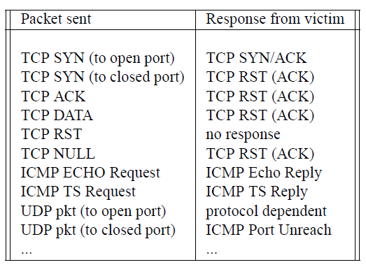
Sample victim response to attacks

Slide 13
NTP Amplification Attack
[Vitaly Shmatikov]
x206 amplification
“Give me the addresses of the
last 600 machines you talked to”
Spoofed SrcIP: DoS target
(234 bytes)
600 addresses
(49,000 bytes)
DoS
Source
NTP
(Network Time Protocol)
server
DoS
Target
December 2013 – February 2014:
400 Gbps DDoS attacks involving 4,529 NTP servers
Reflection attack/Amplification: small query → large response

Slide 14
DNS Amplification Attack
[Vitaly Shmatikov]
x50 amplification
EDNS response
(3000 bytes)
DNS query
SrcIP: DoS Target
(60 bytes)
DoS
Source
DNS
Server
DoS
Target
EDNS: DNS extension that allows large DNS messages, or using or DNSSec to increase message size

Slide 15
Distributed Denial of Service (DDoS) Attacks
Use multiple systems to generate attacks
Attacker uses a flaw in operating system or in a common application to gain access and installs their program on it (zombie)
Attacker can control large collections of such compromised systems, forming a botnet

Slide 16
DDoS attack programs
Tribe Flood Network (TFN)
  By Mixter, 1990s exploited in Sun Solaris
Tribe Flood Network 2000 (TFN2K)
  Rewritten from TFN
  Can run on Unix, Solaris, Windows NT
Attack architecture: 2-layer
  Agent: Trojan program copied to and run on compromised systems
  Handler: command-line program that run compromised systems
  Communication between handler and agent: encrypted, intermixed with decoy packets, using TCP, UDP or ICMP

Slide 17
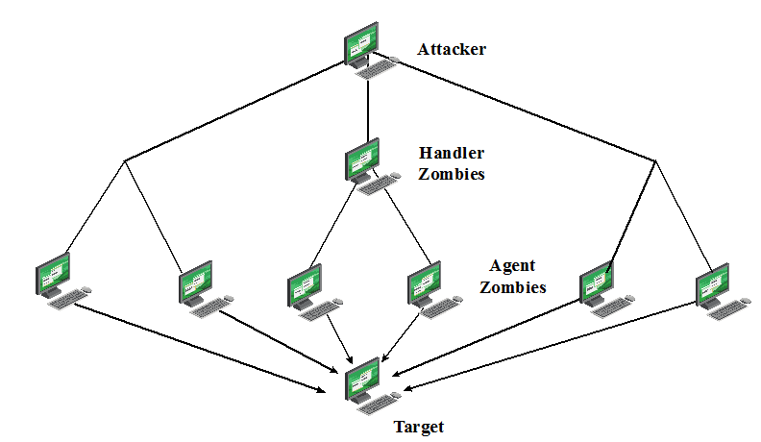
DDoS attack architecture
Handler
zombies
Handler
zombies

Slide 18
Prevalence of DDoS
How prevalent are DDoS attacks in the Internet?
  Reports from Computer Emergency Reponse Team (CERT) 1989 – 1995
  CERT→ AIR-CERT
  News reports: only major incidents
  Service providers and content providers consider data sensitive and private
  Surveys from security personnels
  Other approaches?

Slide 19
D. Moore, G. Voelker, S. Savage
Inferring
Internet Denial-of-Service Activity
(USENIX Security 2001)

Slide 20
Backscatter
[Moore, Voelker, Savage]
Attacker uses spoofed, randomly selected source IP addresses
Victim replies to spoofed source IP
Results in unsolicited response from victim to third-party IP addresses

Slide 21
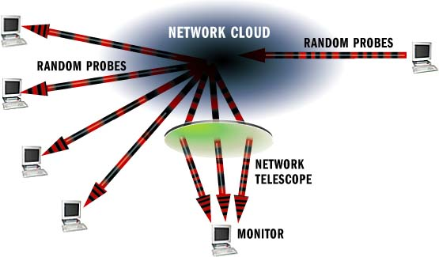
How a Network Telescope Works
[Moore, Voelker, Savage]

Slide 22

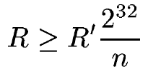
Backscatter Analysis
[Moore, Voelker, Savage]
m attack packets sent
n distinct IP addresses monitored by telescope
Assume attacker chooses source addresses uniformly, expectation of observing an attack:
R’ = measured rate of attack (pkts per second),
R = extrapolated attack rate (pkts per second)

Slide 23
Analysis Assumptions
Address uniformity
  Spoofed addresses are random, uniformly distributed
Reliable delivery
  Attack and backscatter traffic delivered reliably
Backscatter hypothesis
  Unsolicited packets observed represent backscatter

Slide 24
Data Collection
/8 network 2^24 addresses 1/256 of Internet address space

Slide 25
Attack classification
Flow-based analysis
  Classifying individual attacks (how many, how long, what kind)
  Flow: series of consecutive packets that share the same target IP address and IP protocol
  End of flow: no packet within 5 minutes
  Only consider flows that is at least 60 seconds long with at least 100 packets
Event-based analysis
  Understand severity of attacks on short time scales
  Attack event: a victim emitting at least 10 backscatter packets in one minute

Slide 26
Flow-based analysis (more details)
Extract info from each flow
  TCP flag settings (e.g., SYN/ACKs, RSTs)
  ICMP payload
  Address uniformity:
  Port settings: fixed, uniform, or not
  DNS information: DNS address of source address (or victim address)
  Routing info: prefix, mask, or orign AS as registered in local BGP table

Slide 27
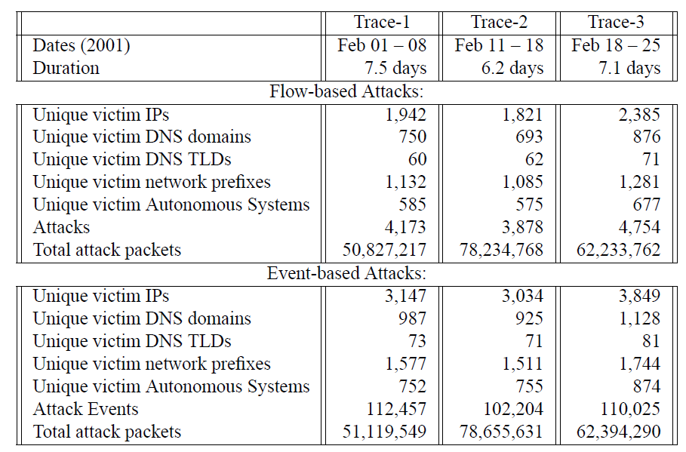
Summary results
[Moore, Voelker, Savage]

Slide 28
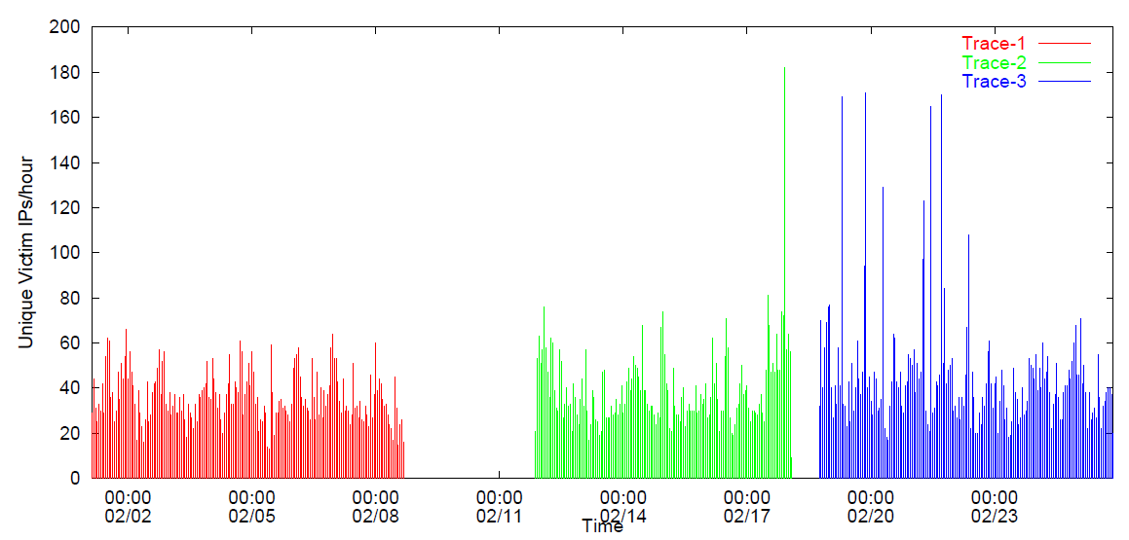
Rate of attacks

Slide 29
Response protocols
[Moore, Voelker, Savage]

Slide 30
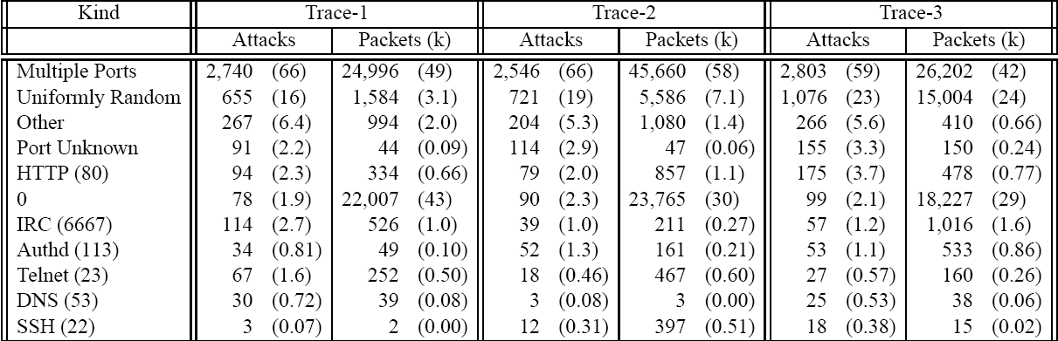
Victims by Port
[Moore, Voelker, Savage]

Slide 31
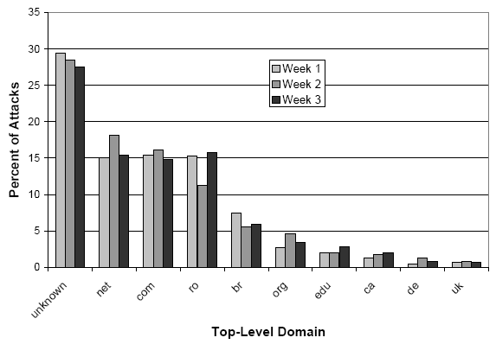
Victims by Top-Level Domain
[Moore, Voelker, Savage]

Slide 32
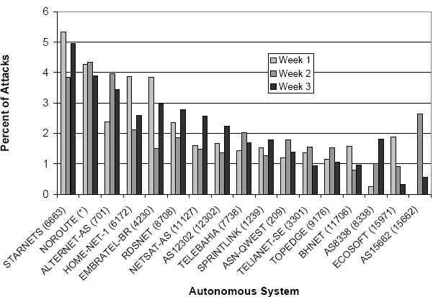
Victims by Autonomous System
[Moore, Voelker, Savage]

Slide 33
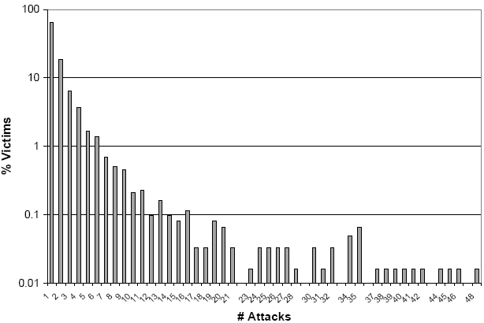
Repeated Attacks
[Moore, Voelker, Savage]
65% victims attacked once, 18% victims attacked twice
One attacked 102 times in one week

Slide 34
Conclusions of the [MSV01] study
[Moore, Voelker, Savage]
Observed 12,000 attacks against more than 5,000 distinct targets.
Distributed over many different domains and ISPs
Small number of long attacks with large % of attack volume
Unexpected number of attacks targeting home machines (based on DNS names), a few foreign countries, specific ISPs

Slide 35
Defense against DoS attacks
These attacks cannot be prevented entirely
High traffic volumes may be legitimate
  High publicity about a specific site
  Activity on a very popular site
Four lines of defense
  Attack prevention and preemption (before attack)
  Attack detection and filtering (during attack)
  Attack source traceback and identification (during and after attack)
  Attack reaction (after attack, eliminate or curtail the effects of attacks)

Slide 36
Preventing DoS attacks
Block source
  On routers as close to source as possible
  e.g., by ISP that knows that address block assigned to customers
Use filters to ensure path back to the claimed source address is the one being used by the current packet
SYN cookies
  simple defense again SYN flooding and SYN spoofing attacks
  D. Bernstein, 1996

Slide 37
SYN Flooding Attack
S
SYN_{C1}
Listening…
SYN_{C2}
Spawn a new thread,
store connection data
SYN_{C3}
… and more
SYN_{C4}
… and more
SYN_{C5}
… and more
… and more
… and more

Slide 38
SYN cookie: main idea
DoS is caused by asymmetric state allocation
  server opens new state for each connection attempt
  attacker can initiate thousands of connections from bogus IP addresses to exhaust server resources
Cookies: make server stateless until initiator produced at least two messages
  Server’s state (IP addresses and ports of the con-nection) is stored in a cookie and sent to initiator
  After initiator responds, cookie is regenerated and compared with the cookie returned by the initiator

Slide 39
SYN Cookies
[Bernstein and Schenk]
C
S
SYN_{C}
Listening…
Compatible with standard TCP;
simply a “weird” sequence number
SYN_{S}, ACK_{C}
sequence # = cookie
Does not store state
F(source addr, source port,
dest addr, dest port,
coarse time, server secret)
Cookie must be unforgeable
and tamper-proof (why?)
F=Rijndael or crypto hash
ACK_{S}
sequence # = cookie+1
Recompute cookie,
compare with the received
cookie, only establish
connection if they match
More info: http://cr.yp.to/syncookies.html

Slide 40
Preventing DDoS attacks (II)
Block suspicious services and combinations
Manage application attacks with a form of graphical puzzle (captcha)
  distinguish legitimate human requests and automated requests
Good general system security practices
Use mirrored and replicated servers when high-performance and reliability is required

Slide 41
Responding to DDoS attacks
Good Incident Response Plan
  Details on how to contact technical personnel in ISP
  Details of how to respond to the attack
Should implement antispoofing and rate limiting filters
Ideally have network monitors and IDS to detect and notify abnormal traffic patterns
Identify type of attacks to decide best response strategies
Have ISP trace packet flow back to source
Switch to alternate backup servers

Slide 42
Summary
Denial-of-service (DoS) attacks
  Classical DoS attacks
  Flooding DoS attacks
Measuring prevalence of DoS attacks in the Internet using network “telescopes”
Defenses against DoS attacks
Notes:
Chapter 7 summary.

