Slide 1
CSE 4905 Internet Worms based on slides of Vitaly Shmatikov

Slide 2
Viruses vs. Worms
Virus
Propagates by infecting other programs
Usually inserted into host code (not a standalone program)
Worms
Propagates automatically by copying itself to target systems
A standalone program

Slide 3
Virus
Piece of software that infects programs
Modifies them to include a copy of the virus
Replicates and goes on to infect other programs
Easily spread through network environments
When attached to an executable program, a virus can do anything that the program is permitted to do
Executes secretly when the host program is run
Specific to operating system and hardware
Takes advantage of their details and weaknesses
Phases: dormant, propagation, triggering, and execution

Slide 4
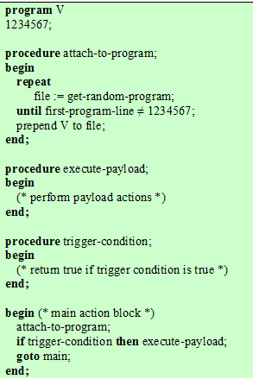
A simple virus

Slide 5
Worms
Program that actively seeks out more machines to infect; each infected machine serves as an automated launching pad for attacks on other machines
Exploits software vulnerabilities in client or server programs
Can use network connections to spread from system to system
Spreads through shared media (USB drives, CD, DVD data disks)
E-mail worms spread in macro or script code included in attachments and instant messenger file transfers

Slide 6
Pseudocode of Witty worm
srand(get_tick_count())
for(i=0; i<20,000; i++)
destIP ← rand()_{[0..15]} || rand()_{[0..15]}
destPort ← rand()_{[0..15]}
packetSize ← 768 + rand()_{[0..8]}
packetContents ← top of stack
send packet to destIP/destPort
if(open(physicaldisk,rand()_{[13..15]}))
write(rand()_{[0..14]} || 0x4E20); goto 1;
9. else goto 2

Slide 7
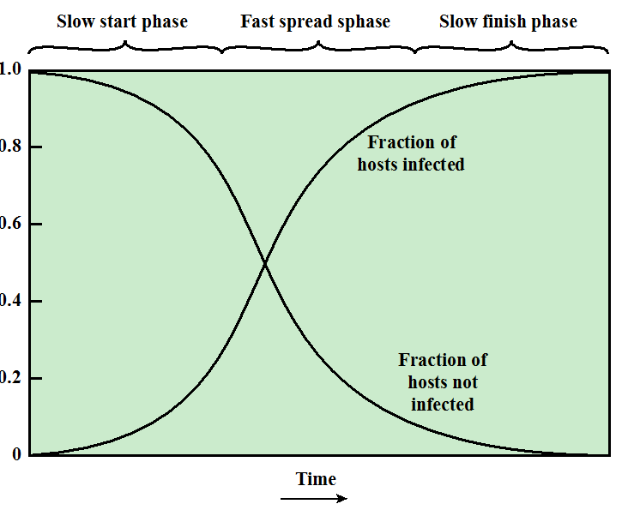
Worm propagation model
Similar to epidemic model:
Can be modeled using ODE (Ordinary Differential Equations)

Slide 8
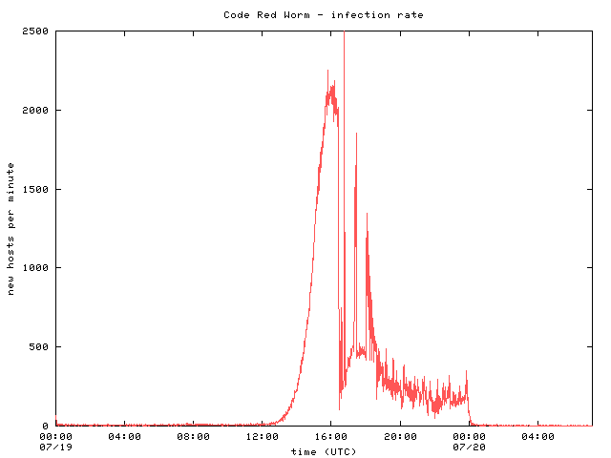
Code Red infection rate
8

Slide 9
1988 Morris Worm
No malicious payload, but bogged down infected machines by uncontrolled spawning
Infected 10% of all Internet hosts at the time
Multiple propagation vectors
Remote execution using rsh and cracked passwords
Tried to crack passwords using a small dictionary and publicly readable password file; targeted hosts from /etc/hosts.equiv
Buffer overflow in fingerd on VAX
Standard stack smashing exploit
DEBUG command in Sendmail
In early Sendmail, can execute a command on a remote machine by sending an SMTP (mail transfer) message

Slide 10
Understanding witty worm via network “telescopes”

Slide 11
A. Kumar, V. Paxson, N. Weaver Outwitting the Witty Worm: Exploiting Underlying Structure for Detailed Reconstruction of an Internet-scale Event (IMC 2005)
Reference

Slide 12
Goals
Understand the behavior of one specific worm (witty worm)
Understand its propagation and its impact on Internet
Network “telescopes” as tools for observing Internet-scale events

Slide 13
Witty Worm
Exploits buffer overflow in the ICQ analyzer in ISS (Internet Security Systems)
ICQ packet: UDP packet with source port 4000
Analyzer copies packet to fixed-size buffer
standard stack smash
Deletes randomly chosen sectors of hard drive
Payload contains “(^.^ insert witty message here ^.^)”
Chronology of Witty
Mar 18, 2004: high-level description published
36 hours later: worm released
75 mins later: all12,000 vulnerable machines infected!

Slide 14
Pseudocode of Witty (1)
srand(get_tick_count())
for(i=0; i<20,000; i++)
destIP ← rand()_{[0..15]} || rand()_{[0..15]}
destPort ← rand()_{[0..15]}
packetSize ← 768 + rand()_{[0..8]}
packetContents ← top of stack
send packet to destIP/destPort
if(open(physicaldisk,rand()_{[13..15]}))
write(rand()_{[0..14]} || 0x4E20); goto 1;
9. else goto 2
Seed pseudo-random generator
Each Witty packet contains
bits from 4 consecutive
pseudo-random numbers

Slide 15
Witty’s PRNG
Witty uses linear congruential generator to generate pseudo-random addresses
X_{i+1} = A * X_{i} + B mod M
Witty: A = 214013, B = 2531011, M = 2³², orbit is a complete permutation (every 32-bit integer is generated exactly once)
Can reconstruct the entire state of generator from a single packet (equivalent to a sequence number)
destIP ← (X_{i})_{[0..15]} | (X_{i+1})_{[0..15]}
destPort ← (X_{i+2})_{[0..15]}
… try all possible lower 16 bits and
check if they yield X_{i+1} and X_{i+2}
consistent with the observations
Given top 16 bits of X_{i} …

Slide 16
CAIDA/UCSD Network Telescope
Monitors /8 of IP address space
Recorded all Witty packets it saw
In the best case, saw approximately 4 out of every 1000 packets sent by each Witty infectee (why?)

Slide 17
Estimating Infectee’s Bandwidth
Suppose two consecutively received packets from a particular infectee have states X_{i} and X_{j}
Compute j-i
Count the number of PRNG “turns” between X_{i} and X_{j}
Compute the number of packets sent by infectee between two observations
Equal to (j-i)/4 (why?)
sendto() in Windows is blocking (means what?)
Bandwidth of infectee =
ΔT: the interval between the two packets
(j-i)/4 * packet size / ΔT

Slide 18
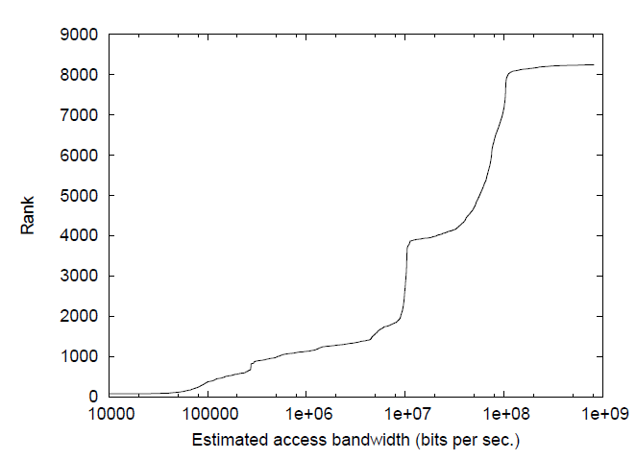
Estimated infectee’s bandwidth
25% of infectees have access bandwidth of 10 Mbps
50% of infectees have access bandwidth of 100 Mbps

Slide 19
Estimating Infectee’s Bandwidth: Another approach
Telescope observe 1/256 of the address space
Telescope observes packets per seconds from an infectee, r
Suppose average packet size is c bits
Then infectee’s bandwidth: 256*r*c
How is this compared to the earlier approach?
This is effective bandwidth (taking account of packet losses)
Earlier approach calculates access bandwidth (some packets are lost)

Slide 20
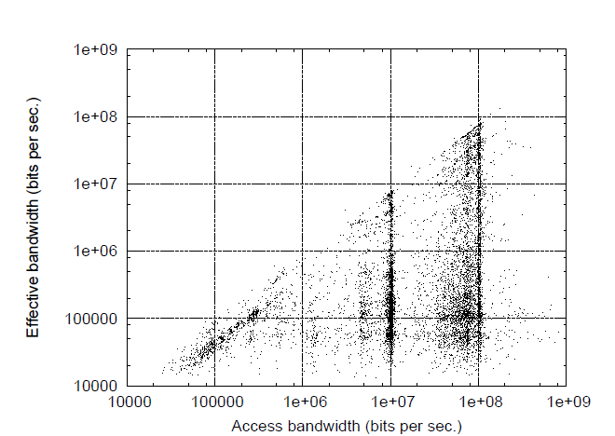
Infectee’s access and effective bandwidth
Effective bandwidth much lower than access bandwidth
Due to packet losses; multiple infectees share a bottleneck

Slide 21
Inferring infection graph
Compute every packet sent by every infectee
Compute who infected whom
Large address space of telescope → infectee can be detected within a few seconds
If an infectee A was first see at time T
inspect list of packets sent by all other infectees active in a short interval (e.g., in past 10 seconds)
If we find B sends a packet to A in the interval, then likely B infected A

Slide 22
Pseudocode of Witty (2)
srand(get_tick_count())
for(i=0; i<20,000; i++)
destIP ← rand()_{[0..15]} | rand()_{[0..15]}
destPort ← rand()_{[0..15]}
packetSize ← 768 + rand()_{[0..8]}
packetContents ← top of stack
send packet to destIP/destPort
if(open(physicaldisk,rand()_{[13..15]}))
write(rand()_{[0..14]} || 0x4E20); goto 1;
9. else goto 2
Seed pseudo-random generator
Each Witty packet contains
bits from 4 consecutive
pseudo-random numbers
Answer:
re-seeding of infectee’s PRNG
caused by successful disk access
What does it mean if telescope observes consecutive packets
that are “far apart” in the pseudo-random sequence?

Slide 23
More Analysis
Compute seeds used for reseeding
srand(get_tick_count()) – seeded with uptime
Seeds in sequential calls grow linearly with time
Compute exact random number used for each subsequent disk-wipe test
Can determine whether it succeeded or failed, and thus the number of drives attached to each infectee
Disk counts of 100 infectees

Slide 24
Bug in Witty’s PRNG
Witty uses a permutation PRNG, but only uses 16 highest bits of each number
Misinterprets Knuth’s advice that the higher-order bits of linear congruential PRNGs are more “random”
Result: orbit is not a compete permutation, misses approximately 10% of IP address space and visits 10% twice
… but telescope data indicates that some hosts in the “missed” space still got infected
Due to an initial “histlist”, or maybe multi-homed or NAT’ed hosts

Slide 25
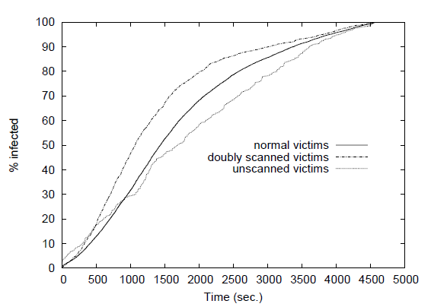
Witty’s growth curve (initial 75 min)
Divide infectees into three classes: 85.4% scanned once (normal), 11.3% doubly scanned, 3.2% never scanned
Growth rate of doubly scanned addresses larger than others

Slide 26
Witty’s Hitlist
Some hosts in the unscanned space got infected very early in the outbreak
Many of the infected hosts are in adjacent /24’s
Witty’s PRNG would have generated too few packets into that space to account for the speed of infection
They were not infected by random scanning!
Attacker had the hitlist of initial infectees
Prevalent /16 = U.S. military base
Likely explanation: attacker (ISS insider?) knew of ISS software installation at the base
Worm released 36 hours after vulnerability disclosure

Slide 27
Patient Zero
A peculiar “infectee” shows up in the telescope observation data early in the Witty oubreak
Sending packets with destination IP addresses that could not have been generated by Witty’s PRNG
It was not infected by Witty, but running different code to generate target addresses!
Each packet contains Witty infection, but payload size not randomized; also, this scan did not infect anyone
Initial infectees came from the hitlist, not from this scan
Probably the source of the Witty outbreak
IP address belongs to a European retail ISP; information passed to law enforcement

Slide 28
Summary
Witty worm mechanism
Reconstruct entire PRNG state sequence using single packet from an infectee
Estimate infectee access and effective bandwidth
Estimate number of disks of an infectee
Identify bugs in Witty PRNG
Identify hitlist and patient zero
General lessons?
Notes:
Chapter 7 summary.

