Slide 1
CSE 4905: Introduction to Network Security
Lecture 27 Review

Slide 2
How to achieve security goals?
Understand the adversary.
what are the resources available?
what is the goal of the attack?
Understand the modes of attack.
in what ways can the attack be launched?
what are the vulnerabilities?
Understand the security/usability tradeoff.
Notes:
Add a tool does not necessarily make a system more secure.

Slide 3
Security goals
NIST Computer Security Handbook (1995)
Confidentiality: Access of assets (viewing/printing/copying/listing) is restricted to entities that are authorized to do so.
Integrity: Assets are processed (modified/altered/created/deleted etc.) only in authorized ways by authorized parties.
Availability: Assets are accessible to authorized parties at the appropriate times.

Slide 4
Tools to achieving CIA
Confidentiality
Encryption
Access Control
Authorization
Integrity
Prevention Mechanisms
Detection Mechanisms
Availability
Redundancy
Intrusion Detection/Prevention

Slide 5
Understanding how to defend
Policy
Incentives
Mechanism
Assurance

Slide 6
Kerckhoff’s Principle
One should assume the only unknown thing about system design is the cryptographic key
“One ought to design systems under the assumption that the enemy will immediately gain full familiarity with them” – Claude Shannon
Put differently, the system designer should know what needs to be private for their system to be “secure”

Slide 7
Cryptographic Tools
 | Primitive | Examples | Notes
Confidentiality | Block Cipher | AES, DES, RC4 | Requires mode of operation, Confusion, Diffusion
 | Public Key Encryption | RSA, ElGamal
 | Key Agreement | Diffie-Hellman | Requires auth to verify partner identity
Integrity | Digital Signatures (public key) | Digital Signature Algorithm (DSA), RSA Signature | Most signatures aren’t the same as encryption schemes
 | Message Authentication Code (private key) | HMAC
 | Authenticated Encryption | GCM Mode of operation | Developed recently due to difficult of combining encryption/MAC
Data Compression | Collision Resistant Hash | MD5, SHA1, SHA2, SHA3

Slide 8
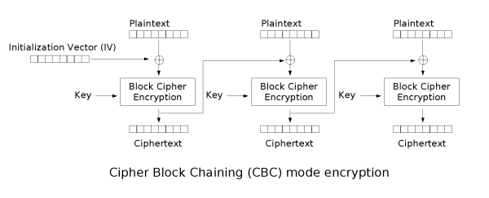
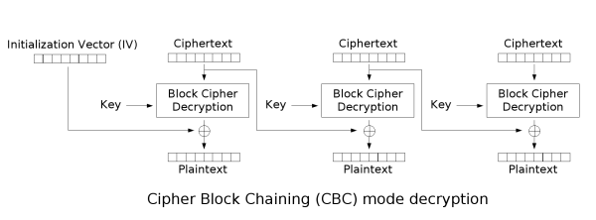
Cipher-block Chaining (CBC)

Slide 9
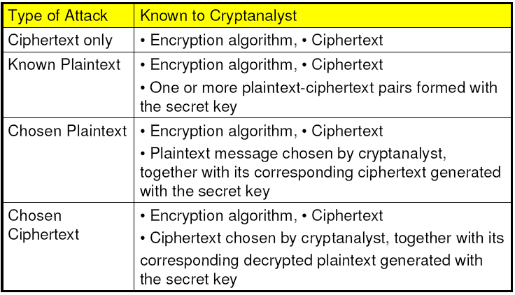
Cryptanalysis scheme

Slide 10
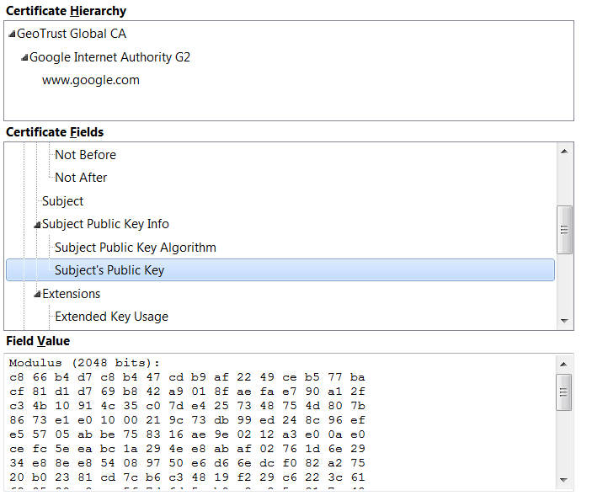
PKI Certificate

Slide 11
HTTP client authentication
Protect passwords
Limit exposure of password
Prohibit guessable passwords
Re-authenticate before changing password
Server side: do not store password
Hashing, Salting, Peppering
Handle authenticators carefully
Make authenticators unforgeable
Avoid using persistent cookies
Limit lifetime of authenticators

Slide 12
Encapsulation
source
message
M
application
transport
network
link
physical
segment
H_{t}
M
H_{t}
datagram
H_{n}
H_{n}
H_{t}
M
frame
H_{l}
H_{n}
H_{t}
M
link
physical
switch
destination
H_{n}
H_{t}
M
network
link
physical
M
application
transport
network
link
physical
H_{l}
H_{n}
H_{t}
M
H_{n}
H_{t}
M
H_{t}
M
H_{n}
H_{t}
M
H_{l}
H_{n}
H_{t}
M
router

Slide 13
WEP encryption: RC4 stream cipher
host/AP share 40 bit symmetric key
host appends 24-bit initialization vector (IV) to create 64-bit key
64 bit key used to generate stream of keys, k_{i}^{IV}
k_{i}^{IV} used to encrypt i-th byte, d_{i}, in frame:
c_{i} = d_{i} XOR k_{i}^{IV}
IV and encrypted bytes, c_{i} sent in frame

Slide 14
Security holes in WEP
24-bit IV, one IV per frame → IV’s eventually reused
IV transmitted in plaintext → IV reuse detected
Key management Not specified
Vendors use their own strategies, often times
Install keys manually
Change keys infrequently (days, months)
Use a single key for entire network
No cryptographic integrity check

Slide 15
WPA2: extensible authentication protocol (EAP)
EAP: end-end client (mobile) to authentication server protocol
EAP sent over separate “links”
mobile-to-AP (EAP over LAN)
AP to authentication server (RADIUS over UDP)
EAP not defined in 802.11i
wired
network
EAP TLS
EAP
EAP over LAN (EAPoL)
RADIUS
IEEE 802.11
UDP/IP
Notes:
Mutual authentication, EAP-TLS, EAP-TTLS, EAP-PEAP

Slide 16
Virtual Private Networks (VPNs)
public Internet
laptop
w/ IPsec
IP
header
IPsec
header
Secure
payload
salesperson in hotel
IP
header
IPsec
header
Secure
payload
IP
header
IPsec
header
Secure
payload
router w/
IPv4 and IPsec
router w/
IPv4 and IPsec
IP
header
payload
IP
header
payload
branch office
headquarters

Slide 17
IPsec
A collection of protocols (RFC 2401)
Authentication Header (AH)
RFC 2402, Provides source authentication and data integrity
Encapsulating Security Payload (ESP)
RFC 2406, Adds confidentiality to AH
Internet Key Exchange (IKE)
RFC 2409
IP Payload Compression (IPcomp)
RFC 3137
Notes:
Why use IPsec over TLS? IPsec protects all the traffic (including TCP headers, e.g., the website that you want to go to). TLS does not encrypt TCP headers.

Slide 18
BGP Poisoning
Route announcements have grown from linear to quadratic in size
Have multiple cryptographic signatures to send and verify
Sign₃₃₅₆(3356, 54113, 151.101.193/24) Sign₅₄₁₁₃(54113, 151.101.193/24)
INTERNET2-TRANSITRAIL-CPS 11164
Evil AS!!
66666
LEVEL 3
3356
66666, 54113, 2 151.101.193/24
…
Main part of RPKI, route announcements must be signed
CT Ed Net 22742
Sign₅₄₁₁₃(54113, 151.101.193/24)
Fastly
54113
Sign₂₂₇₄₂(22742, 11164, 33356, 54113,…)
Sign₁₁₁₆₄(11164, 3356,54113,…)
Sign₃₃₅₆(3356, 54113, 151.101.193/24) Sign₅₄₁₁₃(54113, 151.101.193/24)
Uconn 13796

Slide 19
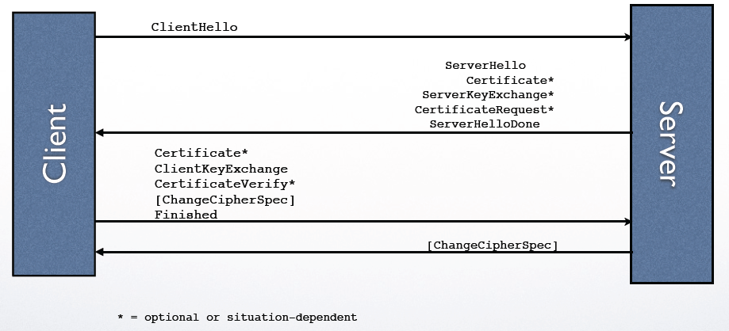
TLS Handshake

Slide 20
TLS Attacks
Data Compression Detection (CRIME)
Manipulation of RSA homomorphism (Bleichenbacher)
Protocol Downgrade Attacks (LOGJAM)
Padding Oracle Attacks (BEAST)
Stream Cipher Cryptanalysis (RC4)
TLS 1.3 Remediations?

Slide 21
DNS Cache Poisoning
Adversary needs: query knowledge, timing, trans ID., source port
root-server
google.com?
google.com 67.218.93.152
google.com?
gtld-server
ripe-server
Client listens to (and caches) the first response
google.com 123.123.123.123

Slide 22
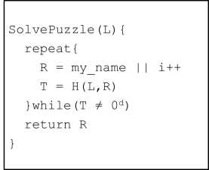
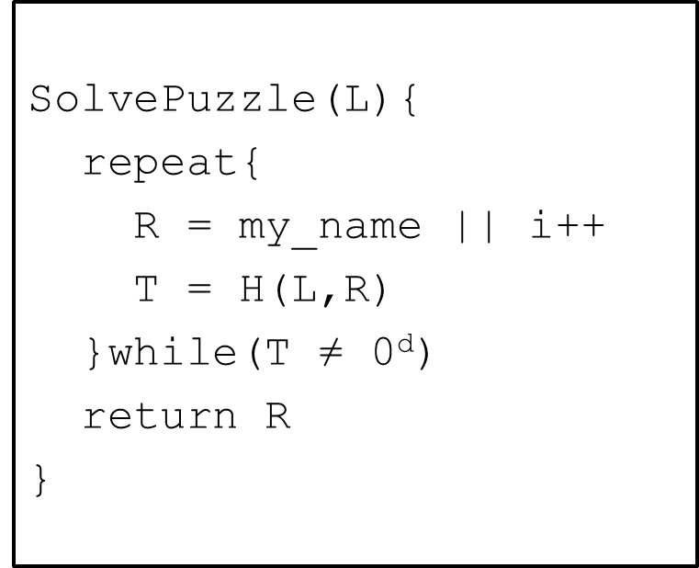
TheoryCoin: How to store money
SolvePuzzle(L,...){
repeat{
R = my_name||(m,s)|| i++
T = H(L,R)
}while(T ≠ 0^{d})
return R
}
P₁
(m,s)
P₃
(m,s)
P₂
(m,s)
P₄
P₃ broadcasts transaction, not accepted until added to block chain
x₄=(P4, (m,s), i₄)

Slide 23
Preventing double spending
The receiver wants to be sure that transaction is part of the “final” blockchain and cannot be undone
x₃=(P₃, i₃)
x₆=(P₃, i₆)
x₇=(P₃, i₇)
x₀=Start!
x₁=(P₁, i₁)
x₂=(P₂, i₂)
x₄=(P₄, i₄)
x₅=(P₅, i₅)
Wait to accept until transaction is several blocks back in the chain
Adversary’s ability to rewrite blocks decreases exponentially with number of blocks IF they control less than 50% of processing

Slide 24
DoS Attacks
Ping Flooding
SYN Spoofing
NTP Amplification
DNS Amplification
DDoS
Defenses:
Attack prevention and preemption (before attack)
Attack detection and filtering (during attack)
Attack source traceback and identification (during and after attack)
Attack reaction (after attack, eliminate or curtail the effects of attacks)

Slide 25
Backscatter
[Moore, Voelker, Savage]
Attacker uses spoofed, randomly selected source IP addresses
Victim replies to spoofed source IP
Results in unsolicited response from victim to third-party IP addresses

Slide 26
Firewalls
firewall
isolates organization’s internal net from larger Internet, allowing some packets to pass, blocking others
administered
network
public
Internet
Firewall: combination of hardware & software system

Slide 27
Intrusion detection systems (IDS)
packet filtering:
operates on TCP/IP headers only
no correlation check among sessions
IDS: intrusion detection system
deep packet inspection: look at packet contents (e.g., check character strings in packet against database of known virus, attack strings)
examine correlation among multiple packets
port scanning
network mapping
DoS attack

Slide 28
Types of IDS
Host-based intrusion detection
Monitors the characteristics of a single host for suspicious activity
Network-based intrusion detection
Monitors network traffic and analyzes network, transport, and application protocols to identify suspicious activity
Three logic components in IDS
Sensors: collect data
Analyzers: determine if intrusion has occurred
User interface: view output or control system behavior

Slide 29
Viruses vs. Worms
Virus
Propagates by infecting other programs
Usually inserted into host code (not a standalone program)
Worms
Propagates automatically by copying itself to target systems
A standalone program

