Slide 1
CSE 4905 Network Security Overview

Slide 2
Internet: “nuts and bolts” view
Internet: “network of networks”
Interconnected ISPs
protocols control sending, receiving of msgs
e.g., TCP, IP, HTTP, Skype, 802.11
Internet standards
RFC: Request for comments
IETF: Internet Engineering Task Force
mobile network
global ISP
home
network
regional ISP
institutional
network

Slide 3
Computer networks
Support communication among computers
Hosts (computers), routers, network links, protocols
Each machine has multiple addresses
MAC address, IP address
Each message from the sender to receiver may stop at many intermediate hops till it reaches its destination (routing)
Possible attacks to computer networks?
Notes:
How addresses are obtained? Is it private? Universally known? Possible to fake?
All these questions have important implications on security; will come to later on.

Slide 4
Many possible attacks!
eavesdrop: intercept messages
actively insert messages into connection
impersonation: can fake (spoof) source address in packet (or any field in packet)
hijacking: “take over” ongoing connection by removing sender or receiver, inserting himself in place
denial of service: prevent service from being used by others (e.g., by overloading resources)
…

Slide 5
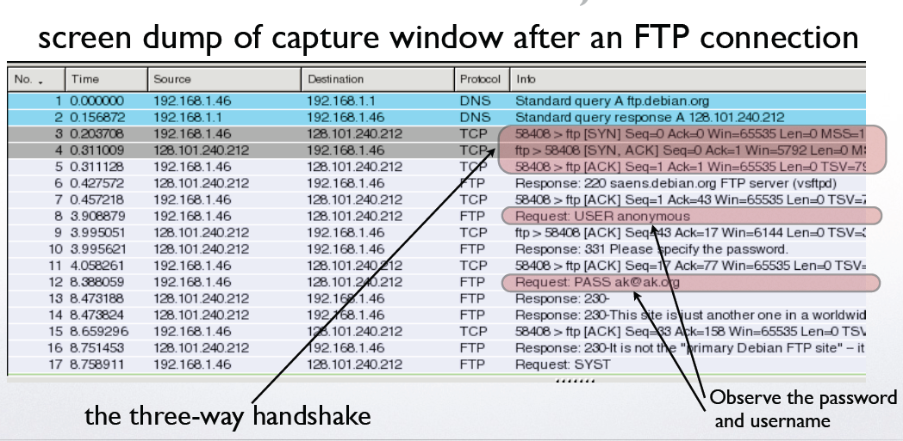
Eavesdropping: one example
Notes:
BEN: remind what FTP is, the protocol isn’t popularly known anymore

Slide 6
Security goals of computer networks
Counter various attacks
Confidentiality, Integrity, Availability
Network security at different layers
Security measures at different layers
Many approaches rely heavily on crypto
See examples of what to do and what not to do…
It is not easy…
Notes:
BEN: would make the point that we’ll see examples of what to do and what not to do. It is not easy to compose the building blocks we covered in the first couple of weeks.

Slide 7
Internet protocol stack
application: supporting network applications
FTP, SMTP, HTTP
transport: process data transfer
TCP, UDP
network: routing of datagrams from source to destination
IP, routing protocols
link: data transfer between neighboring network elements
Ethernet, 802.111 (WiFi), PPP
physical: bits “on the wire”
application
transport
network
link
physical

Slide 8
ISO/OSI reference model
presentation: allow applications to interpret meaning of data, e.g., encryption, compression, machine-specific conventions
session: synchronization, checkpointing, recovery of data exchange
Internet stack “missing” these layers!
these services, if needed, must be implemented in application
needed?
application
presentation
session
transport
network
link
physical
Notes:
BEN: can you give a little bit of background on why these are not present in the internet?

Slide 9
Encapsulation
source
message
M
application
transport
network
link
physical
segment
H_{t}
M
H_{t}
datagram
H_{n}
H_{n}
H_{t}
M
frame
H_{l}
H_{n}
H_{t}
M
link
physical
switch
destination
H_{n}
H_{t}
M
network
link
physical
M
application
transport
network
link
physical
H_{l}
H_{n}
H_{t}
M
H_{n}
H_{t}
M
H_{t}
M
H_{n}
H_{t}
M
H_{l}
H_{n}
H_{t}
M
router

Slide 10
Exercise: security at link layer
Incentives?
What does an encrypted frame look like?
What is being encrypted and what is not?
Suppose use symmetric-key encryption
Who need to agree on the key?
How to agree on the key?
How to ensure integrity?
Is authentication needed?
If you have perfect security at link layer, do you still need security measures at other layers?
If you have perfect security at other layers, do you still need security measures at link layers?

Slide 11
Exercise: security at link layer
Attackers’ incentives
Interference, eavesdrop, insert messages, know volume of traffic, …
What does an encrypted frame look like?
Link layer header not encrypted, other headers (IP, transport layers) and payload encrypted
If you have perfect security at link layer, do you still need security measures at other layers?
Link-layer security only deals with the link between two adjacent hosts
If you have perfect security at other layers, do you still need security measures at link layers?
Yes, e.g., if you want to hide the sender IP, or hide link-layer management traffic

Slide 12
Exercise: security at network (IP) layer
Incentives?
What does an encrypted datagram look like?
What is being encrypted and what is not?
Suppose use symmetric-key encryption
Who need to agree on the key?
How to agree on the key?
How to ensure integrity?
Is authentication needed?
If you have perfect security at IP layer, do you still need security at other layers?
If you have perfect security at other layers, do you still need security at IP layer?

Slide 13
Exercise: security at network (IP) layer
What does an encrypted datagram look like?
Transport layer header and payload are encrypted; others are not
If you have perfect security at IP layer, do you still need security at other layers?
You may still want to have link-layer security; you may not want to use IP layer security (from some traffic)…
If you have perfect security at other layers, do you still need security at IP layer?
Yes, e.g., you want to provide a logic isolation of all data from your computer (you’ll have to do this for each individual session if you use transport-layer security; link-layer security only deals a hop)…

Slide 14
Why need security at different layers?
Different layers have different functionalities, security at different layers serve different purposes
Selectively choose what to use
If one layer not secure, you still have some safeguard from some other layers
e.g., security measures for WiFi network does not work initially

Slide 15
Physical layer security
Many open problems
Particularly for wireless networks
Require knowledge in digital communication
Not covered in this class

Slide 16
Link layer security
Link layer basic services: move a frame from one node to an adjacent node over a communication link
Wireless networks particularly vulnerable
Why?
Case study: securing WiFi networks (802.11 wireless LANs)

Slide 17
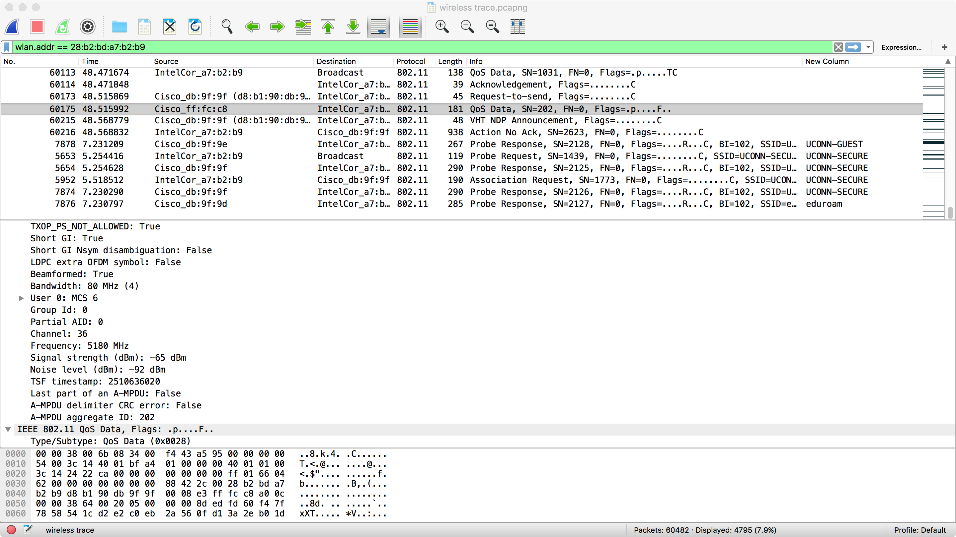
Sniffing wireless traffic

Slide 18
Securing WiFi networks
WiFi basics
Security protocols
WEP (first attempt, severe security flaws)
802.11i, WPA and WPA2 (current protocols)

Slide 19
IEEE 802.11 Wireless LAN
802.11b
2.4 GHz unlicensed spectrum
up to 11 Mbps
direct sequence spread spectrum (DSSS) in physical layer
802.11a
5 GHz range
up to 54 Mbps
802.11g
2.4 GHz range
up to 54 Mbps
802.11n: multiple antennae
2.4 and/or 5 GHz range
up to 200 Mbps
all use CSMA/CA for multiple access
all have base-station and ad-hoc network versions

Slide 20
802.11 LAN architecture
wireless host communicates with base station
base station = access point (AP)
Basic Service Set (BSS) (aka “cell”) in infrastructure mode contains:
wireless hosts
access point (AP): base station
Internet
hub, switch
or router
AP
BSS 1
AP
BSS 2

Slide 21
802.11: association
host: must associate with an AP
scans channels, listening for beacon frames containing AP’s name (SSID, service set ID) & MAC address
selects AP to associate with (use different schemes)
will typically run DHCP to get IP address in AP’s subnet
Security issues
which SSID to select? Automatically select AP?
host authenticate to AP?

Slide 22
802.11: passive/active scanning
BBS 1
BBS 2
BBS 1
BBS 2
AP 1
AP 2
AP 1
1
AP 2
1
1
2
2
2
3
3
4
H1
H1
Passive Scanning:
beacon frames sent from APs
association Request frame sent: H1 to selected AP
association Response frame sent: selected AP to H1
Active Scanning:
Probe Request frame broadcast from H1
Probes response frame sent from APs
Association Request frame sent: H1 to selected AP
Association Response frame sent: selected AP to H1

