Slide 1
CSE 4905 WiFi Security II WPA2 (WiFi Protected Access 2)

Slide 2
Example 802.11 networks
UConn-Secure
WPA2-enterprise
Encryption: AES
Authentication: EAP-PEAP (on a Windows laptop)
My home network
WPA2-personal
Encryption: AES
Authentication: network security key

Slide 3
WPA and WPA2
WPA
designed to work w/ legacy 802.11 hardware (that supports RC4)
Uses Temporal Key Integrity Protocol (TKIP)
WPA2
uses AES-CCMP (for confidentiality and integrity)
currently considered secure (if implemented correctly)
implements the mandatory elements of 802.11i
802.11i, also called Robust Security Network (RSN)

Slide 4
802.11i: improved security
Overcome weaknesses in WEP
Authentication and key management
uses authentication server separate from access point
Stronger encryption mechanisms
Temporal Key Integrity Protocol (TKIP)
AES-CCMP

Slide 5
802.11i: five phases
Discovery
Authentication
Key management
Protected data transfer
Connection termination

Slide 6
802.11i: five phases of operation
AP: access point
STA:
client station
AS:
Authentication
server
wired
network
1 Discovery of
security capabilities
2
STA and AS mutually authenticate, together
generate Master Key (MK). AP serves as “pass through”
3
STA derives
Pairwise Master
Key (PMK)
AS derives
same PMK,
sends to AP
3
STA, AP use PMK to derive
Temporal Key (TK) used for message
encryption, integrity
4
Protected data transfer
5
Connection termination

Slide 7
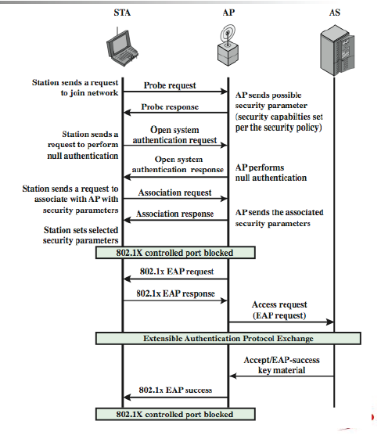
802.11i discovery & authentication

Slide 8
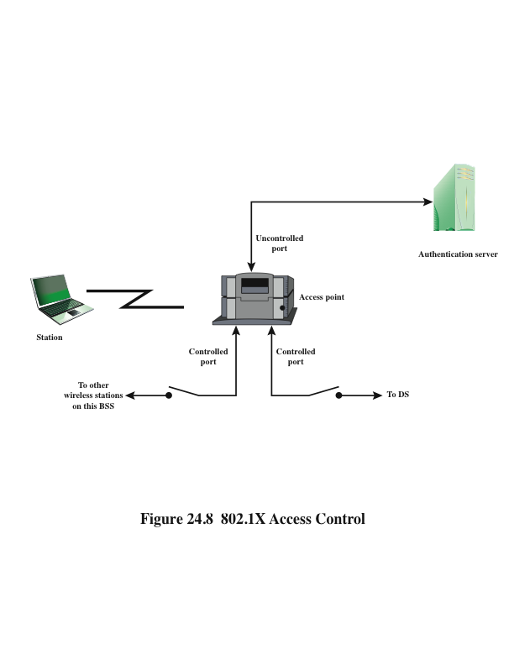
802.1X Access Control
Notes:
IEEE 802.11i makes use of another
standard that was designed to provide access control functions for LANs. The
standard is IEEE 802.1X, Port-Based Network Access Control. The authentication
protocol that is used, the Extensible Authentication Protocol (EAP), is defined in
the IEEE 802.1X standard. IEEE 802.1X uses the terms supplicant , authenticator ,
and authentication server . In the context of an 802.11 WLAN, the first two terms
correspond to the wireless station and the AP. The AS is typically a separate device
on the wired side of the network (i.e., accessible over the DS) but could also reside
directly on the authenticator.
Until the AS authenticates a supplicant (using an authentication protocol),
the authenticator only passes control and authentication messages between the
supplicant and the AS; the 802.1X control channel is unblocked, but the 802.11 data
channel is blocked. Once a supplicant is authenticated and keys are provided, the
authenticator can forward data from the supplicant, subject to predefined access
control limitations for the supplicant to the network. Under these circumstances,
the data channel is unblocked.
As indicated in Figure 24.8 , 802.1X uses the concepts of controlled and
uncontrolled ports. Ports are logical entities defined within the authenticator and
refer to physical network connections. For a WLAN, the authenticator (the AP)
may have only two physical ports: one connecting to the DS and one for wireless
communication within its BSS. Each logical port is mapped to one of these two
physical ports. An uncontrolled port allows the exchange of PDUs between the supplicant
and the other AS, regardless of the authentication state of the supplicant. A
controlled port allows the exchange of PDUs between a supplicant and other systems
on the LAN only if the current state of the supplicant authorizes such an exchange.
The 802.1X framework, with an upper-layer authentication protocol, fits nicely
with a BSS architecture that includes a number of wireless stations and an AP. However,
for an IBSS, there is no AP. For an IBSS, 802.11i provides a more complex solution
that, in essence, involves pairwise authentication between stations on the IBSS.

Slide 9
EAP: extensible authentication protocol
EAP: end-end client (mobile) to authentication server protocol
EAP sent over separate “links”
mobile-to-AP (EAP over LAN)
AP to authentication server (RADIUS over UDP)
EAP not defined in 802.11i
wired
network
EAP TLS
EAP
EAP over LAN (EAPoL)
RADIUS
IEEE 802.11
UDP/IP

Slide 10
EAP methods for WLAN: goals
Strong cryptographic protection of user credentials
Mutual authentication
Instead of one-way in WEP
Client device also needs to authenticate AP
Key derivation
Allow dynamic keys to be derived later on

Slide 11
EAP methods
Cryptographic methods are recommended
EAP-TLS
Based on TLS
Require certificates on both client devices and AS
EAP-TTLS and EAP-PEAP
Outer authentication: authenticate AS to client
Certificate based, only require certificates on APs
Inner authentication: authenticate client to AS
use existing authentication method over TLS tunnel
Non-cryptographic methods
Not suitable for WLAN
Generic token card, EAP-MSCHAP, …

Slide 12
EAP-TLS
EAP-TLS is not part of 802.11i; neither is any other specific authentication method
But EAP-TLS is the de facto 802.11i authentication method
Can meet all 802.11i requirements
Other widely deployed methods do not
EAP-TLS = TLS Handshake over EAP
EAP-TLS defined by RFC 2716
TLS defined by RFC 2246
Always requires provisioning AS certificate on the STA
Mutual authentication requires provisioning STA certificates

Slide 13
Discussion
What authentication method is used between AP & AS
Radius based?
Rely certificate on an AP?
How is the PMK communicated from AS to AP?
TLS based?

Slide 14
802.11i key generation & distribution
After authentication phase, AP and client have pairwise master key (PMK)
Use 4-way handshake to
confirm existence of the PMK
confirm liveness of the peers
Generate a fresh pairwise transient key (PTK) for each subsequent session
…

Slide 15
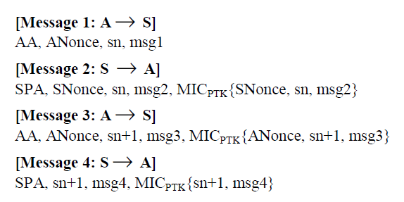
The 4-way handshake
A: access point, S: STA (client device, supplant)
AA (SPA): MAC address of AP (STA)
ANonce (SNonce): nonce from AP (STA)
sn: sequence number, MIC: message integrity code
PTK: generated using PMK, AA, SPA, ANonce, SNonce

Slide 16
The 4-way handshake (cont’d)
AP sends STA a nonce (prevent replay attacks)
STA sends AP a message including: supplant nonce, security parameter from the initial association, whole message protected by MIC; AP extracts SNounce, derives PTK
PTK are now in place on both sides. Need to confirm the key. AP sends STA a message to confirm PTA
STA confirms PTA

Slide 17
Data transfer
Two protocols to protect data transfer
TKIP – for legacy devices only
CCMP – better security for new devices
Two protocols instead of one due to politics

Slide 18
Data transfer requirements
Never send or receive unprotected packets
Message origin authenticity — prevent forgeries
Sequence packets — detect replays
Avoid rekeying — 48 bit packet sequence number
Protect source and destination addresses
Use strong cryptographic primitives for both confidentiality and integrity
Interoperate with proposed quality of service (QoS) enhancements (IEEE 802.11 TGe)

Slide 19
TKIP overview
Designed as a wrapper around WEP
Can be implemented in software
Reuses existing WEP hardware
Runs WEP as a sub-component
Design of TKIP a challenging task
Meets criteria for a good standard: everyone unhappy with it

Slide 20
TKIP design challenges
Mask WEP’s weaknesses…
Prevent data forgery
Prevent replay attacks
Prevent encryption misuse
Prevent keystream reuse
… On existing AP hardware
33 or 25 MHz ARM7 or i486 already running at 90% CPU utilization before TKIP
Utilize existing WEP off-load hardware
Software/firmware upgrade only
Don’t unduly degrade performance

Slide 21
TKIP differences from WEP
Key hierarchy and automatic key management
Per-frame keying
derive a unique RC4 key for each frame from master key
Sequence number (mitigate replay attacks)
New message integrity check (MIC)
Cryptographic hash algorithm: Michael
Countermeasures on MIC failures

Slide 22
TKIP IV and key mixing
IV: 48 bits
Reset to zero, increment by one for each frame
Unique IV during lifetime of a key
Also serves as sequence number
Key mixing: unique keystream for each frame
Include sender MAC address, temporal key, IV (sequence number)
Two STAs that use the same IV will have different keystream

Slide 23
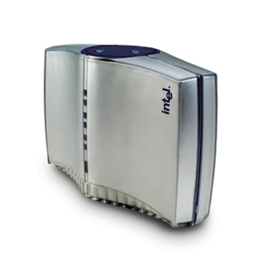
TKIP sequence number & replay protection
Protect again replay
reset packet sequence # to 0 on rekey
increment sequence # by 1 on each packet
drop any packet received out of sequence
Hdr
Packet n
Wireless Station
Hdr
Packet n + 1
Access Point
Hdr
Packet n

Slide 24
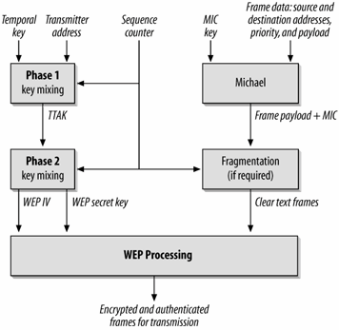
TKIP data processing
Encryption & integrity protection in same process
Data transmission
TKIP frame similar to WEP frame
Reception

Slide 25
Discussion: TKIP vulnerabilities
IV predictable, still in plaintext, problems?
IV supposed to be distinct (in this context, so keystream for each frame for each STA distinct ), not need to be predictable
…

Slide 26
Counter Mode-CBC MAC Protocol (CCMP)
Long-term solution
Based on AES block cipher instead of RC4
AES with 128-bit key and 128-bit blocks (or longer, 192, 256)
Data confidentiality
Encryption: counter mode of block cipher with AES
Message integrity
Cipher-block-chaining message authentication mode (CBC-MAC)
Notes:
CCMP is intended for newer IEEE 802.11 devices that are equipped with
the hardware to support this scheme. As with TKIP, CCMP provides two services:
• Message integrity : CCMP uses the cipher-block-chaining message
authentication code (CBC-MAC), described in Chapter 12.
• Data confidentiality : CCMP uses the CTR block cipher mode of operation
with AES for encryption. CTR is described in Chapter 20.
The same 128-bit AES key is used for both integrity and confidentiality.
The scheme uses a 48-bit packet number to construct a nonce to prevent replay
attacks.

Slide 27
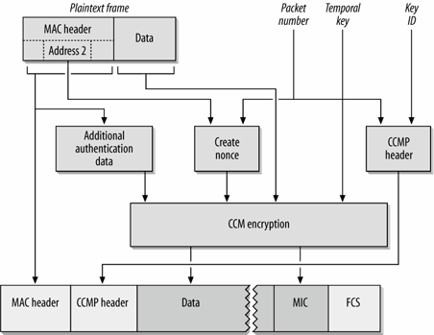
CCMP data processing
48-bit packet number
Similar as sequence number in TKIP
Additional authentication data
Protect frame header
CCMP nonce
Constructed using packet number & sender addr.
CCMP header
Data & MIC encrypted

Slide 28
CCMP frame
Encrypted
Header
Payload
MIC
Authenticated
Use CBC-MAC to compute a MIC on the plaintext header, length of the plaintext header, and the payload
Use CTR mode to encrypt the payload
Counter values 1, 2, 3, …
Use CTR mode to encrypt the MIC
Counter value 0

Slide 29
Comparison
WEP TKIP CCMP
Cipher RC4 RC4 AES
Key Size 40 or 104 bits 128 bits 128 bits
encryption,
64 bit auth
Key Life 24-bit IV, wrap 48-bit IV 48-bit IV
Packet Key Concat. Mixing Fnc Not Needed
Integrity Data CRC-32 Michael CCM Header None Michael CCM
Replay None Use IV Use IV
Key Mgmt. None EAP-based EAP-based

Slide 30
Summary: Securing 802.11 WLAN
WEP: completely broken
Current standard: WPA2/802.11i
Considered secure
Authentication & key management
CCMP
TKIP: intermediate solution
Backwards compatible with WEP

Slide 31
Remaining challenges
Rogue APs
Evil twin attacks
Jamming attacks
…

