Slide 1
SoK: Cryptographically Protected Database Search
Benjamin Fuller, Mayank Varia, Arkady Yerukhimovich, Emily Shen,
Ariel Hamlin, Vijay Gadepally,
Richard Shay, Darby Mitchell, Robert Cunningham
Notes:
Thank you everyone for coming. I’m Ben Fuller and I’m going to be talking about protected database search. This paper is the result of 10 years of work at Lincoln Laboratory and is collaboration with Mayank, Arkady, Emily, Ariel, Vijay, Rich, Darby, and Rob.

Slide 2
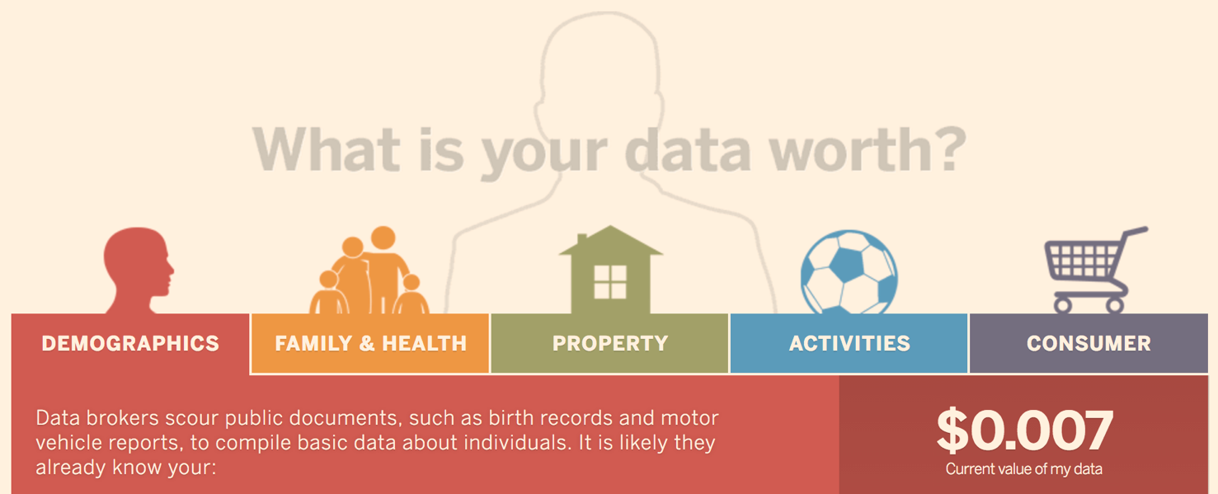
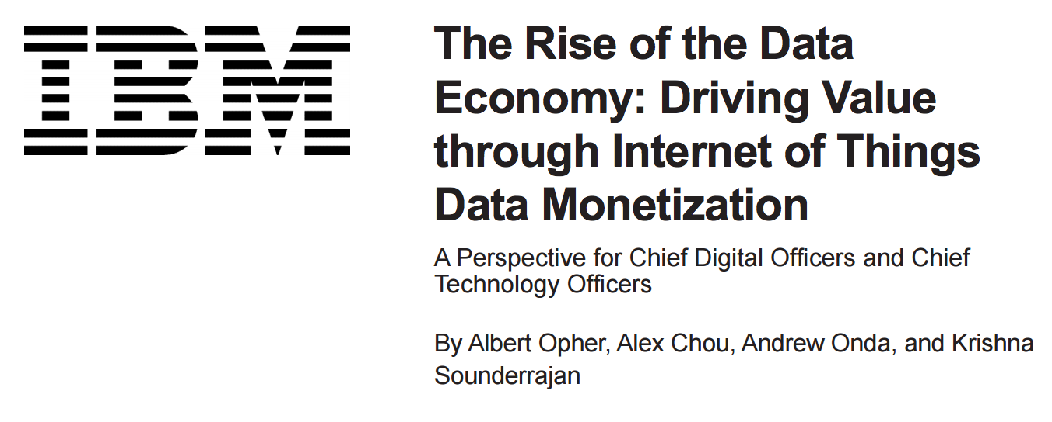
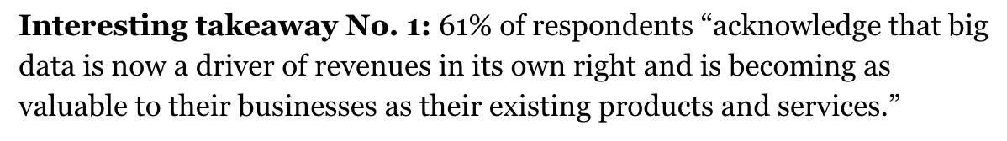
The Data Economy
“Data is the new oil”
– Shivon Zilis, Bloomberg Beta
“Data will become a currency”
– David Kenny, IBM Watson
“… the fourth industrial revolution is connectivity and data”
– Mukesh Ambani, Reliance
Notes:
Big data has become an incredibly important asset to both companies and individuals. Many companies value their data more highly than their IP, products, and employee base. It has great value.

Slide 3
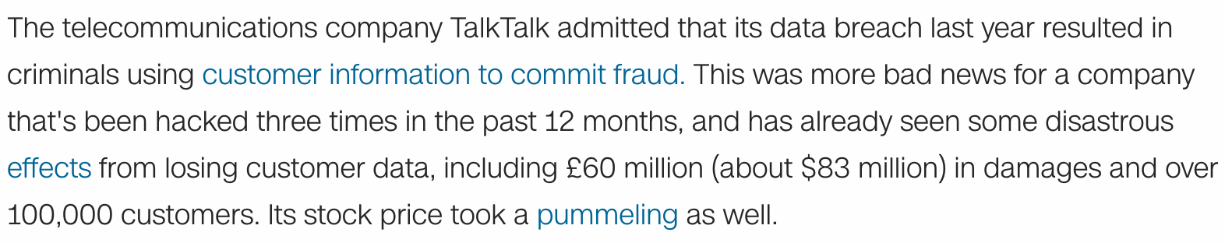
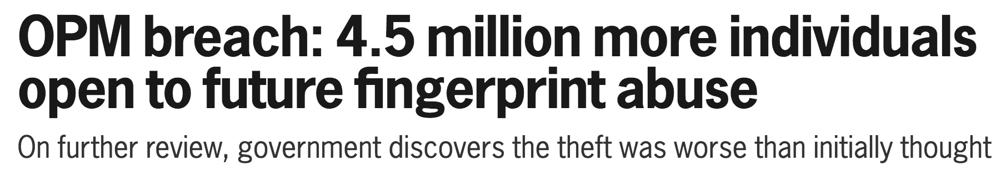


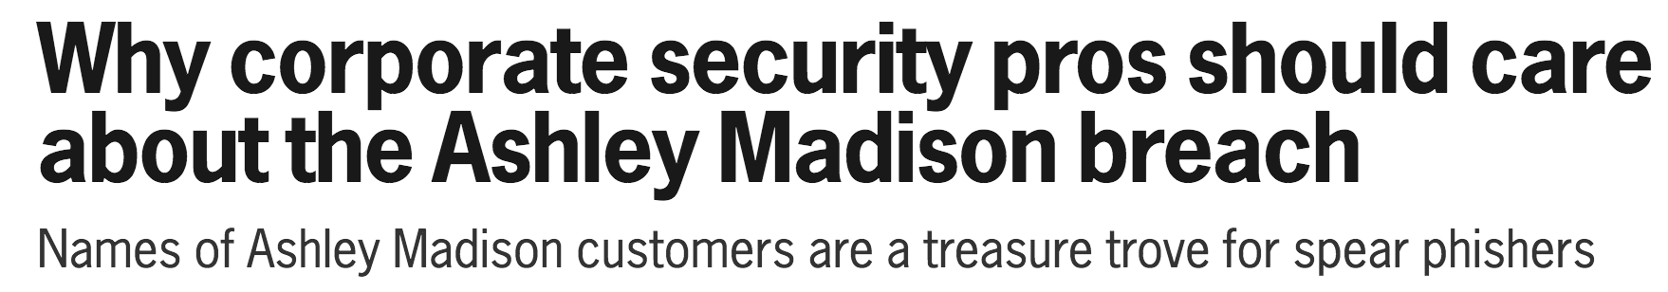


Value implies Risk
“Data is a toxic asset”
– Bruce Schneier, 2016
Notes:
Unfortunately, with value comes risk. I don’t need to go over every data breach of the last five years. Companies have found it difficult to protect their critical data from determined attackers. You could easily update this slide with the attacks of the last week.
Bruce Schneier went so far last year to say that data is a toxic asset and that companies are finding value in not having access to their data.

Slide 4
Lets encrypt data!!
Data owners
Database servers
Backend storage
Clients
…
Notes:
The natural response to this risk is try and encrypt the data. What exactly does it mean to encrypt big data? Data is usually stored in some large database. What threats can encryption protect against?
First lets understand entities in a standard DB configuration. The data owner provides the data to a database server. This is then stored on a backend storage system and queries interact with the server.
We will distinguish between two party case for outsourcing of data and three party case for sharing of sensitive data.
Throughout this talk we’ll consider a single client and single database server unless otherwise noted. Don’t assume what I’m saying extends to multiple clients and servers. There are many challenges in that setting.

Slide 5
Lets encrypt data!!
possible threats?
Data owner
Database server
Backend storage
Client
Network attacks can be (mostly) mitigated using standard techniques such as TLS
Notes:
If we’re going to encrypt data we need to think about what kind of attacker we are defending against.
Network between client and server or
2. Network between server and storage
These attacks can easily be defended (for the most part) using standard secure channel techniques such as TLS

Slide 6
Lets encrypt data!!
possible threats?
Data owner
Database server
Backend storage
Client
Encrypt data at rest, required for some data types due to regulation (HIPAA)
Capability exists in modern databases (e.g. Accumulo)
Notes:
Another potential threat is on the backend storage. This has been the target in some previous attacks.
However, it is possible to encrypt data at rest. Furthermore, it is a requirement for some applications and then capability exists (even on a granular level) in databases such as Accumulo.

Slide 7
Lets encrypt data!!
possible threats?
Data owner
Database server
Backend storage
Client
Client restricted using access control at server
Notes:
We can protect against a client querying unauthorized information by controller what information can be disclosed to each client using access control.

Slide 8
Lets encrypt data!!
possible threats?
Data owner
Database server
Backend storage
Client
Mitigation seems difficult,
server must be able to process queries
Notes:
What seems difficult to protect is an attacker that compromises the database server itself. We can’t just encrypt data at the database server it needs to be able to answer queries.

Slide 9
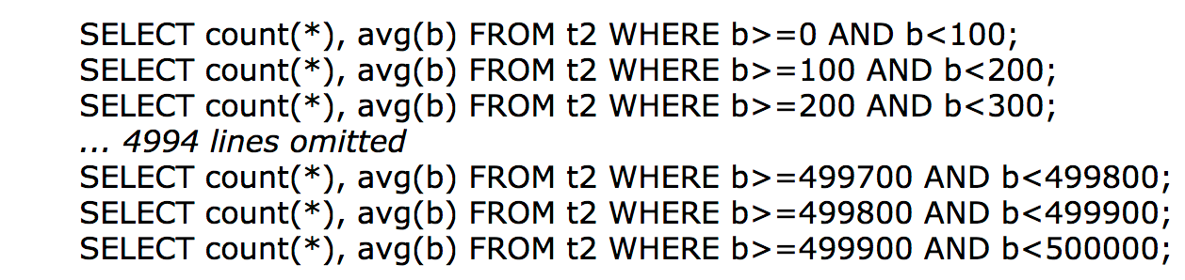
Cryptographically Protected Search
Homomorphic encryption vector-matrix mult: 30s¹
Multi-party computation: 200,000 AES² blocks/s,
does not scale to large data
No server protections
(encrypt data at rest)
Databases are expected to answer
common queries in milliseconds
Risk of data compromise
5000 range queries takes 1s
Return whole dataset encrypted
Use homomorphic encryption or multi-party computation
¹S. Halevi and V. Shoup. (2014) HElib - an implementation of homomorphic
encryption. [Online]. Available: https://github.com/shaih/ Helib
²M. Keller, E. Orsini, D. Rotaru, P. Scholl, E. Soria-Vazquez, S. Vivek,
“Faster Secure Multi-Party Computation of AES and DES Using Lookup Tables,” in ACNS 2017
Utility of stored data
Notes:
Well a very naïve thing we could do is remove the server and just return the entire encrypted database with each query. While this has low risk it removes much of the utility of the stored data. As an alternative we could simply trust the database server and only encrypt data at rest. These two solutions represent the extreme of the risk/utility tradeoff. We are going to explore other points in the space in this talk.
You might say that we have general purpose cryptographic techniques for computing on encrypted data such as fully homomorphic encryption or multi party computation. Unfortunately, these general purpose cryptographic computing techniques are slow. Doing a simple vector matrix multiplication in AES still takes seconds. While MPC has seen tremendous speed advances recently it still does not scale to large scale data.
Databases are expected to answer queries in milliseconds. Here we see 5000 queries from the SQLite test suite that complete in 1.12seconds.
So these techniques do provide more utility but not a ton.

Slide 10
Cryptographically Protected Search
Includes:
Symmetric searchable encryption (SSE)
Property preserving encryption
No server protections
(encrypt data at rest)
Risk of data compromise
Return whole dataset encrypted
Use homomorphic encryption or multi-party computation
Utility of stored data
Notes:
This talk includes discussion of symmetric searchable encryption or SSE and property preserving encryption. We will not consider approaches that use trusted hardware, though they can be complimentary to cryptographic techniques.
If necessary talk about this tradeoff being necessary, refer to D. Cash and S. Tessaro, “The locality of searchable symmetric encryption,” in EUROCRYPT 2014

Slide 11
Why systematize?
No server protections
(encrypt data at rest)
Risk of data compromise
We evaluated results for IARPA SPAR
Return whole dataset encrypted
Use homomorphic encryption or multi-party computation
Utility of stored data
Notes:
We are systematizing this area for a few important reasons:
Its been an area of rapid growth since 2000, there are 50+ papers on ePrint. Multiple sessions at last year’s CCS.
Emergence of commercial products/extensive funding
Both axes are difficult to compare, we’ll start with risk or security

Slide 12
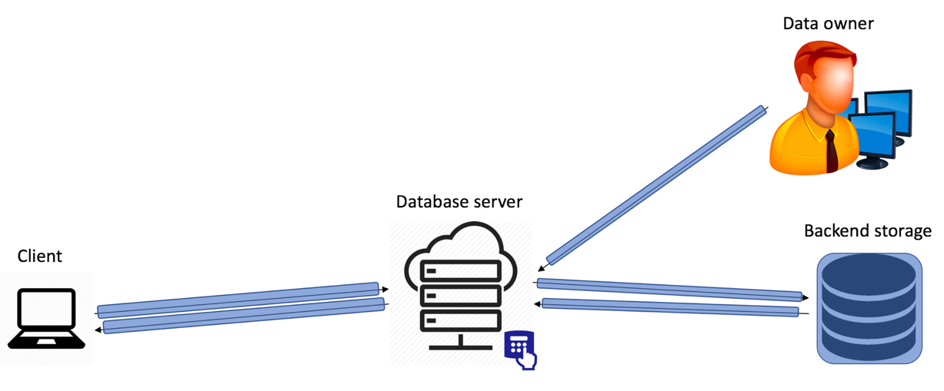
Security of Protected Databases
Data owner
Leakage
Results
Attacker controls one role and follows the protocol (honest but curious)
Client
Database server
Backend storage
Notes:
Searchable encryption is defined using the real ideal paradigm from cryptography. The system is considered secure if each party learns no more than they would by interacting with an ideal party. In this world the client learns the result set and no other party learns any information. Protected databases generally consider a single role being adversarial and work in the honest but curious setting. These restrictions are primarily for efficiency reasons and recent work considers malicious security.
If this was the security model it would be easy to compare. However, protected Solutions also provide each party with leakage functions at database initialization time and with each query.

Slide 13
Security of Protected Databases
Security is determined by leakage
Functions depend on what makes proofs work, no common language
Data owner
Leakage
Results
Client
Database server
Backend storage
Notes:
Security of these systems is determined by leakage. Unfortunately, there is no common language, researchers define leakage functions based on what makes their proofs work. So we don’t have a ranking of leakage and don’t even know if different systems have the same leakage.
Two-party: client and owner are same party, authorized for all info, can ignore leakage to client and owner. Three-party case all leakage is relevant.

Slide 14
Common Language for Leakage
Define five types of leakage of increasing impact³:
Structure
Identifiers
Predicates
Equality
Order
Some schemes leak:
1. Initialization on entire DB
2. At Query on results
Data owner
Leakage
Results
Client
Database server
Backend storage
³Partially based on S.Kamara, “Structured encryption and leakage suppression,”
presented at Encryption for Secure Search and Other Algorithms, Bertinoro, Italy, June 2015.
Notes:
One of our contributions is to provide a systematic language for talking about leakage. We define 5 types of increasing impact.
Structure: properties of object only concealable via padding such as length/size, set cardinality
Identifiers: pointers to objects that persist across multiple accesses
Predicates: identifiers with additional information. E.g. “identifier x is for value within range [a,b]”
Equality: for each column possible to determine equality of values
Order: ordering of objects
Implicitly there is a sixth type where the actual data value is revealed. We note that some schemes reveal this information about the entire data set while others only reveal it on the records returned by a query. This can be a huge difference for databases where queries are very selective.

Slide 15
Outline
Overview of Protected Search
Leakage Impacts
Finding a basis for search results
  Range queries
    Compatible approach: Order-Preserving Encryption / CryptDB
    Custom approach: Partial Order-Preserving Encryption
    Obliv approach: SisoSPIR
  Combining queries
Extending to new database paradigms
Notes:
This is the outline for the rest of the talk. We are going to cover the consequences of these leakage functions and then show different approaches for achieving range queries with very different leakage. We’ll then conclude with the prospect of applying protected search to different types of databases.

Slide 16
Hospital Data Set
Birth Month | Length of Stay | Gender | Diagnosis | SSN
February | 1 | M | Flu | 000-00-001
April | 30 | M | Cancer | 000-00-002
June | 3 | F | Pneumonia | 000-00-003
Assume:
  Server sees which field queried
  Records are identifiable between queries
Notes:
Suppose we have a simple hospital data set with three columns: birth month, length of stay, diagnosis, and SSN. All of these fields have various levels of sensitivity.
For this example lets suppose the only things we know is that the scheme leaks to the server which field is queried and that records are identifiable between queries. This information is revealed by most protected search schemes. Other than that we will assume nothing about the workings of the system

Slide 17
Statistical Attack Against Hospital Length of Stay
Suppose:
  Queries of form:
  SELECT * FROM table WHERE length_stay=XXXXX;
  Observe |records|
  Create unique id for query
Notes:
We will consider a statistical attack against a hospital’s length of stay column.
The server sees some information of the form listed in the chart but receives no other information. Lets suppose they assign a unique identifier to each query listed on the x axis. They then record how many records are returned by each query.
After a few queries they construct the graph on the left. On its own this isn’t very useful.

Slide 18
Statistical Attack Against Hospital Length of Stay
Query with highest number of returned
records likely represents 4 days
Distribution of length of stay is known,
attacker can use prior statistical information
Notes:
However, I can go to the NIH and find out the distribution of hospital length of stay across hospitals. I can then compare the two graphs to guess that welkjv corresponds to 4 days. This means I’ve identified the query and the length of stay for every returned record. Citation for data on left: “Predicting length of stay from an electronic patient record system: a primary total knee replacement example” Evelene M Carter and Henry WW Potts.
This is a problem. All we’ve leaked is the number of returned records but this can be combined with prior statistical information to reveal a lot about the dataset.

Slide 19
Statistical Attack Against Hospital Length of Stay
Query with highest number of returned
records likely represents 4 days
What to do if number of records is not identifying enough?
Or statistical prior is inaccurate?
Attacks exploit correlation between fields, use techniques from optimization
Notes:
The quality of this attack depends on how accurate the prior information is and how different the number of records is for different values of the field.
If either of these conditions are true, a more sophisticated attack is possible that exploits correlation between data fields.

Slide 20
Count Attack⁴
Length Stay | Num Records
nqlwe | 174
pombo | 8
pqwej | 65
qlkwe | 230
welkjv | 451
zekng | 220
Exploit correlation between multiple columns in dataset
Construct co-occurrence matrix
Gender | Num Records
asdlkje | 590
fnylkj | 560
⁴D. Cash, P. Grubbs, J. Perry, and T. Ristenpart, “Leakage-Abuse Attacks Against Searchable Encryption”, CCS 2015
Notes:
So we’ve converted the graph we had on the previous slide to the table in the top left. In addition, we constructed a similar table for the gender column. To learn more information we exploit the second piece of leakage that records are identifiable between queries. This allows to construct a matrix of how many records fit each queried term.

Slide 21
Count Attack⁴
 | asdlkje | fnylkj
nqlwe | 71 | 15
pombo | 47 | 13
pqwej | 59 | 100
qlkwe | 236 | 28
welkjv | 118 | 348
zekng | 59 | 56
Length Stay | Num Records
nqlwe | 174
pombo | 8
pqwej | 65
qlkwe | 230
welkjv | 451
zekng | 220
Gender | Num Records
asdlkje | 590
fnylkj | 560
Fnylkj is likely male, men are known to stay in
hospital for longer, thus welkjv is likely 5 days
⁴D. Cash, P. Grubbs, J. Perry, and T. Ristenpart, “Leakage-Abuse Attacks Against Searchable Encryption”, CCS 2015
Notes:
This matrix allows us to split length of stay based on gender. Since there are fewer males we can guess fnylkj is male. We can then use the fact that males tend to stay in the hospital longer to guess that welkjv corresponds to 5 days not 3 days.

Slide 22
Count Attack⁴
 | asdlkje | fnylkj
nqlwe | 71 | 15
pombo | 47 | 13
pqwej | 59 | 100
qlkwe | 236 | 28
welkjv | 118 | 348
zekng | 59 | 56
Matrix creates many more constraints on prior
Can use L_{p} optimization to minimize distance between co-occurrence matrix and prior⁵
Cash et. al. iteratively find unique entries to identify one value on x or y axis
Only works if chosen columns are correlated, still degrades with quality of prior
⁴D. Cash, P. Grubbs, J. Perry, and T. Ristenpart, “Leakage-Abuse Attacks Against Searchable Encryption”, CCS 2015
⁵M. S. Islam, M. Kuzu, and M. Kantarcioglu. “Access pattern disclosure on searchable encryption: Ramification, attack and mitigation”, NDSS 2012
Notes:
Using this matrix we’ve gone from a linear number of constraints in the number of queries to a quadratic number of constraints. The attacker can use techniques from optimization to maximize the fit between their statistical prior and the data.

Slide 23
Count Attack⁴
 | asdlkje | fnylkj
nqlwe | 71 | 15
pombo | 47 | 13
pqwej | 59 | 100
qlkwe | 236 | 28
welkjv | 118 | 348
zekng | 59 | 56
Relies on:
  Field visible
  Records identifiable
  across queries
Some schemes leak this at Initialization for data set:
  Attack can be performed without any queries
⁴D. Cash, P. Grubbs, J. Perry, and T. Ristenpart, “Leakage-Abuse Attacks Against Searchable Encryption”, CCS 2015
⁵M. S. Islam, M. Kuzu, and M. Kantarcioglu. “Access pattern disclosure on searchable encryption: Ramification, attack and mitigation”, NDSS 2012
Notes:
To reiterate this attack only depends on the field queried being visible and the ability to identify the same record when it is returned in multiple queries.
Note this information is leaked about the entire data set at initialization by some schemes. For others it is only revealed when the records are returned.

Slide 24
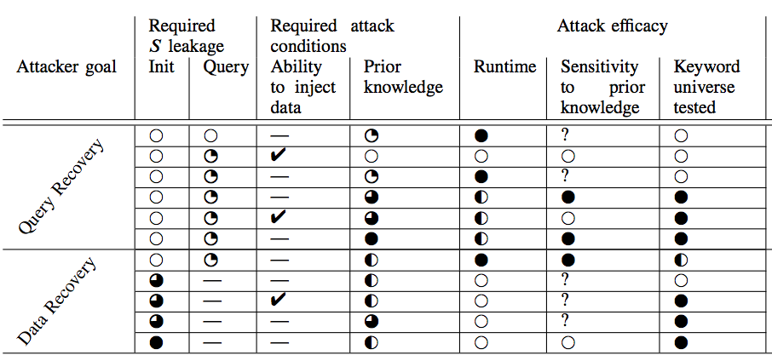
Summary of Leakage Attacks
Emerging attacks:
  Require adversary to insert data⁶
  Use only size of network response⁷
⁶Y. Zhang, J. Katz, and C. Papamanthou, “All Your Queries Are Belong to Us: The Power of File-Injection Attacks on
Searchable Encryption,” USENIX Security 2016
⁷G. Kellaris, G. Kollios, K. Nissim, and A. O’Neill, “Generic attacks on secure outsourced databases,” CCS 2016
Notes:
Leakage attacks are increasing in power and effectiveness very rapidly. Some recent trends include improving efficacy by inserting specially crafted records and using even less information than the example above.

Slide 25
Why systematize?
No server protections
(encrypt data at rest)
Risk of data compromise
Return whole dataset encrypted
Use homomorphic encryption or multi-party computation
Utility of stored data
Focus of the remainder of the talk
Notes:
In the first part of this talk we covered the risk of data compromise, in the remainder we’ll focus on the utility of the stored data. This is some combination of query functionality and performance.

Slide 26
Approaches to Protected Databases
Find three approaches to protected databases:
Legacy:
  Leak at Initialization
  Inherit DB advances
Custom:
  Leak during Query
Oblivious:
  Leak only structure
  Require multiple servers
  to be efficient
Leakage of increasing impact³:
Structure
Identifiers
Predicates
Equality
Order
Some schemes leak:
1. Initialization on entire DB
2. At Query on results
³Partially based on S.Kamara, “Structured encryption and leakage suppression,”
presented at Encryption for Secure Search and Other Algorithms, Bertinoro, Italy, June 2015.
Notes:
Find three main approaches to protected databases:
Legacy: Use a traditional database at server, prepare encrypted data in way that indexing mechanism still function
Leak at Initialization
Automatically benefit from advances in database technology
Custom: Design cryptographic database indices
Leak during Query,
revealing Identifiers or Predicates
Require full database replacement
Obliv: Subclass of Custom that uses oblivious data structure to hide repeated access
These approaches currently have different leakage profiles and different security against known attacks
This is not known to be inherent

Slide 27
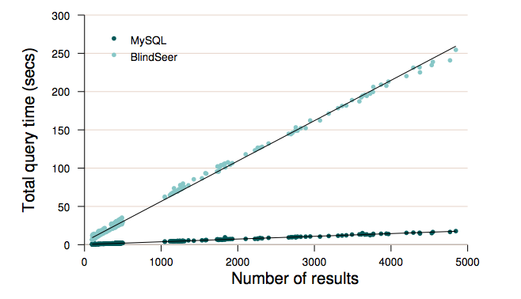
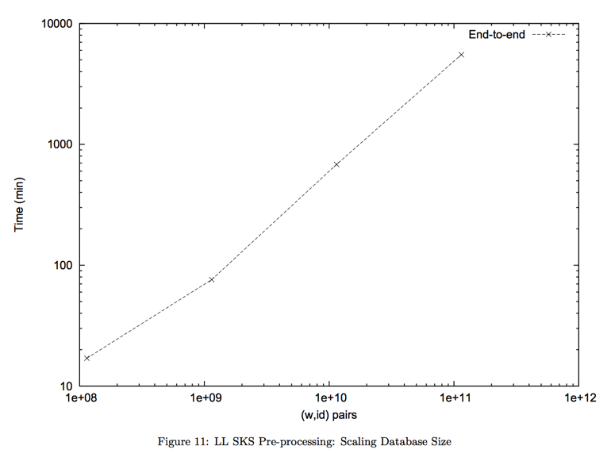
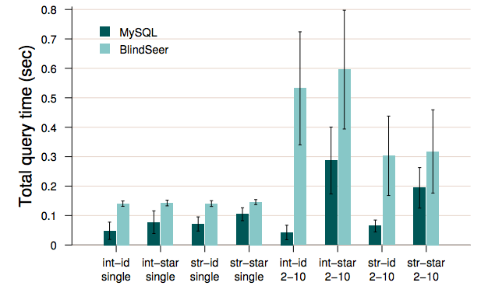
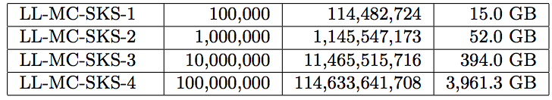
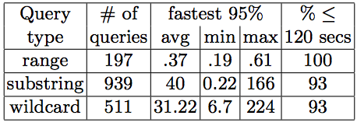
Approaches to Protected Databases
Developed⁸:
  a database instrumentation platform
  data and query generator
Used in prior work^{9,10}
Find three approaches to protected databases:
Legacy:
  Leak at Initialization
  Inherit DB advances
Custom:
  Leak during Query
Oblivious:
  Leak only structure
  Require multiple servers
  to be efficient
⁸https://github.com/mitll-csa/sparta
⁹V. Pappas et al. “Blind Seer: A Private Scalable DBMS,” S&P 2014
¹⁰D. Cash et al. “Dynamic Searchable Encryption in Very-Large
Databases: Data Structures and Implementation,” NDSS 2014
Notes:
To measure performance we developed a database instrumentation platform that measures database performance along with a data and query generator. This tool has been used in evaluating state of the art work and is open sourced at the link on the slide.
We stress this tool has been used at the 10TB scale for 100M records.

Slide 28
How to compare functionality?
Natural approach: what fraction of a unprotected database language is supported?
Current systems implement base queries using cryptography, extend from these base queries:
  Keyword Equality
  Range
  Boolean Combination
  Other (graph alg and substring)
Find three approaches to protected databases:
Legacy:
  Leak at Initialization
  Inherit DB advances
Custom:
  Leak during Query
Oblivious:
  Leak only structure
  Require multiple servers
  to be efficient
Notes:
Comparing functionality is more difficult. The most natural approach is to ask what fraction of a DB language is supported. However, there is significant syntactic sugar that can be implemented but is a result of product immaturity. Do we mean fraction of actual language features? Fraction of queries? For what application?
We find that current systems implement what we call base queries with crypto. Generally this is a very small number (1 or 2). They then extend using noncrypto techniques to other queries. The common base queries are keyword equality, range, Boolean, and some specialized types. We’ll cover three systems (one Legacy, one Custom, and one Oblivious) to range queries to demonstrate the performance and security differences.

Slide 29
Outline
Overview of Protected Search
Leakage Impacts
Finding a basis for search results
  Range queries
    Order-Preserving Encryption
    Partial Order-Preserving Encryption
    SisoSPIR
  Combining queries
Extending to new database paradigms

Slide 30
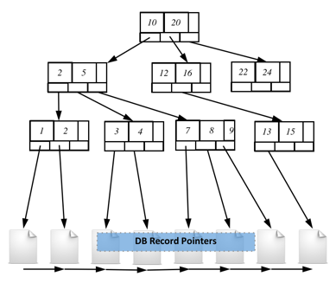
Order-Preserving Encryption (OPE):
Legacy approach to Range
Enc that preserves plaintext order:
  If m₁< m₂ then Enc(m₁) < Enc(m₂)
Ideal function can be approximated by sampling
(using pseudo random function)
from the hyper geometric distribution¹¹
Database server
  Encrypt query Enc(a), Enc(b)
  Let server use standard search mechanism
  Return encrypted records
Client
  Enc(a), Enc(b)
  c₁, c₂, c₁₀, c₄₀₀₀
¹¹A. Boldyreva, N. Chenette, Y. Lee, and A. O’Neill. “Order-preserving symmetric encryption,” EUROCRYPT 2009
Notes:
The first approach we’ll cover is order-preserving encryption also known as OPE. This is a legacy approach to range.
The key to this approach is to recognize that many queries the database server only needs to perform comparison. So it develops an encryption scheme that preserves order.
If we have such a scheme we can insert data encrypted with OPE for each field. Then we can use a traditional DB mechanism such as a B-tree to search over this data. At search time we just provide the encrypted values we are search for. The rest of the search proceeds normally.
It is possible to construct a nearly ideal OPE scheme by sampling from the hyper geometric distribution.
Unfortunately, even the ideal object here has some problems.

Slide 31
Leakage Attacks of OPE
Data is sorted, does not protect dense data
Strongest leakage attack applies to OPE
Technique used in many
commercial products
Row corresponding to OPE
Notes:
OPE is very easy to deploy, requires no changes to DB backend. Unfortunately, it keeps data sorted. If all values are present in the database it provides absolutely no protection. Indeed, the strongest leakage attack applies to OPE.
Can we retain security and keep some of the simplicity? Idea: don’t allow server to perform comparisons, done by client

Slide 32
Partial Order Preserving Encoding¹²:
Custom Approach to Range
Database server
Client
10 | 28 | 41 | 91 | 150
28 | 150 | 91 | 41 | 10
¹³D. Roche, D. Apon, S. Choi, A. Yerukhimovich “POPE: Partial Order Preserving Encoding” CCS 2016
Notes:
This is the idea behind the recent work called partial order preserving encoding.
Here we start with a sorted data array. We encrypt the data array using a semantically secure encryption scheme, permute the data and deliver it to the server.

Slide 33
Partial Order Preserving Encoding¹²:
Custom Approach to Range
Database server
Client
28 | 150 | 91 | 41 | 10
150 | 41
41 | 150
Nodes selected for promotion
¹³D. Roche, D. Apon, S. Choi, A. Yerukhimovich “POPE: Partial Order Preserving Encoding” CCS 2016
Notes:
Inserts entire data set using standard encryption
Server implicitly initializes empty tree
When client issues range query [10, 15],
Now the server has no ability to perform comparisons and search quickly.
So what the server does is it ”promotes” random nodes. Lets say the second and fourth node.
Client decrypts, sorts nodes, and sends
encrypted values back
For each value in current node, compared
to sorted values

Slide 34
Partial Order Preserving Encoding¹²:
Custom Approach to Range
Database server
Client
28 | 150 | 91 | 41 | 10
41 | 150
Branch 0, 1, 1, 1, 0
¹²D. Roche, D. Apon, S. Choi, A. Yerukhimovich “POPE: Partial Order Preserving Encoding” CCS 2016
Notes:
Inserts entire data set using standard encryption
Server implicitly initializes empty tree
When client issues range query [10, 15],
server promotes random nodes
Client decrypts, sorts nodes, and sends
encrypted values back

Slide 35
Partial Order Preserving Encoding¹²:
Custom Approach to Range
Database server
Client
Traverse tree hierarchically – branch if many
unsorted values at node
All comparisons performed by client, server sees tree
Created nodes reduce number of client comparisons needed in future queries
28 | 150 | 91 | 41 | 10
41 | 150
Branch 0, 1, 1, 1, 0
28 | 10
150 | 91 | 41
Notes:
For each value in current node, compared
to sorted values
Client can use sorted nodes to decide which paths to traverse
Can keep cache of recently selected nodes
By carefully balancing tree and selecting parameters can ensure client doesn’t make too many comparisons
Security is better than OPE if tree isn’t fully built and thus has unsorted nodes
Still reveals record identifiers: repeated records can be connected between queries

Slide 36

SisoSPIR¹³ – Oblivious Approach to Range
10
20
B+ trees are used in many unprotected databases
  Variable number of children per node
2
5
12
16
22
24
1
2
3
4
7
8
9
13
15
DB Record Pointers
Notes:
SisoSPIR is an oblivious approach to range. It hides record identifiers between repeated queries.
The idea is to look at a common database structure a B+ tree which is a tree with a variable number of children per node.

Slide 37

SisoSPIR¹³ – Oblivious Approach to Range
Which branch is taken in tree traversal
  Use multi party computation to evaluate comparison
  Keep next node secret shared between Client/Server
  Lookup using SPIR (with shared input/output)
Records retrieved in linked list
  Permute list and retrieve records using SPIR
Evaluate comparison using
multi party computation
10
20
2
5
12
16
22
24
1
2
3
4
7
8
9
13
15
DB Record Pointers
Uses multiple servers to improve PIR efficiency
DB Records + Pointers
¹³Y. Ishai, E. Kushilevitz, S. Lu and R. Ostrovsky, “Private Large-Scale Databases
with Distributed Searchable Symmetric Encryption,” CT-RSA 2015
Notes:
First lets consider an unprotected search of a DB for all records with values between [3,8]
Traverse tree twice to find endpoints in linked list
Traverse linked list to get relevant records
The SisoSPIR scheme notes the two sensitive pieces of information revealed by this traversal. The first is which branch is taken at each node.
The second is which records are retrieved in the linked list.
This scheme uses multiple servers to improve PIR efficiency.

Slide 38
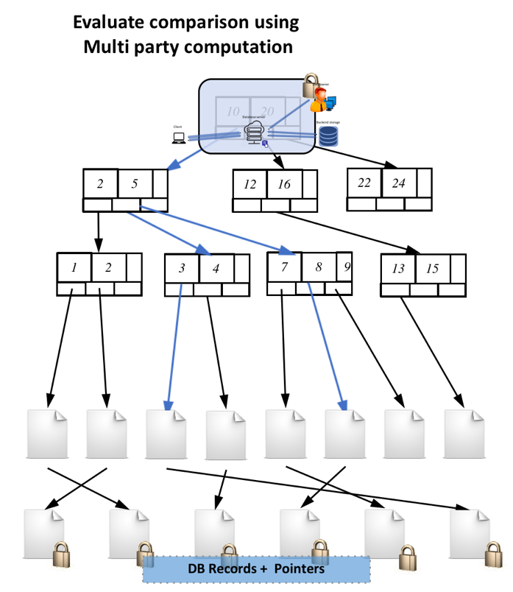
Legacy
Custom
Oblivious
16
15
Hyper
Geometric
Dist.
14
13
12
11
10
9
ciphertexts
8
7
41 | 150
6
5
4
3
2
1
28 | 10
150 | 91 | 41
1
2
3
4
5
6
7
plaintexts
Data is high entropy
Small fraction of DB is returned by queries
Otherwise
Notes:
To summarize we’ve seen three distinct approaches to range queries. These schemes offer different points in the risk/utility tradeoff. We feel that legacy schemes are appropriate when the data is high entropy and sparse, custom schemes are appropriate when a small fraction of the DB is queried (over the lifetime of the DB), and Oblivious schemes are prudent otherwise.

Slide 39
Query Combination
Black-box techniques to combine base queries:
  Range → Equality, search for [a, a]
  Boolean → Range, using set covers
  Range → Substring, by inserting each prefix
Most combination techniques are less efficient and have more leakage than equivalent base query
Allow for rapid expansion of query functionality
Notes:
We saw different cryptographic approaches to range queries. Constructing cryptographic search is hard: need to expand answerable queries. We call this query combination. Similar techniques used in unprotected database search. Precise analysis more important for protected search, intermediate results may not be usable.
Combined techniques tend to be worse than a base construction but they allow for rapid expansion of DB functionality.

Slide 40
Approaches to Protected Databases
Natural approach: what fraction of a unprotected database language is supported?
Systems implement base queries w/ crypto,
extend from these base queries:
  Keyword Equality
  Range
  Boolean Combination
  Other (graph alg and substring)
SQL has a well defined mathematical set-theory basis of operations¹⁴:
Union: A∪B
Difference: A \ B
Join: A x B
Projection: Take some dimensions of results
Selection: Take rows satisfying some condition
¹⁴E. Codd, “A relational model of data for large shared data
banks,” Communications of the ACM, 1970
Notes:
Let’s return to our question of how much functionality is covered by protected databases. We said that using the fraction of the language is inappropriate. However, most DB systems have a well-defined mathematical basis of operations. For example, SQL has the set-theoretical relational algebra defined by Codd in 1970.
These bases give us a roadmap for constructing protected search and the current gaps. Cryptographers need to:
1) Provide base queries
2) Combine queries expressively to get SQL

Slide 41
DB Paradigm | Basis Operation | Crypto Base Operation?
SQL – Relational Data | Union | Yes - Logical OR in Boolean Schemes
 | Difference | Yes - By combining Logical AND, Logical Negation
 | Join | Some - Legacy Approaches and recent work in Custom (but not dynamic)
 | Selection | Yes – Use traditional access control to encrypt columns
 | Projection | Mostly – Keyword equality, substring, limited wildcard, range
Notes:
Crypto has done a fairly decent job of covering the SQL basis. The weak point is Join where one of two options is available:
1) Legacy approach
2) Custom approach that does not support dynamic data
A natural question is are we done?

Slide 42
Unprotected DB Development
1970
1980
1990
2000
2010
2020
Introduction of relational model by Codd
MySQL, PostGRES,
Oracle
Crypto community starts working
on protected search
NoSQL Key-Value
It took 20 years to secure SQL
How can we catch up?
NoSQL Graph DBs
NewSQL
Polystore
Notes:
SQL was developed in the early 70s and became the dominant database paradigm. This was the situation in the mid 90s when cryptographers began working protected search. Naturally, cryptographers began trying to protect SQL. Unfortunately, during those twenty years we saw the introduction of four new database paradigms. “One size fits all: an idea whose time has come and gone” - M. Stonebraker, 2005. It took 20 years to mostly secure SQL. How can we ever catch up if there’s four new paradigms?
If the crypto community always waits for new databases to emerge they can never catch up

Slide 43
Keeping up with database diversification
Unprotected databases have mathematical bases:
For SQL: Union, Difference, Join, Projection, Selection
For Key-Value Store:
Construct,
Find,
Array (+, x),
Element-wise x
For Graph:
Linear algebra over matrices
Cryptographers and DB designers should work together to:
Identify base queries that are likely to be useful across DB paradigms
Understand critical functions of emerging databases
Quickly fill gaps using combiners
Questions?
Notes:
We think that protected databases are mature enough they cannot be developed in isolated. Cryptographers and DB designers have to work together. We propose the following three pronged approach:
Develop and optimize base queries likely to be useful across paradigms,
Identify new base queries of emerging paradigms.
Quickly combine techniques to support emerging database settings
Using this approach we think it is possible to develop protected databases in parallel with unprotected systems.
And with that I’ll stop and take any questions.

Slide 44
Backups

Slide 45
DB Paradigm | Basis Operation | Crypto Base Operation?
NoSQL – Key Value Store | Construct | Yes
 | Find | Yes – Mature range search with variety of techniques
 | Array (+, x) | Some – Addition possible using partially homomorphic techniques
 | Element Wise x | Some – Using partially homomorphic techniques
Main gap is support for very high insert rates above 1M records per second

Slide 46
DB Paradigm | Basis Operation | Crypto Base Operation?
Graph Databases– Linear Algebra | Construct | Yes
 | Find | Yes – Mature range search with variety of techniques
 | Matrix (+, x) | Some – Have private algorithms for matrix mult./add.
 | Element Wise x | Some – Using homomorphic operations
Current matrix operations operate on full structure, need algorithms for sparse matrices (most graph algorithms)

