Slide 1
Environmental Authentication in Malware
Jeremy Blackthorne, Benjamin Kaiser, Benjamin Fuller, and Bulent Yener
Notes:
Thank you for the introduction. I’m Ben Fuller this work is called environmental authentication in malware and is joint with Jeremy, Ben, and Bulent.
This is a joint work between malware analysts and cryptographers. I’m going to spend quite a bit of time introducing the problem and focusing on modeling. I want to start off by stressing that I’m not an expert in malware behavior. I’ll answer questions as best as I can. My understanding of malware comes from my coauthors who have spent years as malware analysts.

Slide 2
Contribution
Malware changes behavior by observing environment to avoid analysis
Complementary technique to obfuscation
Formal analysis of interplay between analyst and malware
Malware in the wild
Malware on a critical piece of infrastructure
Malware on machine that can be modified by the analyst
Notes:
So the first bullet here isn’t a contribution but a framing of our work. We notice that a large class of malware changes it behavior under different environmental conditions. The goal of this is to prevent malware analysts from understanding its behavior.
Our contribution is to formally model this interaction and understand whether this technique has solid theoretic foundation. Towards this end we’ll consider whether a piece of malware can hope to evade an analyst in several different scenarios.
First we consider an analyst that finds a piece of malware in the wild. In this setting they only have access to the malware and not the target environment. In this setting, we show (tight) necessary and sufficient conditions for observing the environment.
In the second scenario we consider an analyst that finds a piece of malware running on its target that is unable to completely stop the machine to perform analysis. Lastly, we consider this scenario where the analyst may act arbitrarily on the machine.

Slide 3
Establish Botnets
Sabotage
Two major goals:
Deliver some payload
Don’t let people understand payload
Espionage
Ransomware
Focus today
Notes:
Since most of us here aren’t malware experts I’ll start with a little bit of an overview of different types of malware. My apologies if I’ve forgotten your favorite type/goal of malware. There is only so much space on the slide. First malware like zeroaccess infects computers with the goal of establishing a large botnet. This botnet can then be used for other purposes such as sending spam messages or mining bitcoins. Second is sabotage of physical parts. This example is Stuxnet which appears to have been designed to destroy nuclear centrifuges. This malware hopped between multiple different platforms until it finally arrived on the control system fro the centrifuges. Next is collecting information or espionage. This can be performed by individuals, organizations, and governments. This malware usually gathers as much information as possible and spreads between computers so that it can find more information. Its very important for this type to be able to write to the network to send back collected intelligence. Lastly, we have ransomware which encrypts critical data on a target computer with a decryption key that is held off of the computer. This key is notionally released if the victim pays some form of ransom often in the form of cryptocurrency.
So we see a wide variety of different types of behavior. Across those types we can say that malware has two basic goals. The first is to deliver some payload (which is kind of an obvious goal). The second is less obvious which is to keep people from understanding its payload. I’ll describe more of why this is a goal and it will be focus of our talk today.

Slide 4
Espionage
Two major goals:
Deliver some payload
Don’t let people understand payload
Preventing analysis is a major goal of modern malware:
Malware is expensive
Malware families reuse components
Malware is randomized, creating defenses requires deep understanding
Notes:
To expand no this second goal, almost all modern malware wants to prevent analysis by security research teams. First, modern malware is very expensive. We aren’t talking about some kid in their basement. Modern malware such as Stuxnet which used four ”zero-day” vulnerabilities is estimated to represent millions of dollars of development. Because of this its very natural for malware designers to try and reuse components such as packers, command and control, sniffers, etc. Furthermore, modern malware is randomized with each copy creating its own virtual instruction set so it is not possible to determine if two malware samples are the same “behavior” just by examining the binary files. Thus, analysts put forth tremendous effort to understand different components of malware families so that they can create defenses that quickly recognize and stop new samples of this malware. Obviously, it is the malware designers’ interest to avoid this. Even if a single piece of malware is intended to have a limited lifetime, they would like to be able to reuse these components in the future.

Slide 5
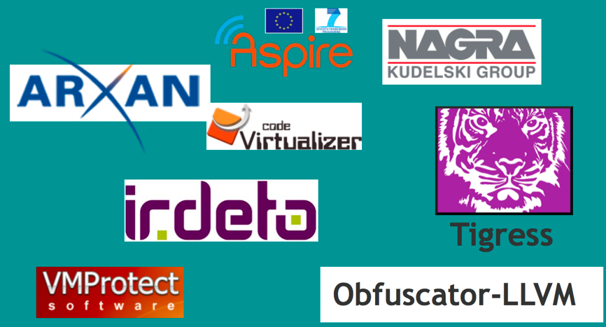
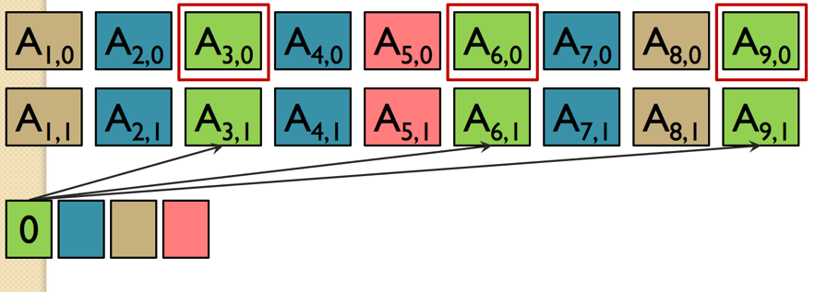
Hiding program behavior?
Obfuscation
Formal techniques: VBB (Barak et al., 2001), iO (Garg, Gentry, Halevi, Raykova, Sahai, Waters 2013)
Informal techniques: white-box cryptography (Saxena, Wyseur, Preneel 2009), data/layout/control obfuscation (Collberg, Thomborson, Low 1997)
Notes:
So we’re at a crypto conference when we think of hiding program behavior the first thing we think of is obfuscation. Obfuscation is obviously an area of interest in the crypto community with formal definitions such as virtual black box due to Barak, Goldreich , Impagliazzo, Rudich, Sahai, Vadhan, and Yang in CRYPTO 2001. This paper also defined indistinguishability obfuscation which achieves “best-possible” obfuscation but wasn’t thought to be very useful. This was then constructed in the work by Garg, Gentry, Halevi, Raykova, Sahai, and Waters based on the multilinear map construction of Garg, Gentry, Halevi. While the security of iO constructions is still an important topic we don’t consider it further in this talk. We merely point out that obfuscation is a well studied goal in cryptography with security achievable for large classes of programs under non-standard programs and for small classes of programs under more standard assumptions.
Furthermore, this is also studied extensively in the malware and digital rights management settings. There are many sub areas including white box cryptography and heuristic obfuscation which includes techniques such as data, layout, and control obfuscation. This techniques are designed to frustrate analysts, with obfuscators and analysts in an arms race with neither side having a clear victory. @inproceedings{saxena2009towards, title={Towards security notions for white-box cryptography}, author={Saxena, Amitabh and Wyseur, Brecht and Preneel, Bart}, booktitle={International Conference on Information Security}, pages={49--58}, year={2009}, organization={Springer} } @techreport{collberg1997taxonomy, title={A taxonomy of obfuscating transformations}, author={Collberg, Christian and Thomborson, Clark and Low, Douglas}, year={1997}, institution={Department of Computer Science, The University of Auckland, New Zealand} } Figure right from Halevi presentation on iO. Figure left from Collberg invited talk eurocrypt 2016

Slide 6
Hiding program behavior?
Obfuscation
Formal techniques: VBB (Barak et al., 2001), iO (Garg, Gentry, Halevi, Raykova, Sahai, Waters 2013)
Informal techniques: white-box cryptography (Saxena, Wyseur, Preneel 2009), data/layout/control obfuscation (Collberg, Thomborson, Low 1997)
Obfuscation isn’t enough in the malware setting:
Does not protect learnable programs
Cannot obfuscate system calls which are needed for many payloads (file system, network, keyboard, GPU, screen, USB)
Establish Botnets
Espionage
Sabotage
Ransomware
Notes:
However, obfuscation often isn’t enough enough for malware. First, obfuscation is not designed to protect learnable programs: those where the program is extractible based on a polynomial number of input/output pairs. Furthermore, malware is not about executing a program in isolation. The goal is to have some effect. For malware to be useful it always either has some effect on the system or communicates information about the system to other parties. These effects can include file system, network, keyboard, GPU, screen, or writing to USB devices. Mapping our four types of malware to these system calls we see that every type of malware uses multiple types of system calls to achieve its desired effect. Because of this an analyst does not need to understand the internals of a piece of malware they can focus their analysis on the system calls being made.

Slide 7
Hiding program behavior?
Obfuscation
Formal techniques: VBB (Barak et al., 2001), iO (Garg, Gentry, Halevi, Raykova, Sahai, Waters 2013)
Informal techniques: white-box cryptography (Saxena, Wyseur, Preneel 2009), data/layout/control obfuscation (Collberg, Thomborson, Low 1997)
Environmental Authentication
Change behavior based on the execution environment
Complementary technique to obfuscation
Notes:
Because of this malware uses a second technique to stop analysis. We call this environmental authentication. It has been known by a variety of names over the years including environmental key generation, secure triggers, host-based fingerprinting, environment targeted malware and environmental keying. The goal of all of these techniques is the same. To deliver the payload on a target and undisturbed computer and to hide its behavior in other settings especially when under observation.
We stress that this technique is complementary to obfuscation (either formal or informal). We have taken care to ensure that our results hold in the presence of any obfuscation techniques. Thus, we tend to assume that an analyst only has access to an input/output behavior of a system.

Slide 8
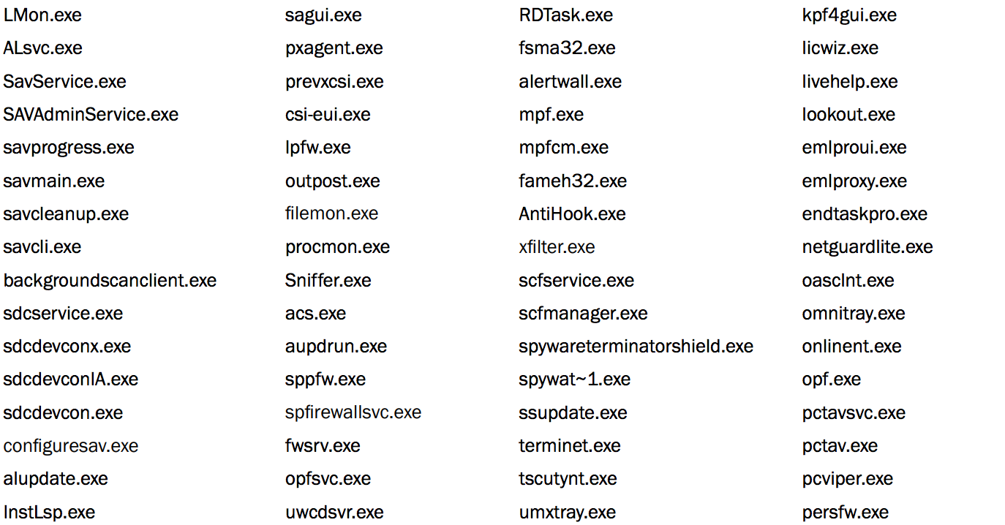
Seems to target Lebanese banking network,
Main deployment in Lebanon, Israel, and Palestinian territory
Protection mechanisms:
Obfuscation
Exits if known anti virus program running on computer
Cosmos: steal hardware info
Godel: infects malware to USB drive
Tailor: steal network info
Lagrange: installs custom fonts
Gauss: browser plugins that steal cookies
Shell: loader and network comm
Notes:
To understand how this technique works we’ll dig into a single goal of espionage and focus on the Gauss family of malware (first described by Kasperky lab). Gauss is related to Flame (which was jointly discovered by AHER Center of Iranian National CERT, Kaspersky Lab and CrySyS Lab). This malware appears to target Lebanese banking networks and has primarily been observed in the middle east. Gauss is made of several modules. Different subsets of these modules are found on different infections. These modules are named after famous mathematicians. The cosmos module learns about the computer bios, Godel transfers malware to the USB drive, Tailor looks at the network interfaces, Lagrange installs custom fonts, Gauss steals browser info, and lastly there is a shell module that orchestrates the rest of this behavior.
This is a very sophisticated family of malware that uses many protection techniques.
First it obfuscates much of its behavior. Code is often encrypted using a simple but randomized encryption to prevent simple matching. All created files are encrypted as are strings used by the system. However, these techniques are not the focus of the talk. In addition it employs several techniques to hide from a malware analyst. First, it checks running programs and terminates if any anti-virus program is found. This is a simple enumeration of the running processes.

Slide 9
Seems to target Lebanese banking network,
Main deployment in Lebanon, Israel, and Palestinian territory
Protection mechanisms:
Obfuscation
Exits if known anti virus program running on computer
Checks if google.com is available (terminates if it has not been reachable 56 consecutive times)
USB portion terminates after being run 30 times
Special payload versions that are encrypted with key derived from registry key (key and payload unknown)
Cosmos: steal hardware info
Godel: infects malware to USB drive
Tailor: steal network info
Lagrange: installs custom fonts
Gauss: browser plugins that steal cookies
Shell: loader and network comm
Notes:
Next it checks if there is an active network connection by trying to connect to google and windows update servers. Malware analysis is often done in sandboxed and disconnected environments. Importantly this connection is through https which makes it more difficult to fake. Next it creates lifetime by only allowing its USB malware to run 30 times. Each time the USB drive is loaded this counter is decremented.
Now its important to note that items 2-4 can be effectively faked by a malware analyst. However, in the fifth item there are special encrypted versions of the payload. These are encrypted with RC4 using a key derived from hashing the %PATH% environment variable and the location of PROGRAM_FILES. This hash is done 10,000 times. To the best of our knowledge these specialized payloads have never been decrypted and their purpose in unknown.

Slide 10
Seems to target Lebanese banking network,
Main deployment in Lebanon, Israel, and Palestinian territory
Protection mechanisms:
Obfuscation
Exits if known anti virus program running on computer
Program that changes behavior based on environment: environmentally authenticating
Checks if google.com is available (terminates if it has not been reachable 56 consecutive times)
USB portion terminates after being run 30 times
Special payload versions that are encrypted with key derived from registry key (key and payload unknown)
Notes:
Techniques 2-5 are designed to only execute on a target computer and not when being analyzed. These are only the techniques that Gauss is known to use, there are many other techniques including detecting variations in time, registry keys, virtual machine presence. We call this collection of techniques environmentally authenticating. This authentication decision can be explicit where the branch is taken based on a decision on implicit where a key is only derived under the right conditions. In the presence of obfuscation this distinction becomes irrelevant. As we’ll see the only thing that matters is how frequently different strings authenticate.
We are now ready to define a security game. The goal of this work is to understand the security of this technique. Thus, we’ll reverse roles, we’ll consider malware as the system designer and the analyst as the adversary. However, an impossibility result might be the right thing to hope for in this setting.

Slide 11
Malware (good guy)
Analyst (adversary)
Select target computer E
Creates decision procedure D and sensor S
E
1/0
D
S
Notes:
We now are going to formalize the interaction between a piece of malware and an analyst. The malware analysts first goal is to ensure their program actually works. Towards this end they have a target computer system E. We’ll model the environment of this system as a single one dimension array. We can effectively model many of the different parts of the environment this way such as disk, registry, and other memory. Indeed, most system calls are reads and writes to some system call which can be thought of as part of the environment. The main disadvantage of this abstraction is that it doesn’t model time well.
So we have a piece of malware that has targeted a computer system E. Based on this computer system it will create a decision procedure outputs a bit 1/0 representing whether the system has authenticated. This procedure will take inputs from E defined by a sensor S. (In the paper we consider multiple sensors and procedures but we’ll limit discussion to 1 in this talk)

Slide 12
Malware (good guy)
Analyst (adversary)
Select target computer E
Creates decision procedure D and sensor S
Load Malware onto target
Correctness: D should output 1 on E’_{S}
E
E’
1/0
D
S
Notes:
The first goal of the malware is to be correct. In this game, the malware is loaded onto the target which modifies the environment to E’. Correctness says that D should output 1 on high probability even on this change environment.
Now this goal on its own isn’t very meaningful. We could consider a fixed D that always outputs 1.

Slide 13
Malware (good guy)
Analyst (adversary)
Multiple adversary postures:
1) Blind
Select target computer E
Creates decision procedure D and sensor S
Load Malware onto target
Correctness: D should output 1 on E’_{S}
E’
1/0
D
S
Notes:
We’ll consider multiple different security definitions starting with the most favorable to the malware. We’ll consider a blind analyst that finds the malware in the wild and does not know the intended target. Because of this we can’t assume that the analyst has the environment E’ available.

Slide 14
Malware (good guy)
Analyst (adversary)
Multiple adversary postures:
1) Blind
Find accepting input to D (oracle access) given S
Select target computer E
Creates decision procedure D and sensor S
Load Malware onto target
Correctness: D should output 1 on E’_{S}
E’
1/0
D
S
Notes:
Now the analyst’s goal is find an input to D that outputs 1 given just the location of the sensor. The value S is usually recoverable from a piece of malware because it is based on system calls. However, we only give the analyst input/output access to D (so our results hold in the presence of obfuscation).

Slide 15
Malware (good guy)
Analyst (adversary)
Multiple adversary postures:
1) Blind
Find accepting input to D (oracle access) given S
Thm: Secure iff E_{S} has super-log entropy
Intuition: Random guessing of inputs works as expected if analyst can sample environments
Gauss custom payloads have not been decrypted
E’
1/0
D
S
Notes:
Our first results are in this setting and are not really surprising. The malware will be secure in this setting iff E_S has sufficient entropy. This is a little imprecise, we really mean that the decision procedure accepts with negligible probability over the distribution E_S.
The standard techniques of guessing random inputs works if this condition does not hold and we can show that even given multiple guesses the analyst will not will if not be able to find an accepting input.
This corresponds to the Gauss setting where the path variable has sufficient entropy where it has not been recovered.

Slide 16
Malware (good guy)
Analyst (adversary)
Multiple adversary postures:
1) Basic: malware found running on target
No apriori visibility of malware behavior
Analyst loads
E’
1/0
D
S
Notes:
We then consider a second scenario which corresponds to incident response. In this setting, an employee observes their computer is acting strangely and calls the IT department or an analyst. In this setting we assume the infected computer is a piece of critical infrastructure offline or snapshotted. The game is more complicated in this setting. Here we assume that the analyst has no apriori visibility of the malware or its behavior. However, it can load itself on the same computer system E’.

Slide 17
Malware (good guy)
Analyst (adversary)
Multiple adversary postures:
1) Basic: malware found running on target
No apriori visibility of malware behavior
Analyst loads
Given S, oracle access to D
Output guess for E’_{S}
E*
1/0
D
S
Notes:
The analyst loading changes the computer system (because the analyst has to overwrite some parts of the environment). Once the analyst has been loaded it is told the sensor positions and has oracle access to the decision algorithm. Its goal is output a value of E’_S that causes the decision algorithm to output 1. This is the most interesting scenario so we’ll dig into it a bit more.

Slide 18
Basic game
E*
Assume: the size of the malware is small relative to the system
S
Notes:
First we’re going to assume that the size of the malware is small relative to the rest of the system. Malware has incentive to stay small.

Slide 19
Basic game
E*
Assume: the size of the malware is small relative to the system
Thm: analyst always wins if system is redundant can effectively reproduce E’_{S}
S
Notes:
The first obvious observation is that if the computing environment is highly redundant, that is the analyst can reconstitute the part of the environment they overwrite then it is impossible to provide security. Many computer systems are redundant so this is a negative result.

Slide 20
Basic game
E*
Assume: the size of the malware is small relative to the system
Consider case where E is not redundant (all subsets have entropy conditioned on rest)
S
Notes:
We’re going to continue analyzing this situation is the setting where the environment is not redundant. This is still meaningful as there could be components of the environment that the analyst has to overwrite that are not redundant.

Slide 21
Basic game
E*
Assume: the size of the malware is small relative to the system
Consider case where E is not redundant (all subsets have entropy conditioned on rest)
Interaction is two-player simultaneous game:
Malware wins if analyst load location=S
Analyst wins otherwise
S
Notes:
We can think of the interaction between the malware and the analyst as a simultaneous two player game. The malware wins if the analyst loads in the sensor positions and the analyst wins otherwise.

Slide 22
Basic game
E*
Assume: the size of the malware is small relative to the system
Consider case where E is not redundant (all subsets have entropy conditioned on rest)
Interaction is two-player simultaneous game:
Malware wins if analyst load location=S
Analyst wins otherwise
S
S
I
Analyst
Notes:
We can go through several examples and count when each player wins. In this setting, both players announce and S wins.

Slide 23
Basic game
E*
Assume: the size of the malware is small relative to the system
Consider case where E is not redundant (all subsets have entropy conditioned on rest)
Interaction is two-player simultaneous game:
Malware wins if analyst load location=S
Analyst wins otherwise
S
S I
Analyst
I
Notes:
Here the analyst wins.

Slide 24
Basic game
E*
Assume: the size of the malware is small relative to the system
Consider case where E is not redundant (all subsets have entropy conditioned on rest)
Interaction is two-player simultaneous game:
Malware wins if analyst load location=S
Analyst wins otherwise
S
S I
Analyst
II
Notes:
Finally in this setting the analyst wins.

Slide 25
Basic game
E*
Assume: the size of the malware is small relative to the system
Consider case where E is not redundant (all subsets have entropy conditioned on rest)
Interaction is two-player simultaneous game:
Malware wins if analyst load location=S
Analyst wins otherwise
Equilibrium is for both players to play randomly
S
Notes:
Its not hard to see that subject to constraints on the size of S and the analyst the right strategy is for both players to play randomly.

Slide 26
Basic game
E*
Assume: the size of the malware is small relative to the system
Consider case where E is not redundant (all subsets have entropy conditioned on rest)
Thm: If | |*|S| < |E | then analyst can win with good probability
If analyst plays randomly, collide with S in few positions, query oracle on all possible values of missing locations
S
Notes:
In fact we can show that no matter the strategy of the malware if the product of the size of the analyst and the size of the sensor is less than the size of the total environment then the analyst wins with good probability. This relies on upper bounding the number of collisions between the analyst and the sensor using concentration bounds. If the analyst only overwrites a few positions they can exhaustive guess the positions they erased.

Slide 27
Basic game
E*
Assume: the size of the malware is small relative to the system
Consider case where E is not redundant (all subsets have entropy conditioned on rest)
Thm: If | |*|S| < |E | then analyst can win with good probability
Thm: If | |*|S| = 𝛚(|E|log |E|) then malware is secure (when all subsets of E have high entropy)
S
Notes:
We show that this bound is nearly tight with a log factor difference. When the number of collisions between the analyst and the sensor get too big they the analyst has to guess too many locations and the malware is secure.

Slide 28
Resettable game
E’
Analyst can first create a snapshot of E’ before loading:
Can load once
Learn S
Load second time in location that doesn’t intersect with S
Malware can’t be secure
S
Notes:
Lastly we consider a second version of the incident response game where the analyst is able to make a copy of the environment before loading. We show that the analyst is always able to win in this game by following this simple strategy (on slide).

Slide 29
Conclusion and Open Problems
Formalized common malware goal of authenticating the environment:
Blind game: malware found in the wild
Basic game: malware found on target but target cannot be interrupted
Resettable game: target machine can be snapshotted and reconstituted
Open problems:
Modeling time in sensor procedures
Modeling malware that receives state from an online command and control
Questions? Benjamin.fuller@uconn.edu
Notes:
To wrap up we formalized the common malware technique of authenticating its environment. We considered the security of this technique in three different settings. First, Blind: secure iff sensing from entropic positions
Basic: secure iff analyst is likely to overwrite large portion of sensed positions (and subsets have entropy)
Resettable: never secure To conclude there’s a couple of open problems. First, its not possible for malware to read a large part of the environment in a single instruction. It may be possible for the malware analyst to execute the malware and pivot between instructions. We were unable to come up with a satisfying model for this situation but this may provide more negative results. Second, by assuming that the environment is a single array we assume that the environment does not react to the malware. Modern malware receives instructions from command/control servers, these instructions may serve to bootstrap authentication.
With that I’ll stop, please send Ben your questions.

